Slide 1
Performed activities
The Virtual Community Tool

Slide 2
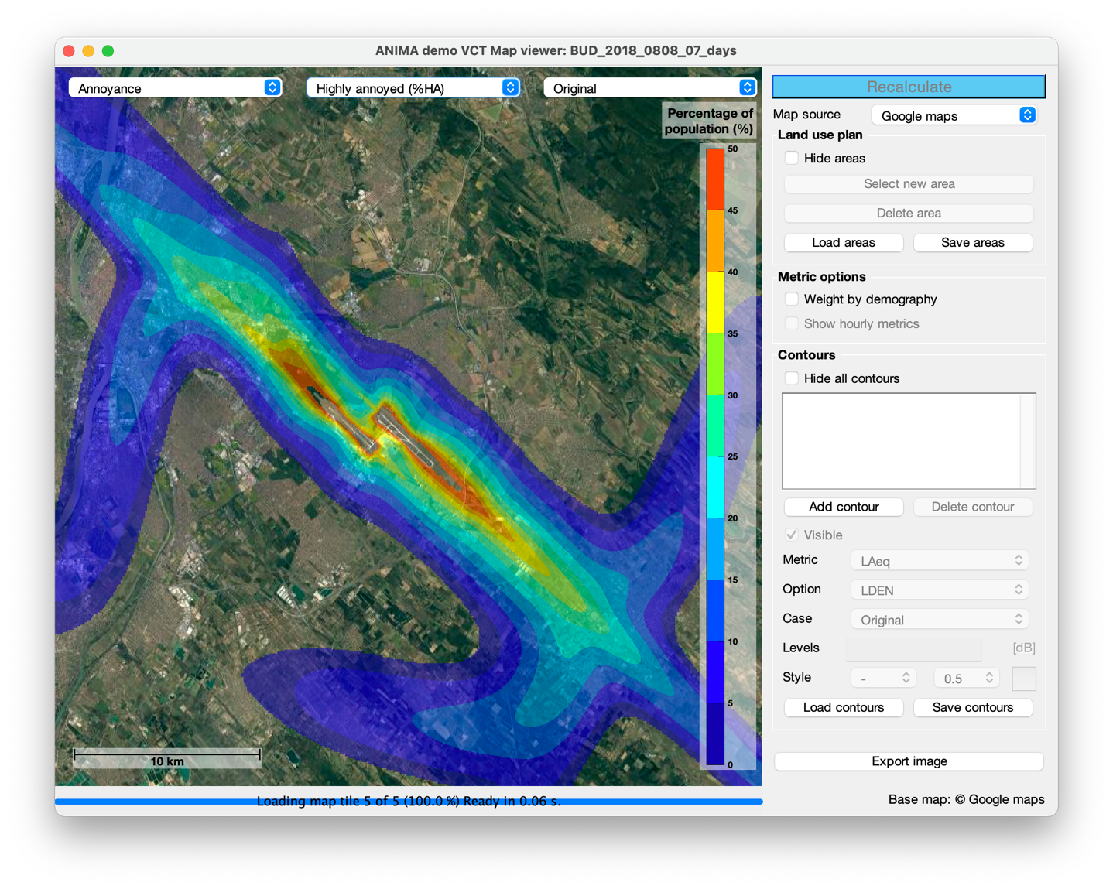
New metrics: % of Highly Annoyed people (%HA)

Slide 3
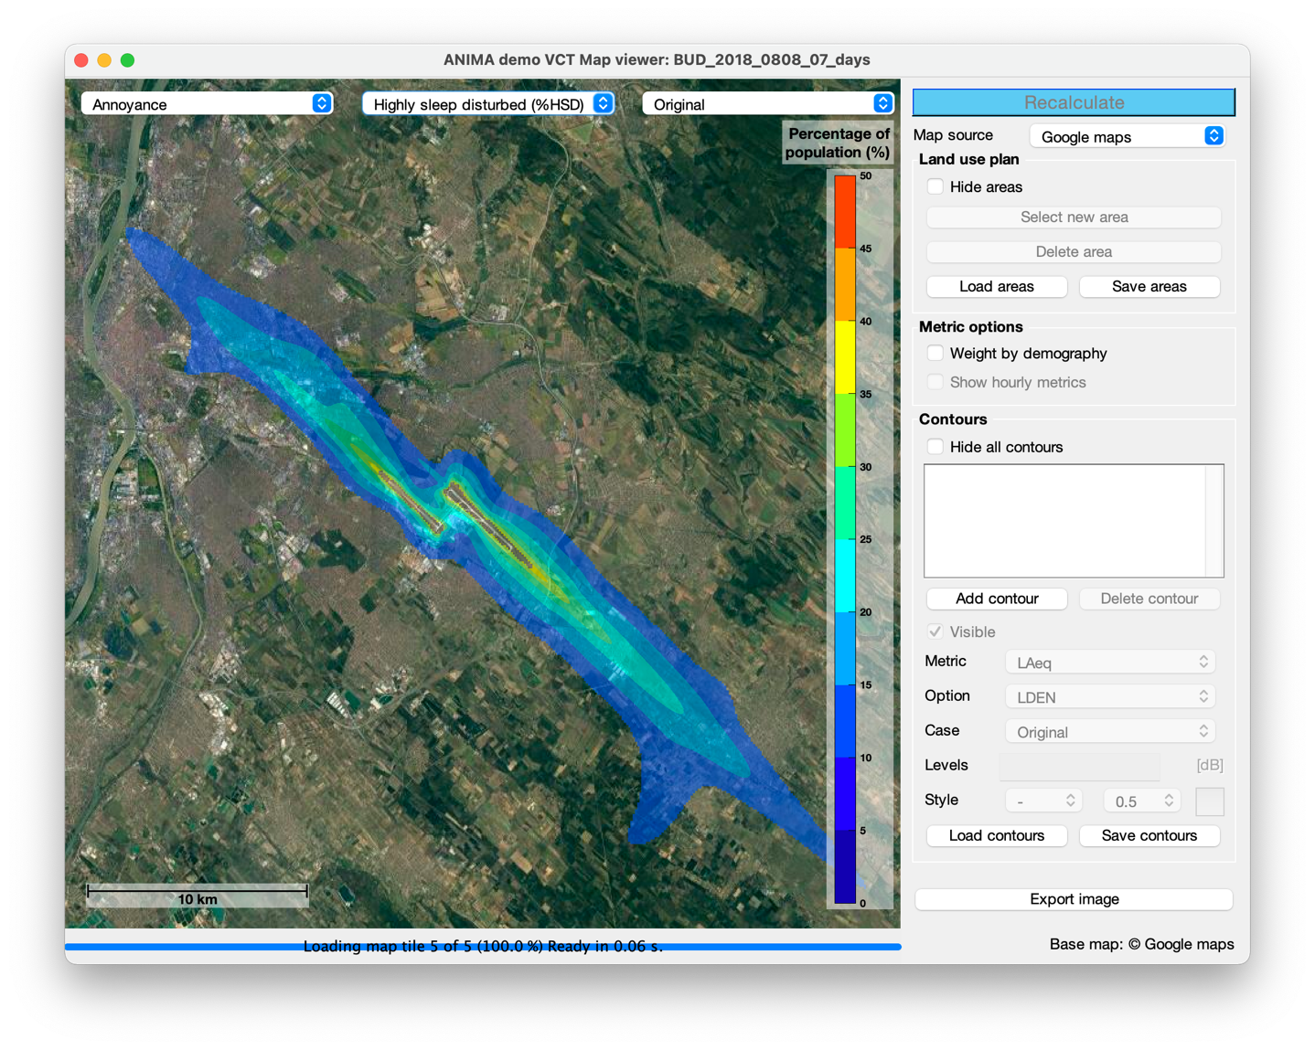
New metrics: % of Highly Sleep Disturbed people (%HSD)

Slide 4
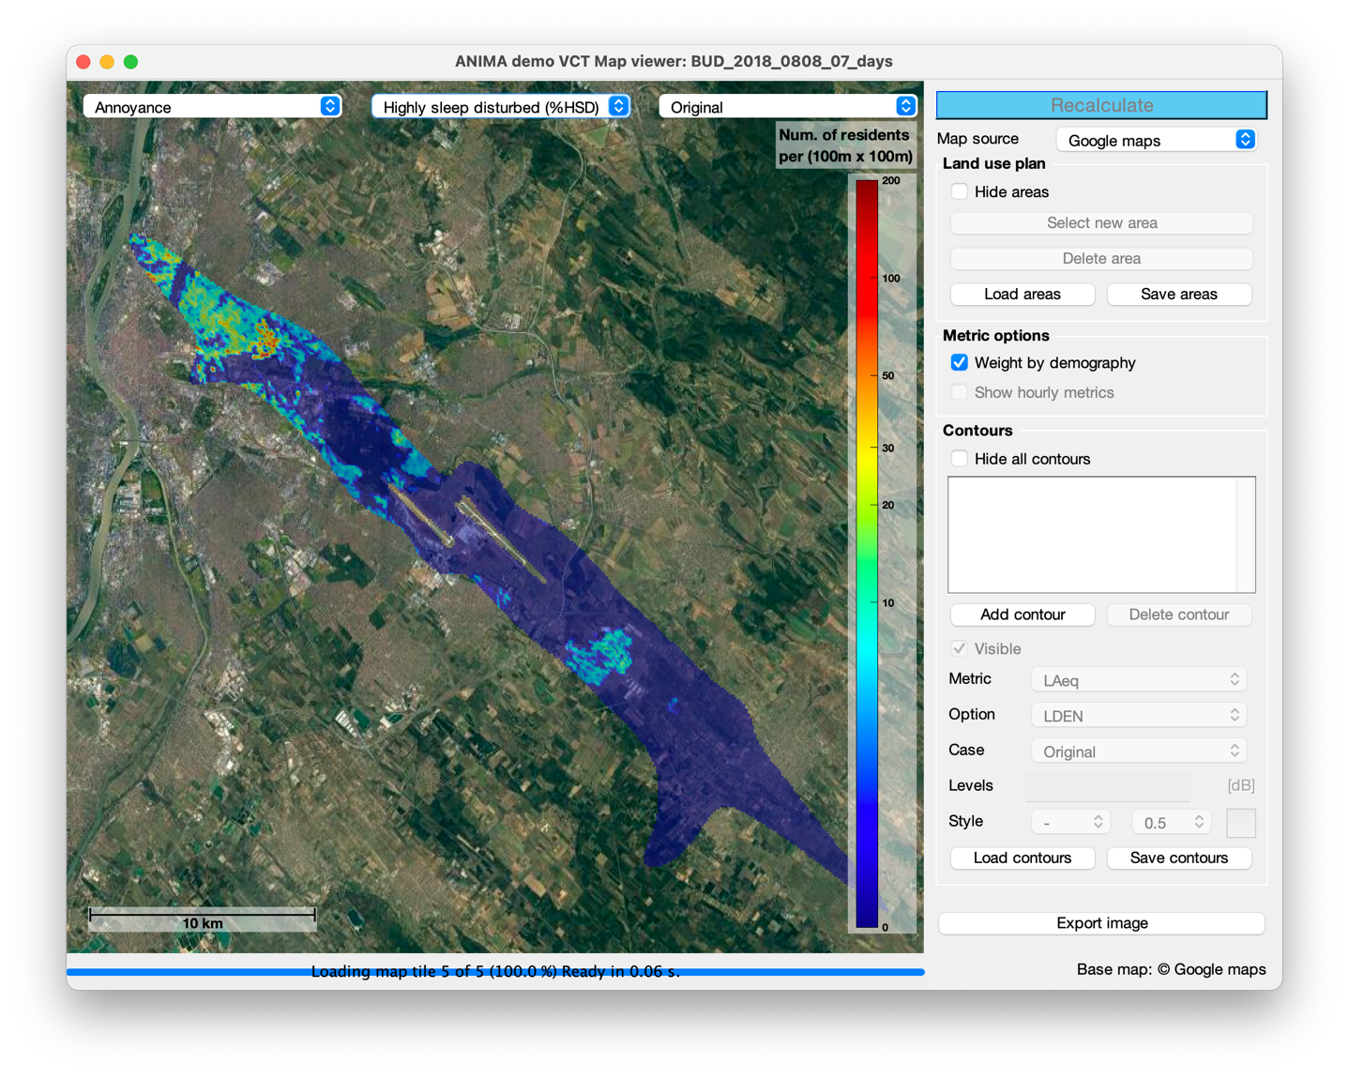
New metrics: weighted by demography (%HSD)

Slide 5
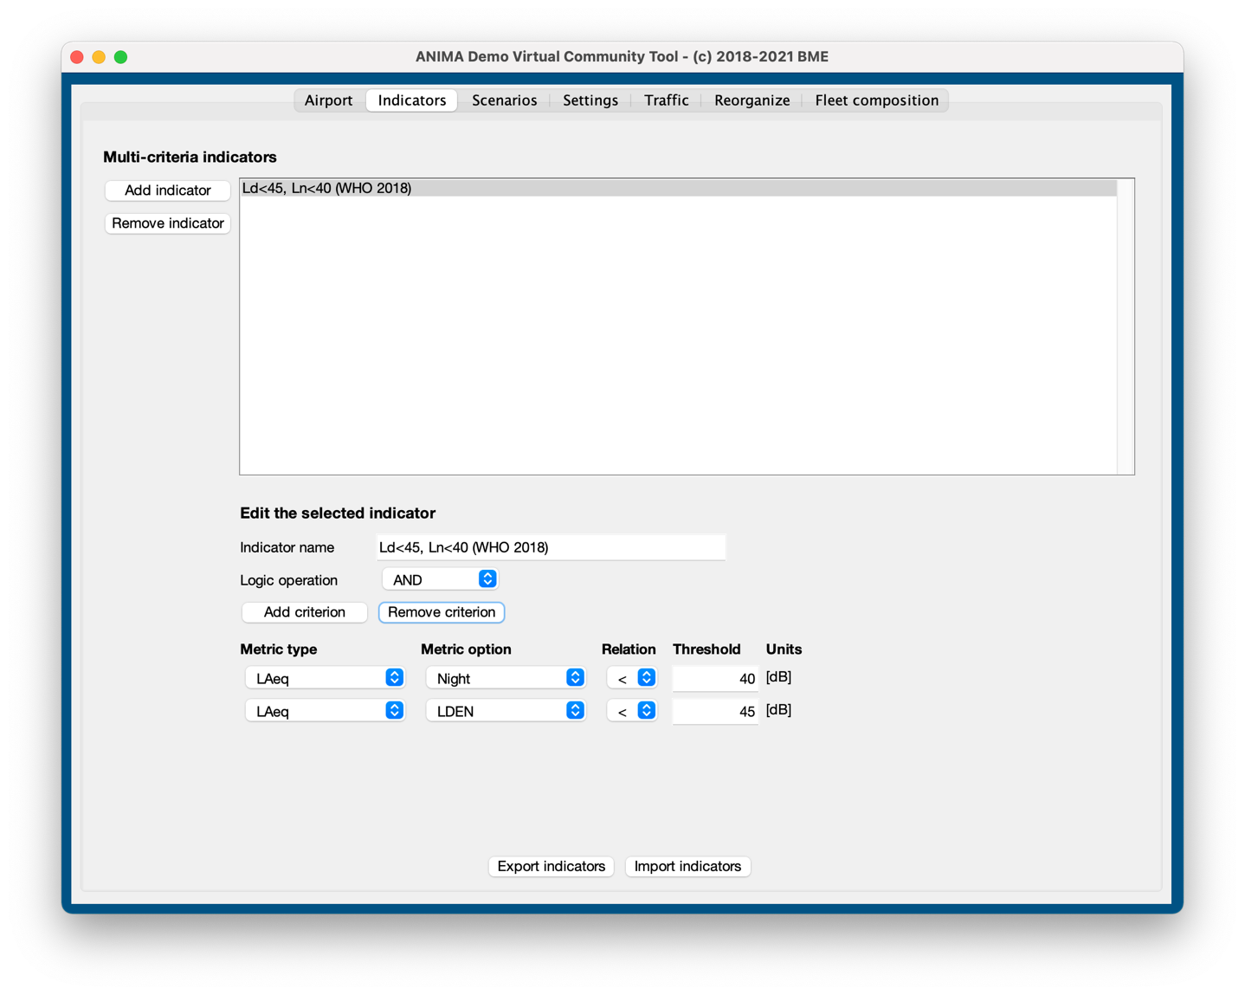
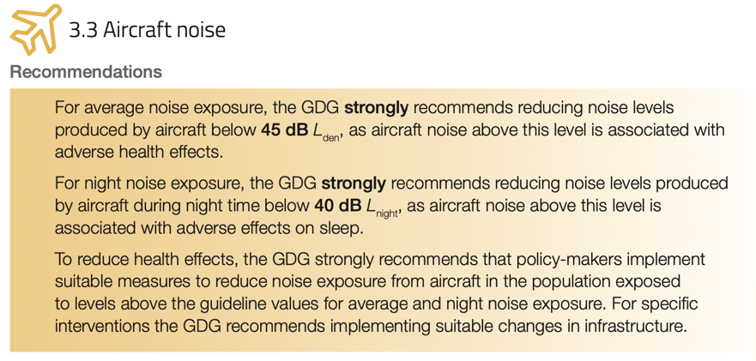
Multi-criteria indicators
Excerpt from Environmental Noise Guidelines for European Region, WHO 2018

Slide 6
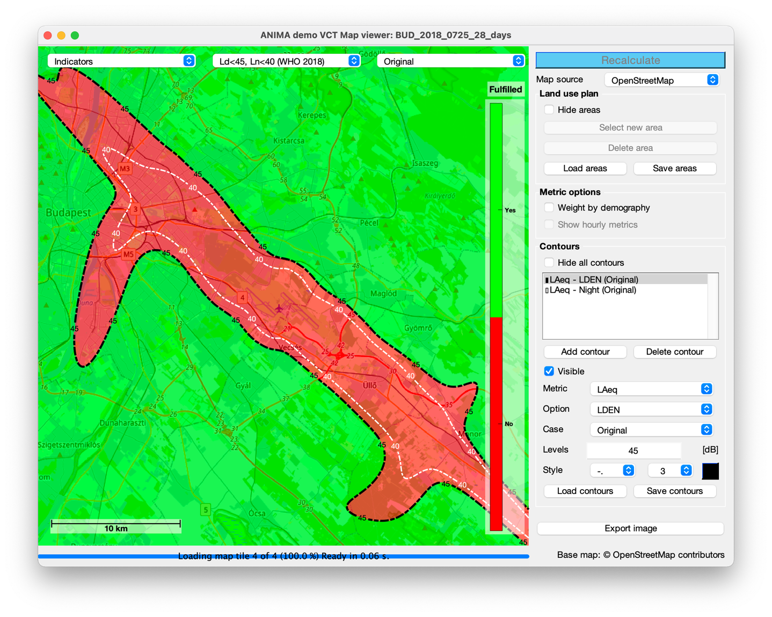
Multi-criteria indicators

Slide 7
Multi-criteria indicators: scenario change

Slide 8
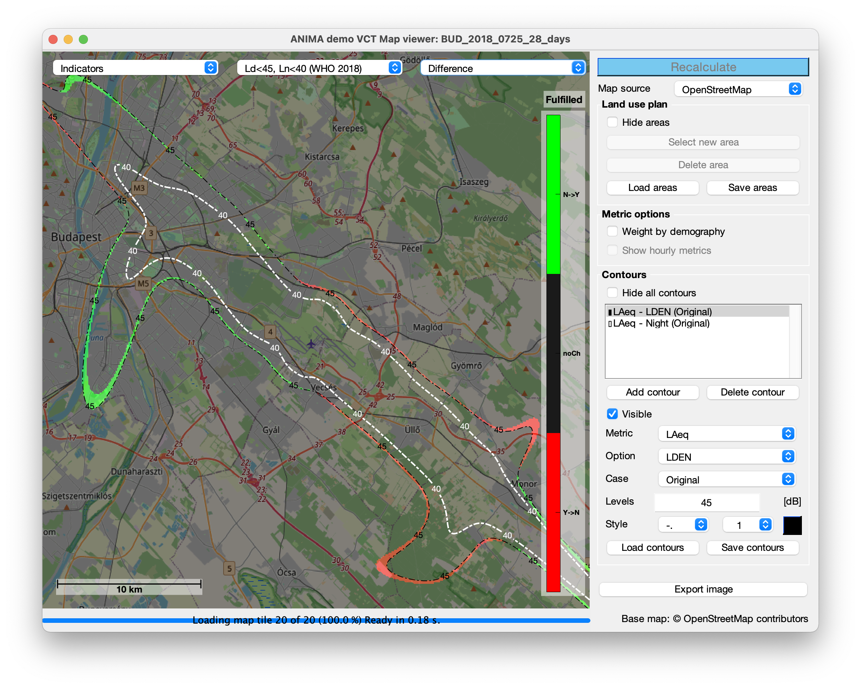
Multi-criteria indicators: scenario changed

Slide 9
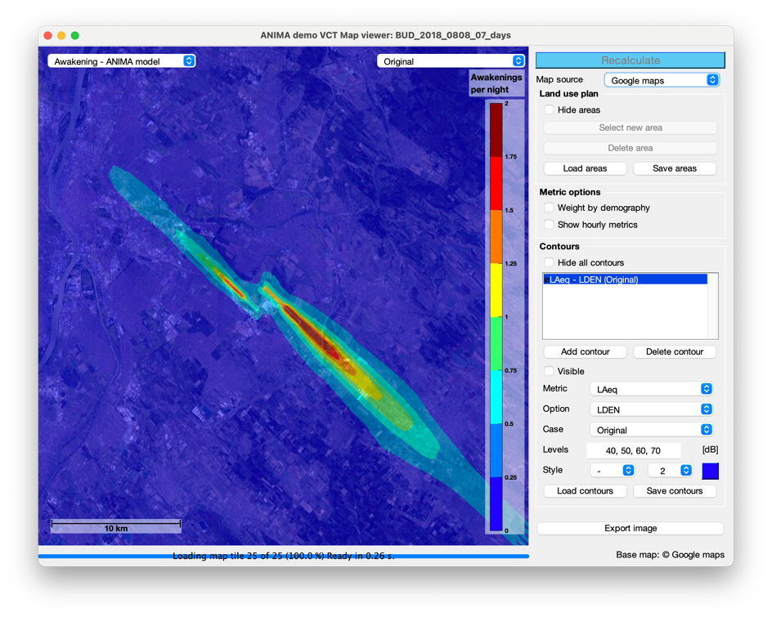
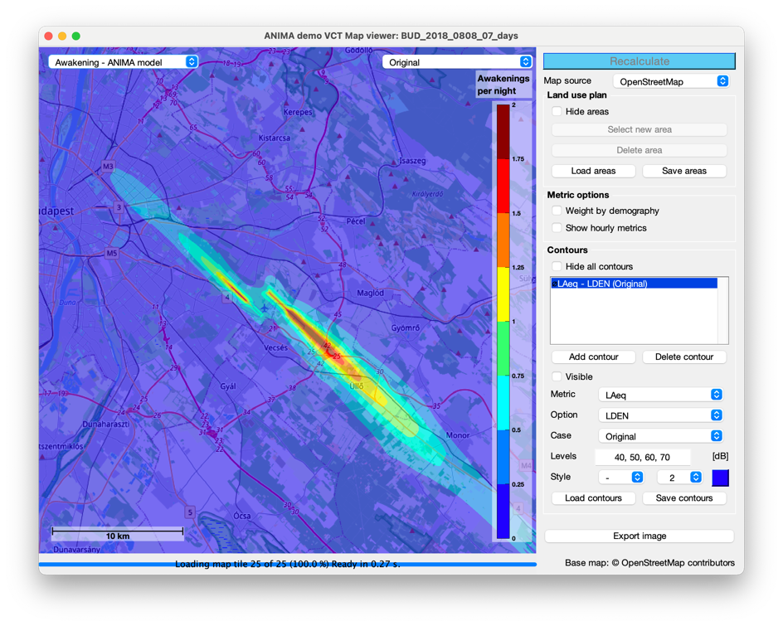
Selectable base layer: publications!
Google maps
Open Street Maps

Slide 10
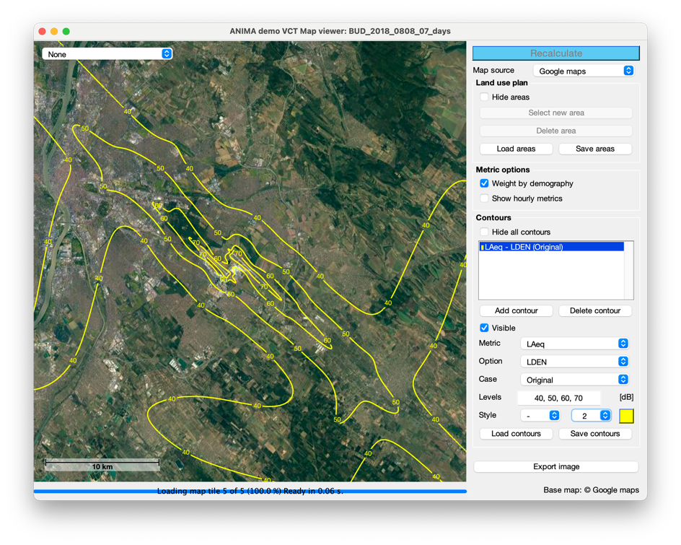
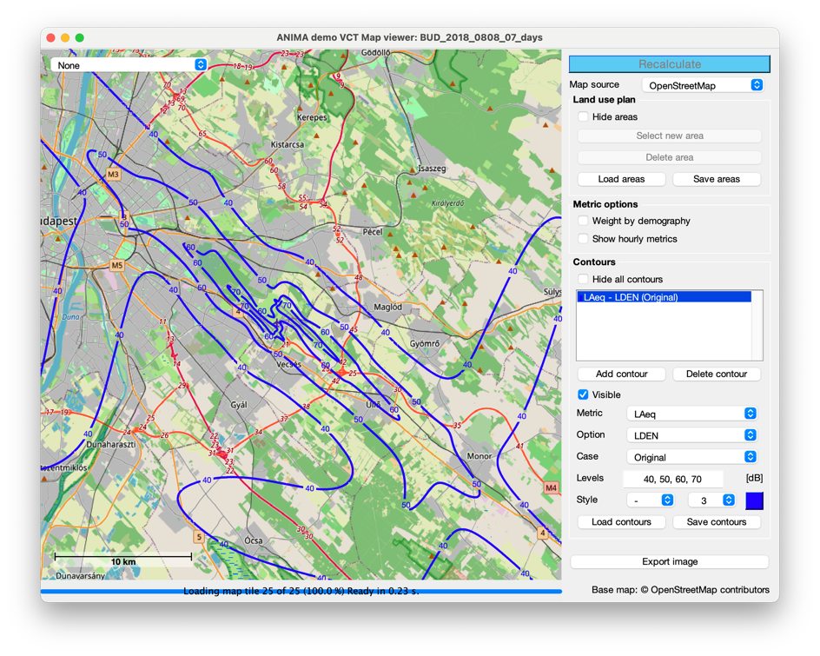
Selectable base layer: publications!
Google maps
Open Street Maps

Slide 11
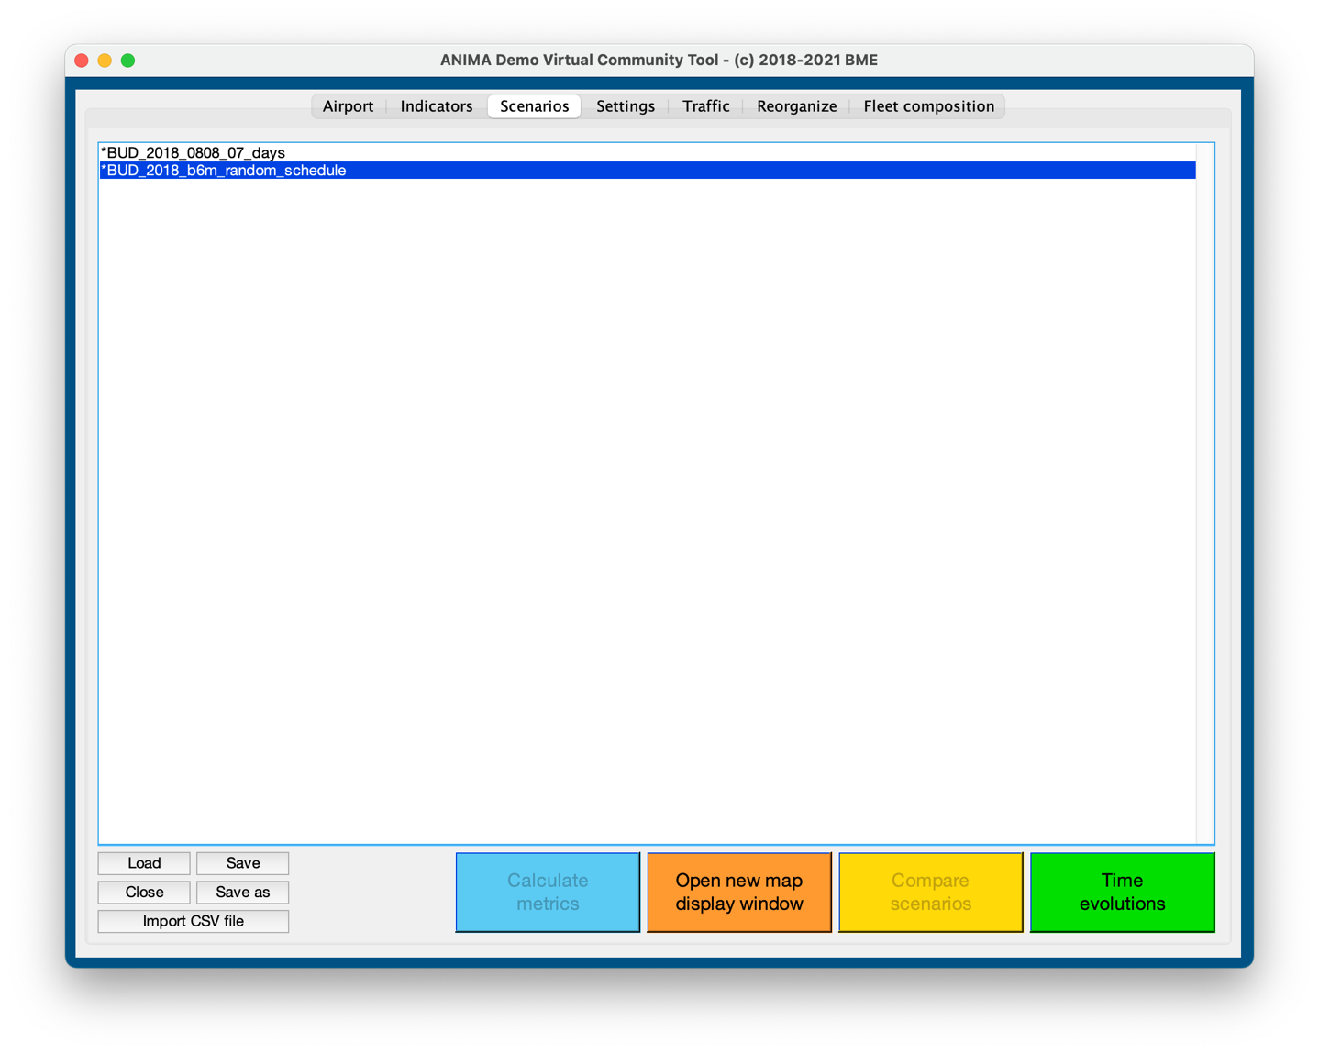
New feature: time evolution

Slide 12
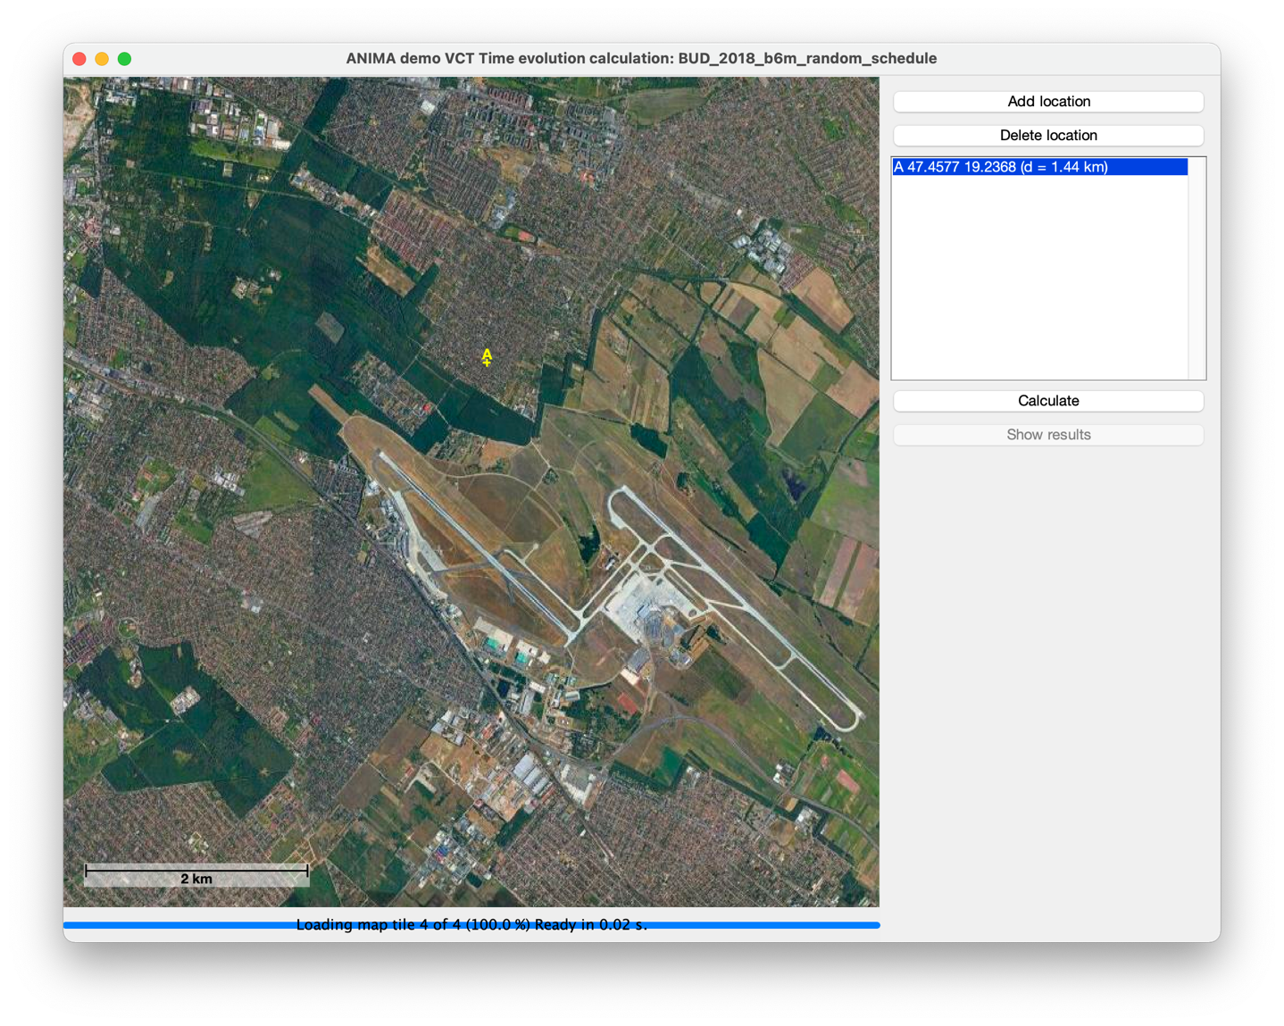
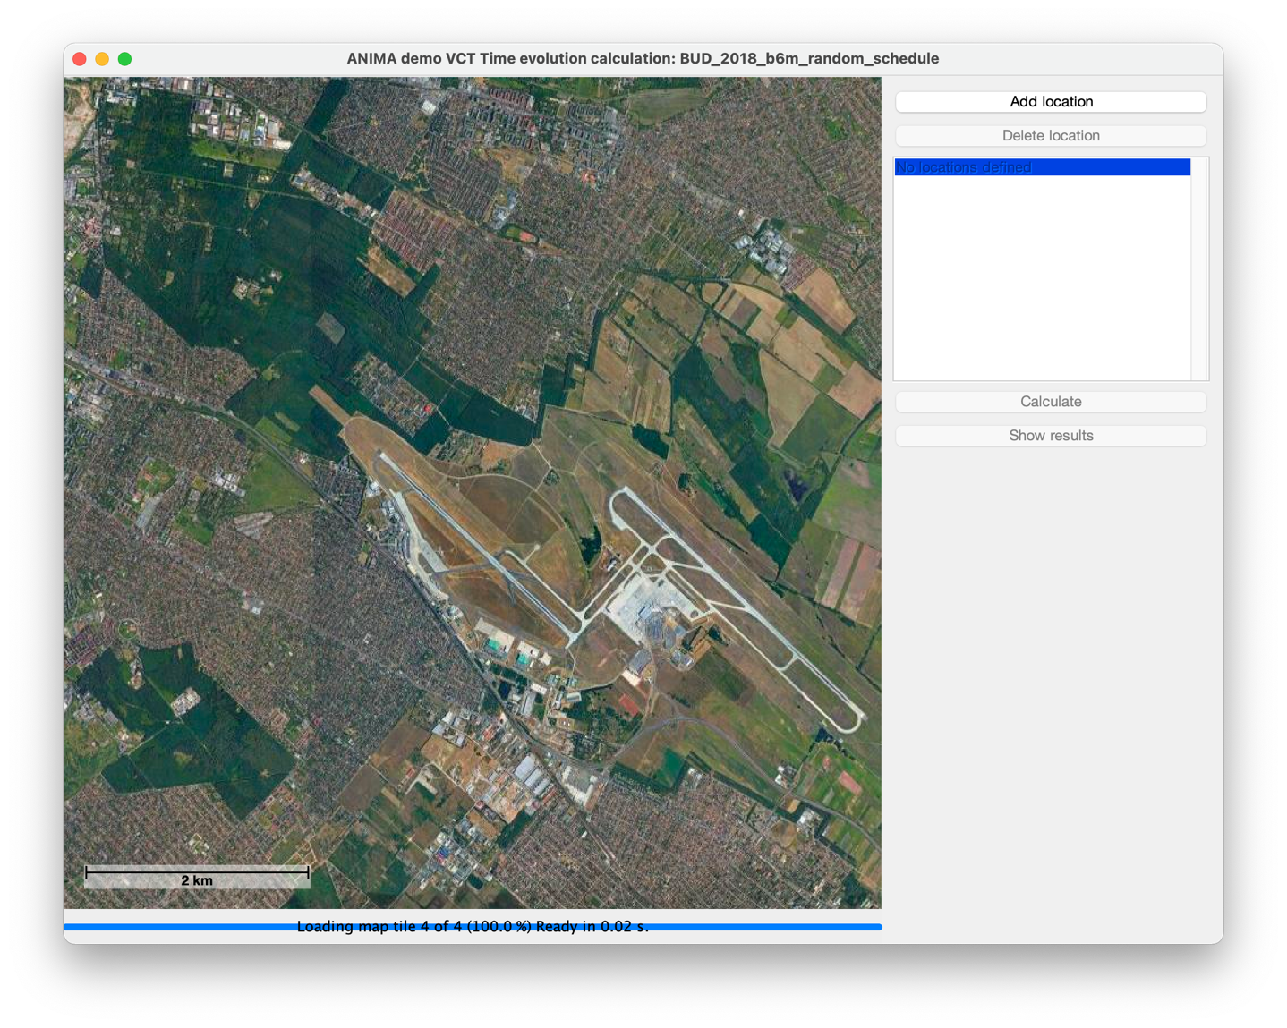
New feature: time evolution

Slide 13
New feature: time evolution

Slide 14
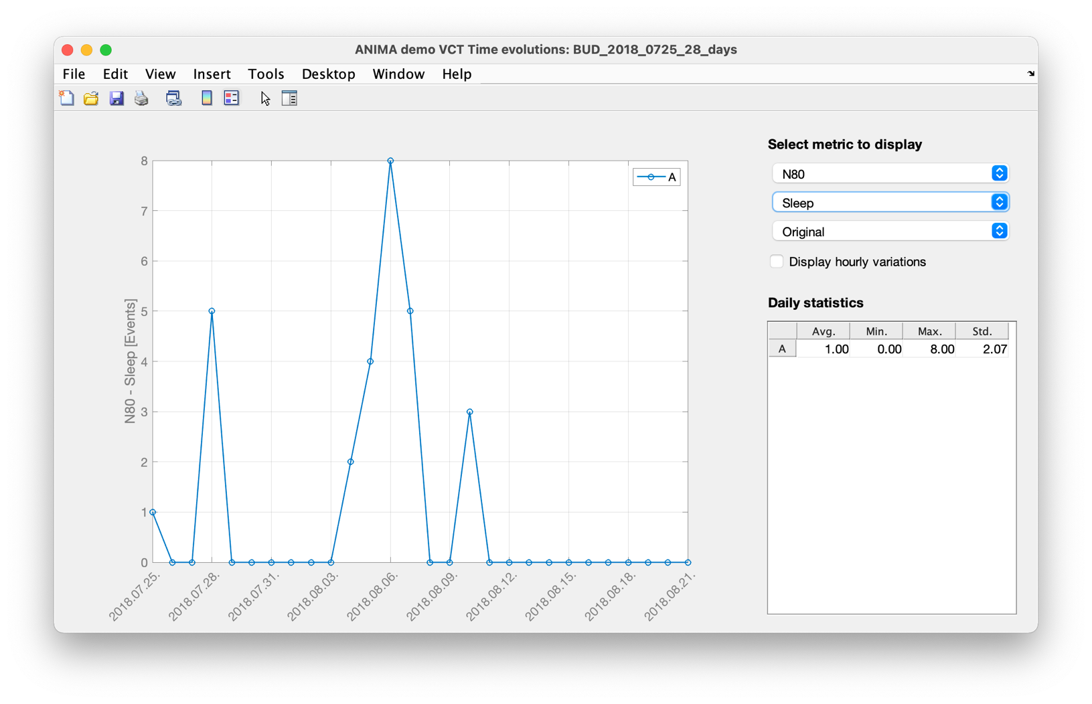
New feature: time evolution

Slide 15
Finally: tool is on server, ready to download
The Virtual Community Tool
https://last.hit.bme.hu/demoVCT
Random schedule has been generated
(Trial) licence can be requested
Licenses can be anytime recalled
Extensive getting_started document available
User is warned and is only allowed to try-out

Slide 16
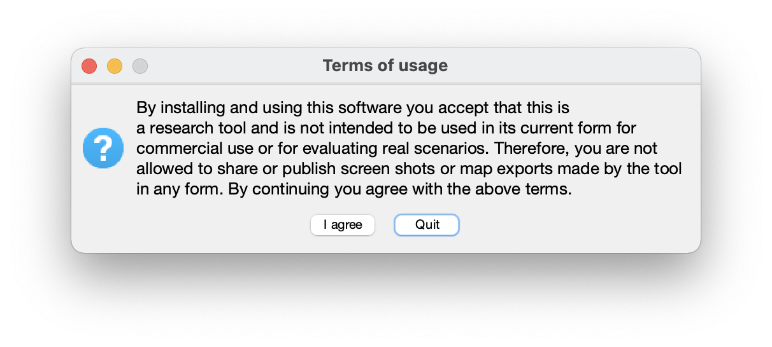
Finally: tool is on server, ready to download
The Virtual Community Tool
https://last.hit.bme.hu/demoVCT
Random schedule has been generated
(Trial) licence can be requested
Licenses can be anytime recalled
Extensive getting_started document available
User is warned and is only allowed to try-out

Slide 17
Next steps
Please contact me/send me contacts to ask for testing the tool
Other airports to be added? (ANOTEC?)
Further planned improvements
Multi-criteria limits across scenarios (e.g. Spain regulations: annual Lday < 55 dB + worst day’s Lday<58 dB)
Update user manual: new functions + replace screenshots
Dissemination:
home page, promo-video, publication

