Slide 1
Acoustic Drone Detection
Subtitle and brief description of the presentation
P. Fiala, G. Firtha, P. Rucz, A.B. Nagy
Department of Networked Systems and Services
mailaddress@hit.bme.hu

Slide 2
Project Background
GINOP-2.2.1-2017-00087
Development of a Complex Sensor System to Detect and Classify Unmanned Aerial Vehicles
Participants
Military National Security Service (KNBSZ)
BME VIK: HVT, LAST
BME GPK: MOGI (Mechatronics Dept.)
Humansoft / 4iG
Notes:
<number>

Slide 3
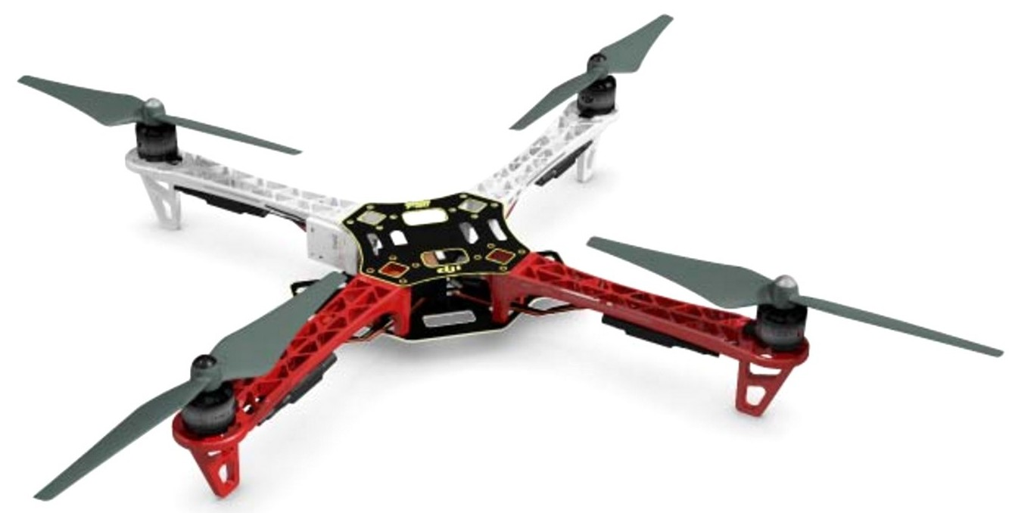
Detection principles
Radio Source Localization – MNSS
RADAR, MicroDoppler – HVT
Optical Detection – MOGI
Multispectral Detection (heat) – MOGI
Acoustic Detection – LAST
Sensor fusion – 4iG

Slide 4
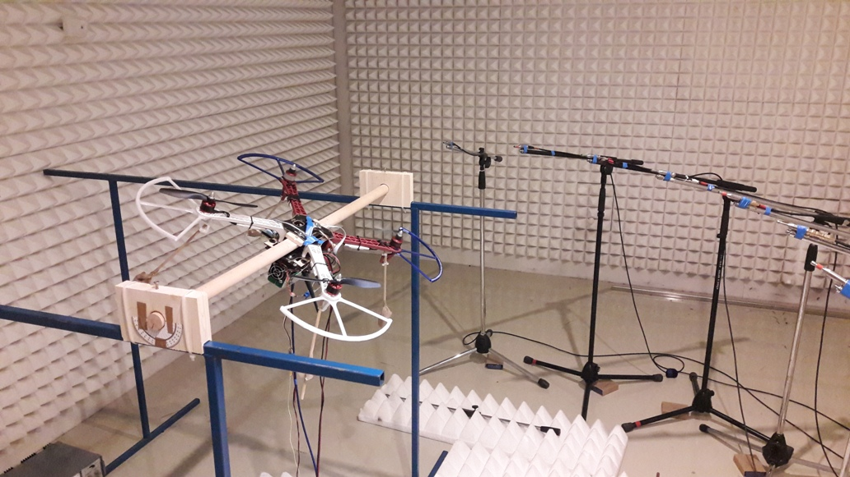
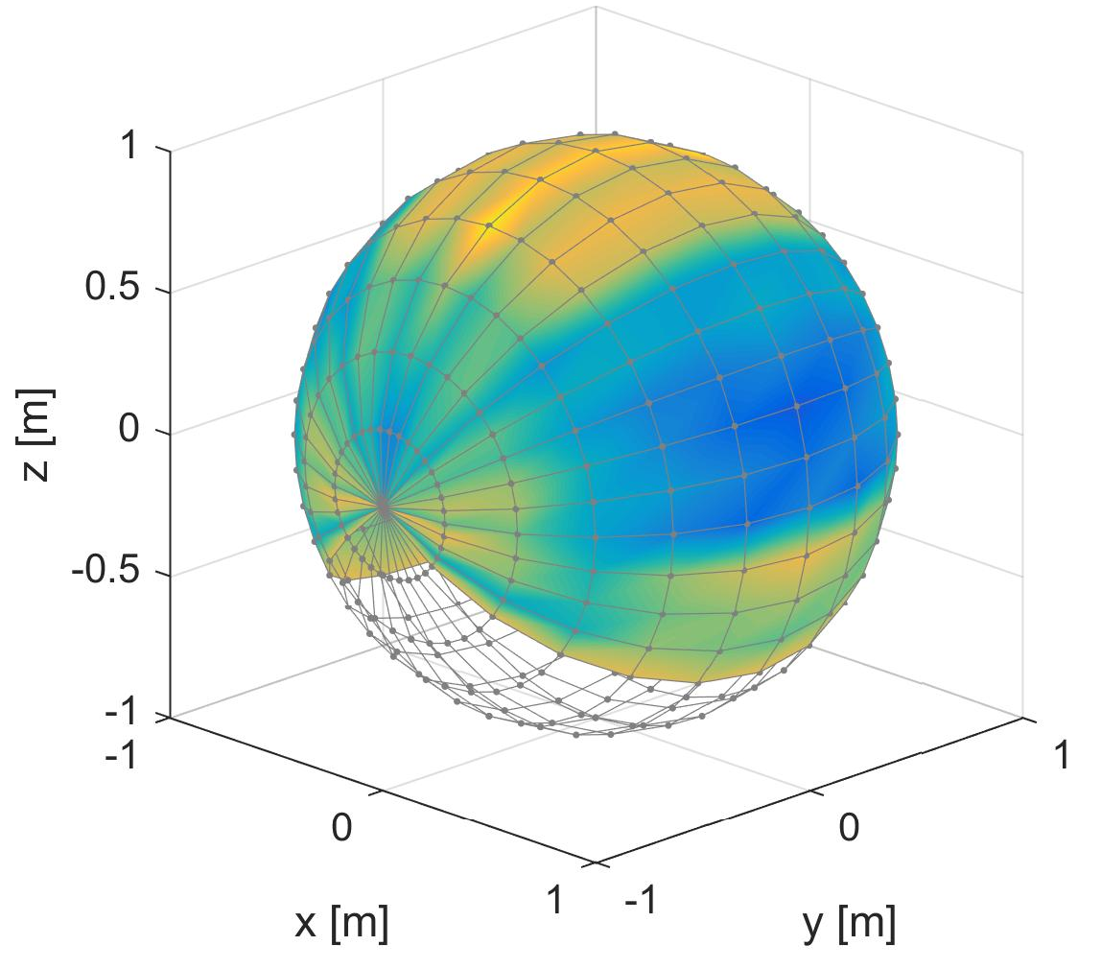
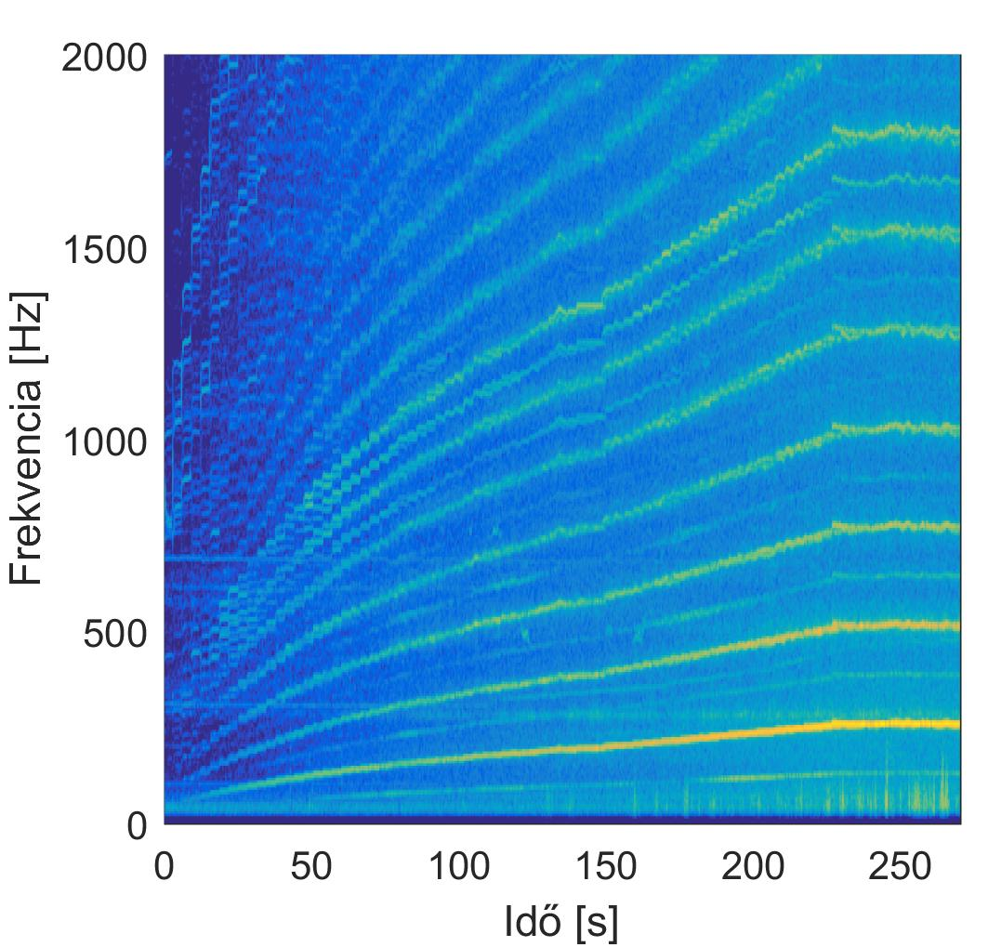
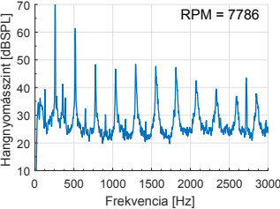
Laboratory measurements

Slide 5
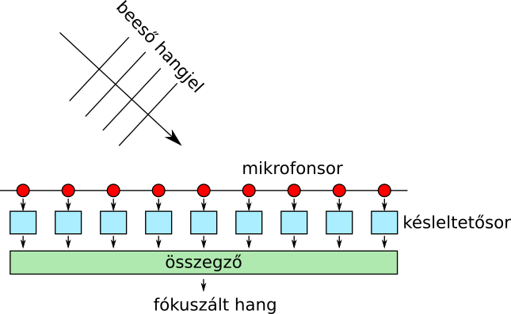
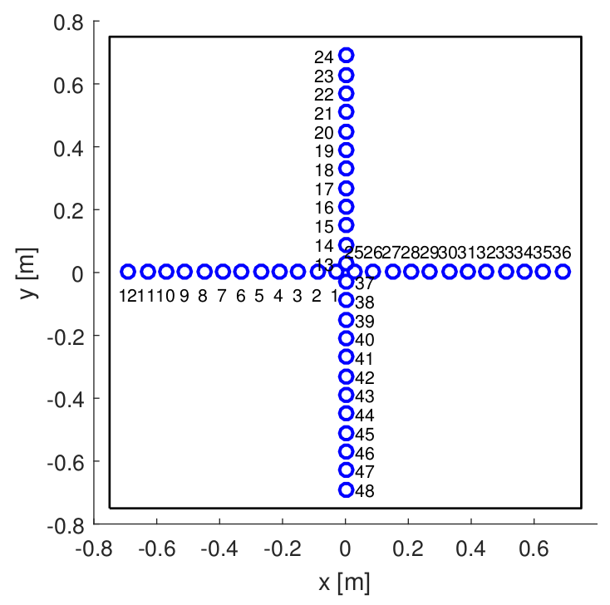
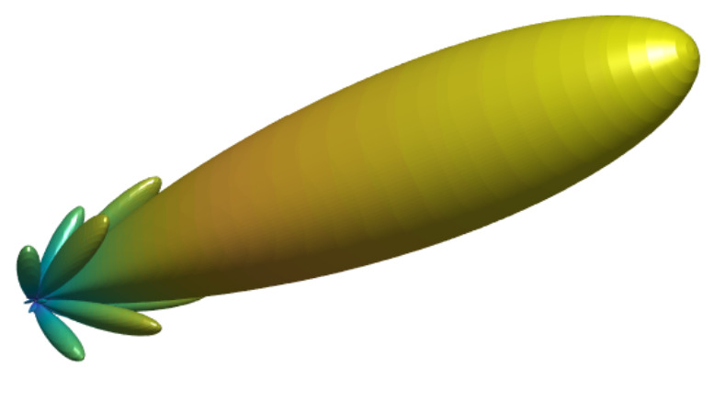
acoustic focusing
Cross Arrangement and its directivity

Slide 6
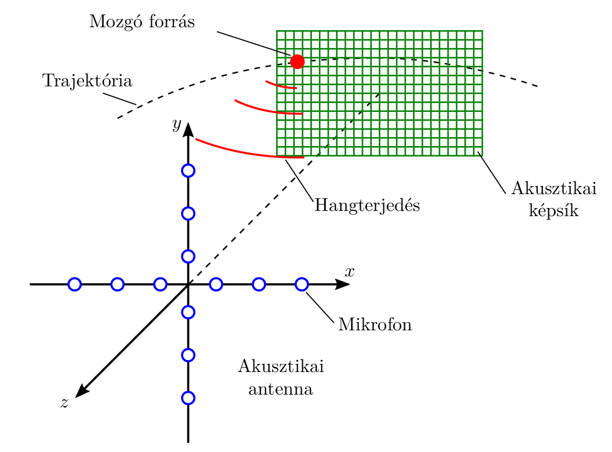
acoustic localization

Slide 7
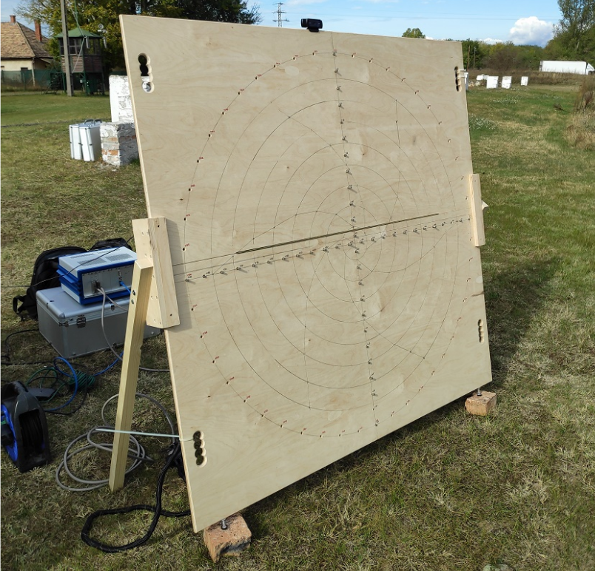
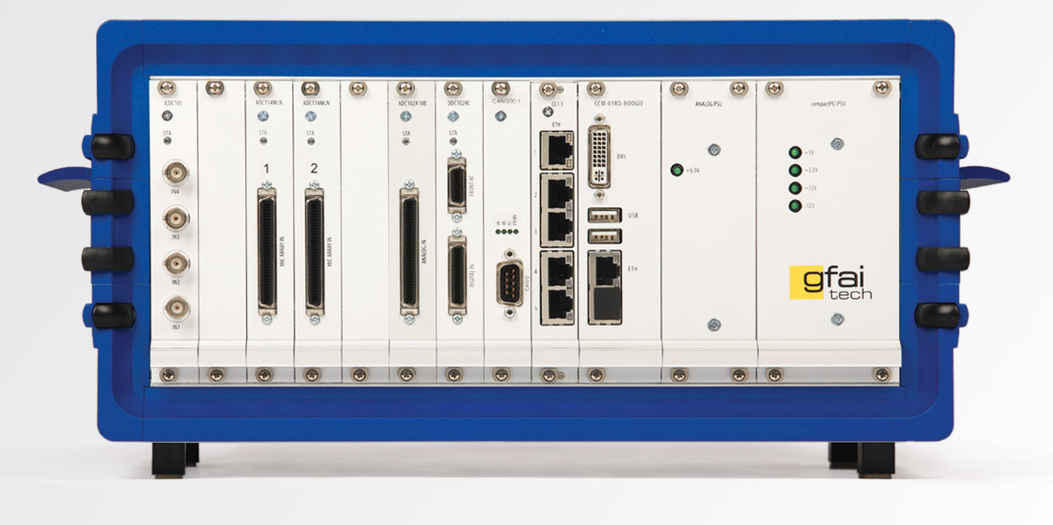
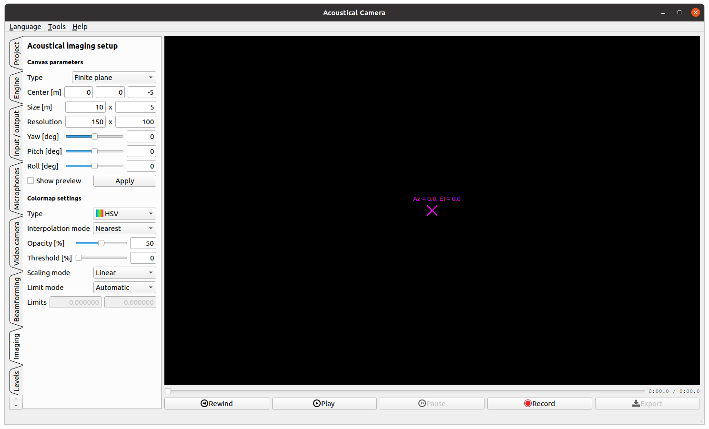
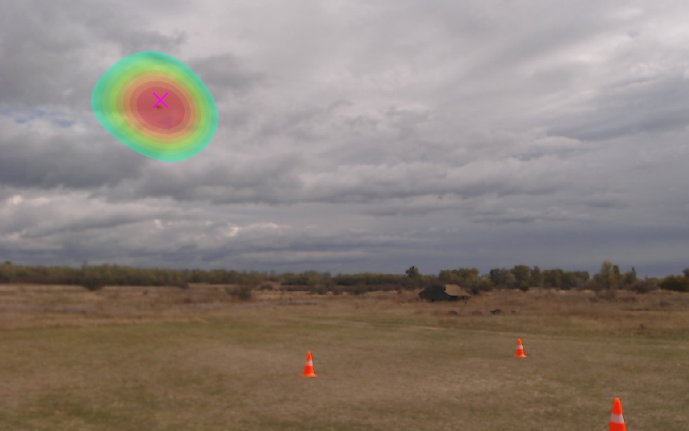
Hardware and software

Slide 8
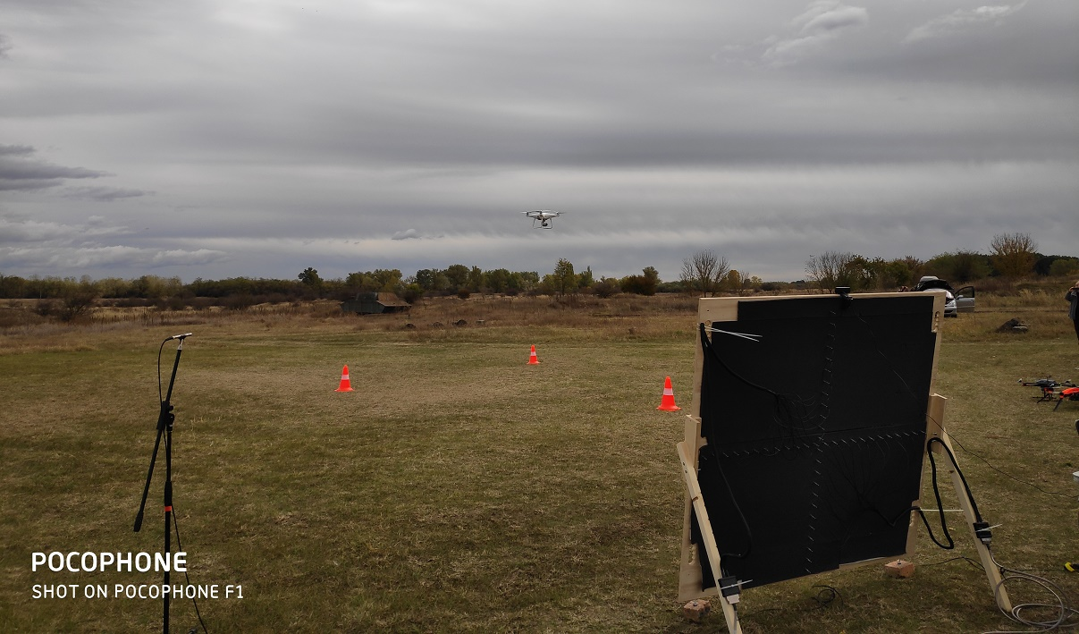
Test measurements

Slide 9
Final demonstration

