Slide 1
Soundboard Models for Piano
Systematic Estimation for Stochastic Ribbed Boards
Dóra Jenei-Kulcsár and Péter Fiala
Department of Networked Systems and Services
dkulcsar@hit.bme.hu

Slide 2
Piano and Its Models
strings
soundboard
force input
sound radiation

Slide 3
Model Overview
string
soundboard
hammer
sound radiation
$$V_{out}$$
$$V_{in}$$
Soundboard filters
$$v_{0}$$
Hammer model
$$F_{f}$$
$$F_{s}$$
String model
Sound radiation
$$p(t)$$
$$u_{s}$$
↓
↑
$Φ$, $ω$
Soundboard model
$$f(t)$$
$$v\left(x,t\right)$$
Hammer model
String model
Soundboard model
Sound radiation
Mass-spring system
Hysteretic spring models
Digital waveguide model
Multi-string coupled system
Stochastic FEM for laminates
Modal description
IIR filter set on string termination
Rayleigh-integral
FIR filter set

Slide 4
Soundboard Models
Bare Board
Arbitrary Ribbed Board
Equidistant Ribbed Board
Equivalent Stiffening Layer
Analytical models in special cases
Base model to be estimated
Well documented
2-ply asymmetric laminate
Predefined geometries
Based on equivalent mass
Nemeth2011
Nettles 1994
Estimated Bare Board
Symmetric Angle-Ply Laminate
Multi-Ply Laminate
Sandwich Panel
Effective mechanical properties
$±θ$ 4-ply laminate
Arbitrary ply structure
Face sheets and core
Nettles1994
Zebdi2008
Based on previous steps
Based on previous steps

Slide 5
Stochastic Approach

Slide 6
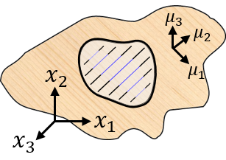
Examples
Deterministic bare board
Stochastic fibre orientation 7-plies
Stochastic bare board
Stochastic fibre orientation with ribs 7-plies
Stochastic ribbed board

Slide 7
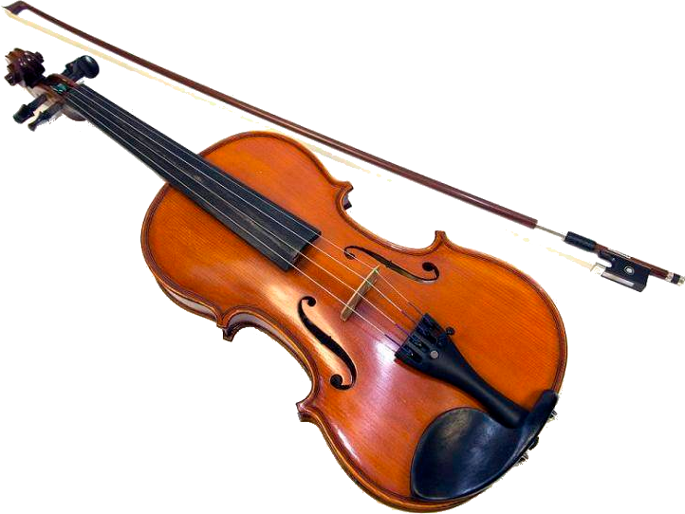
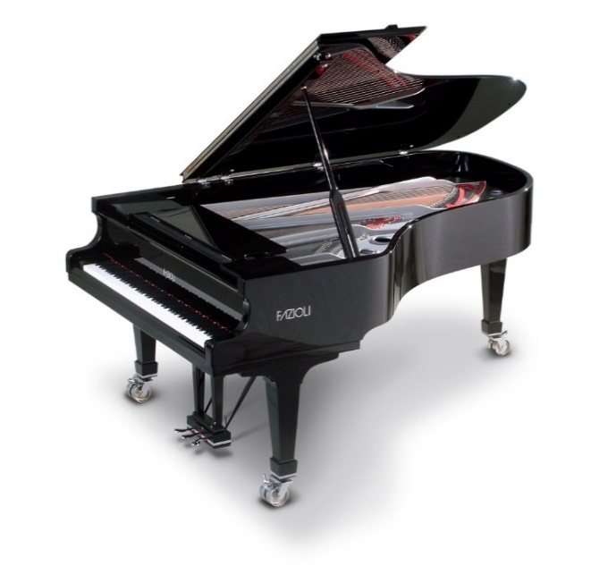
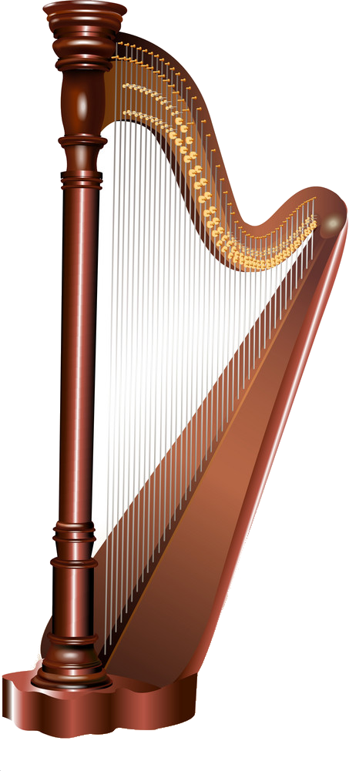
Summary
Results
Piano model
Different soundboard models are implemented
Effects of stochastic soundboard parameters can be analysed
Conclusion
Further work
Ribs are dominant also in stochastic case
Carefull layering can be compensate the stochastic behaviour
Systematic estimation enable parameter design for manufactured composite soundboards
Validation of systematic estimation
Determination the effect of stochastic behaviour to the parameter estimation

