Slide 1
ANIMA project
Aviation Noise Impact Management through novel Approaches
F. Márki, P. Rucz, G. Firtha
Budapest University of Technology and Economics

Slide 2
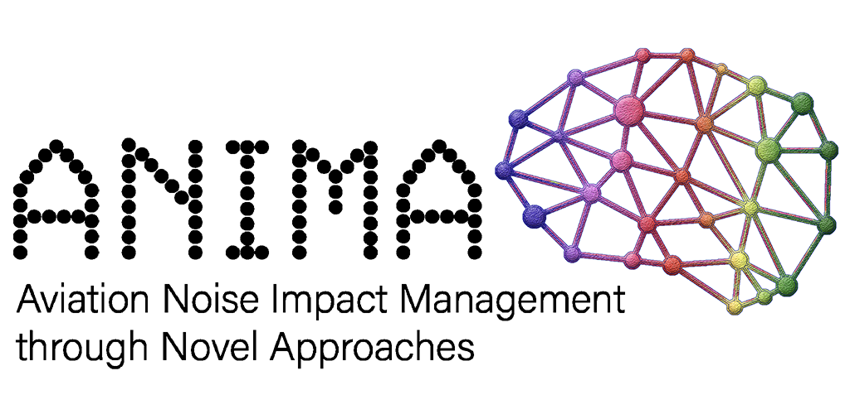
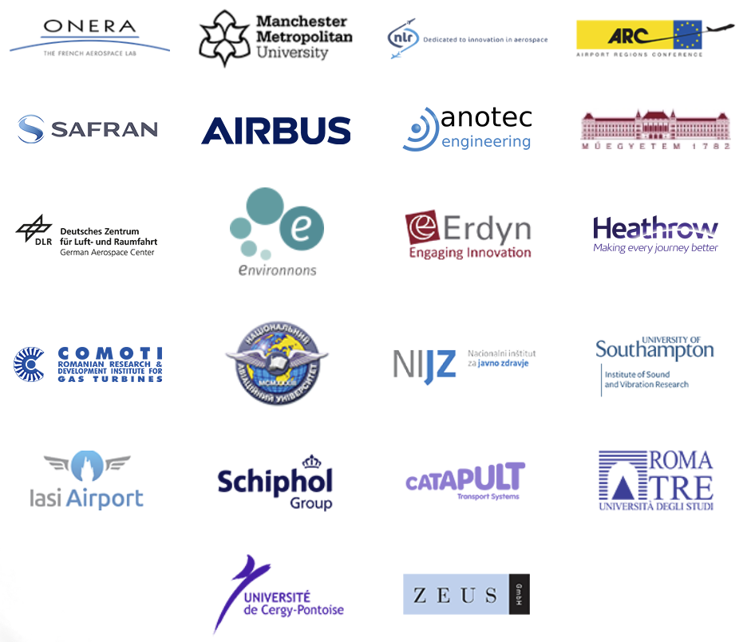
Key informations
Duration: Oct. 2017 – Dec. 2021
22 partners from 11 countries
Cost: Overall: 7,4 M EUR, BME-HIT: 307 k EUR
Goal: make aircraft noise less annoying to airport residents!

Slide 3
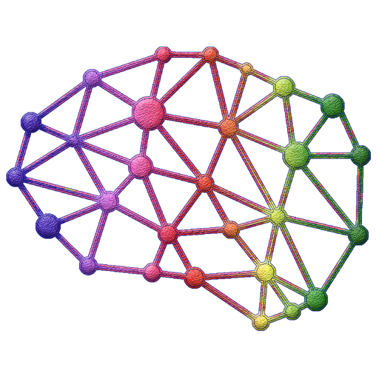


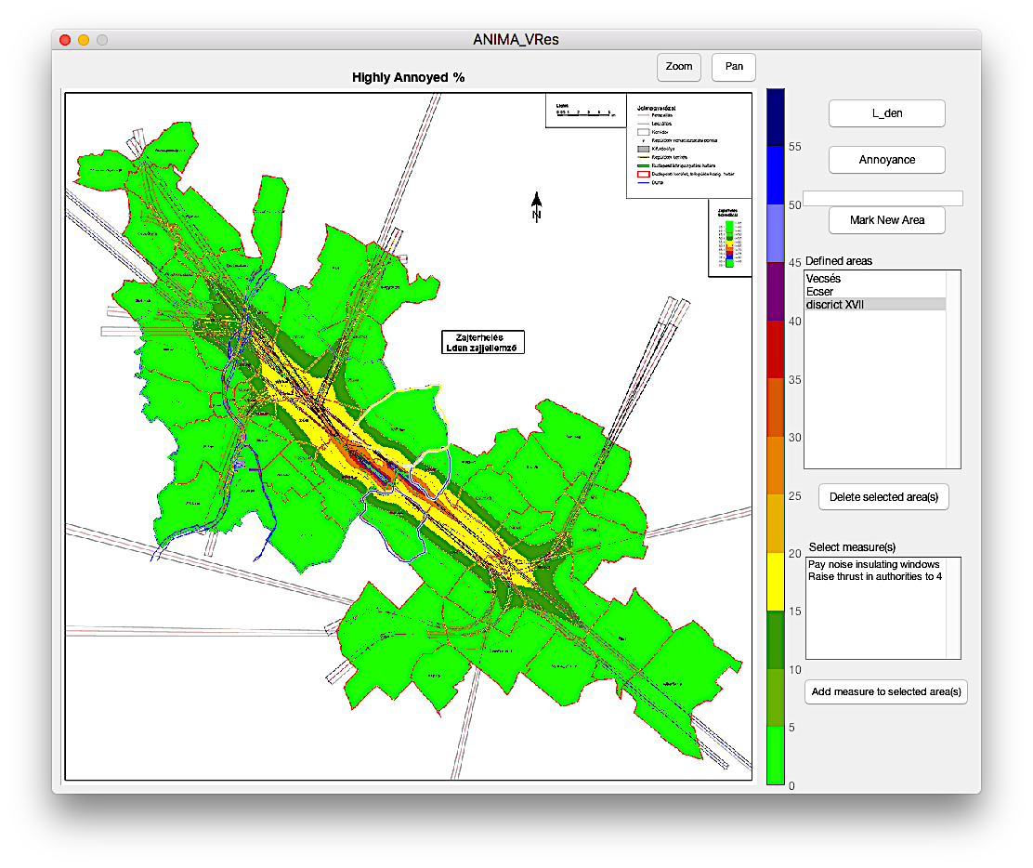
BME Tasks
Develop mobile application for pilot study on quality of life
Develop the Virtual Community Tool
Anima Research

Slide 4

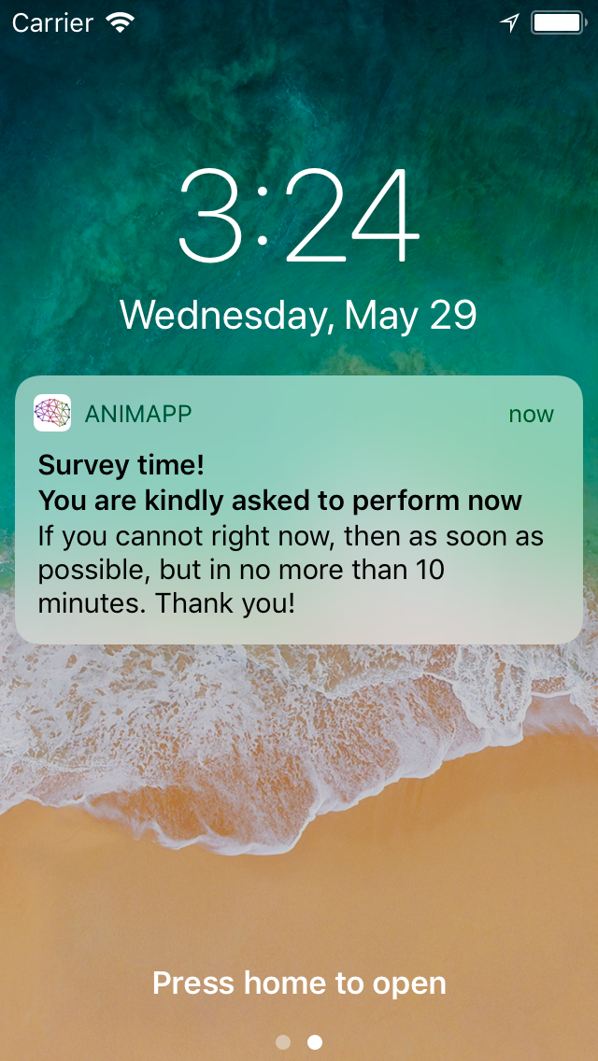
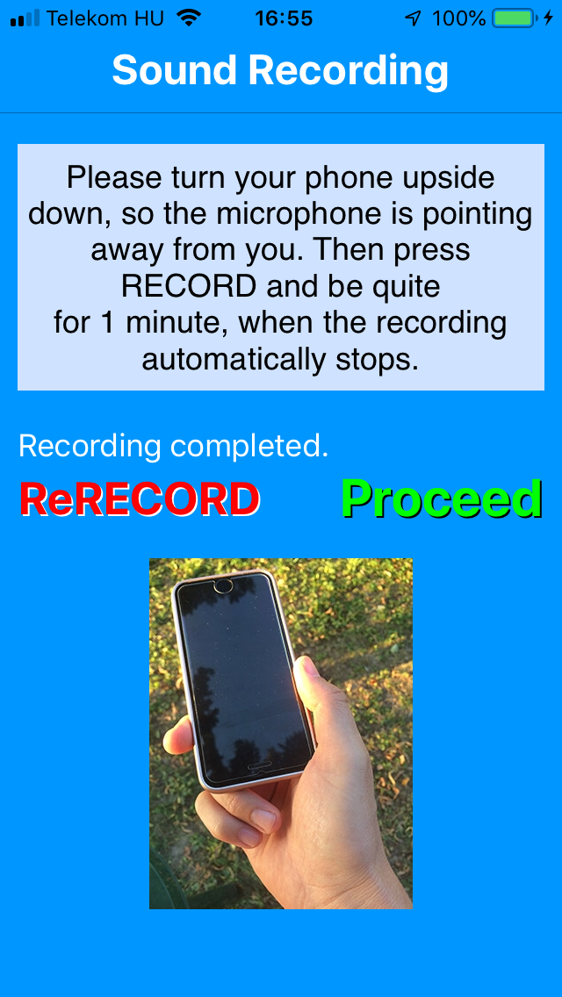
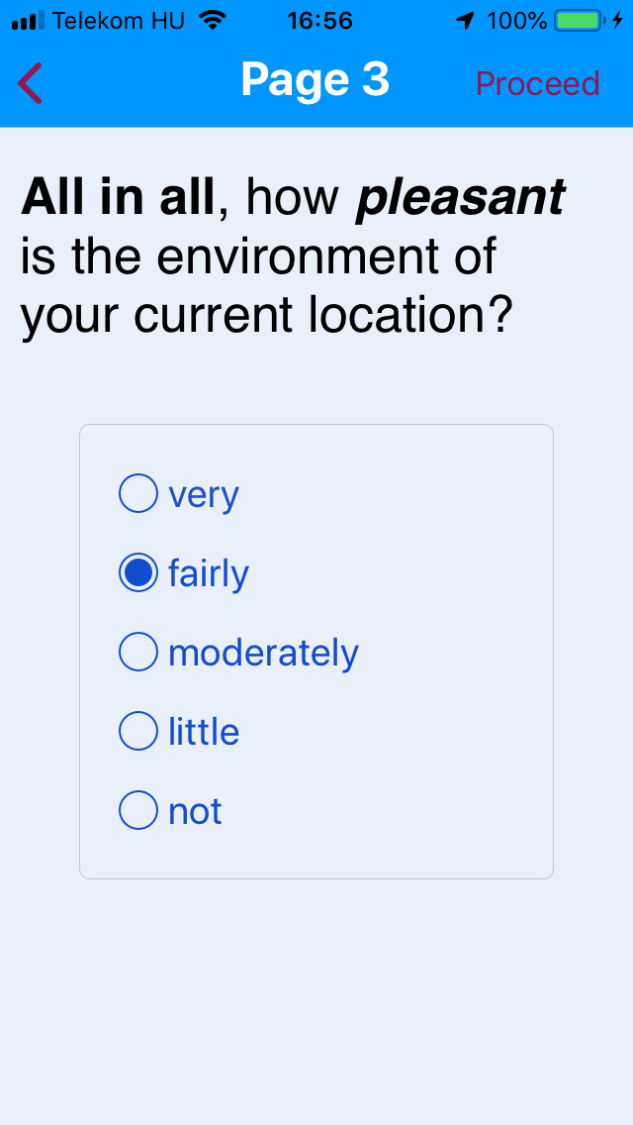
Animapp
Original launch 2019 -> shifted to 2020 Covid ’19
Study has been performed around Heathrow & Ljubljana airports
Data cleaning, packaging + acoustics data generation in progress

Slide 5
virtual community tool
Noise modelling software compute only acoustics,
typically long-term averaged metrics
Change of
amount of traffic, fleet composition, runway usage etc difficult
Need for a tool
  computing indicators nearer to people’s experience
  easy to analyse scenarios -> users not only experts
  data generated understandable by airport residents
  especially helpful for less experienced countries
Notes:
5

Slide 6
virtual community tool
Notes:
6

Slide 7
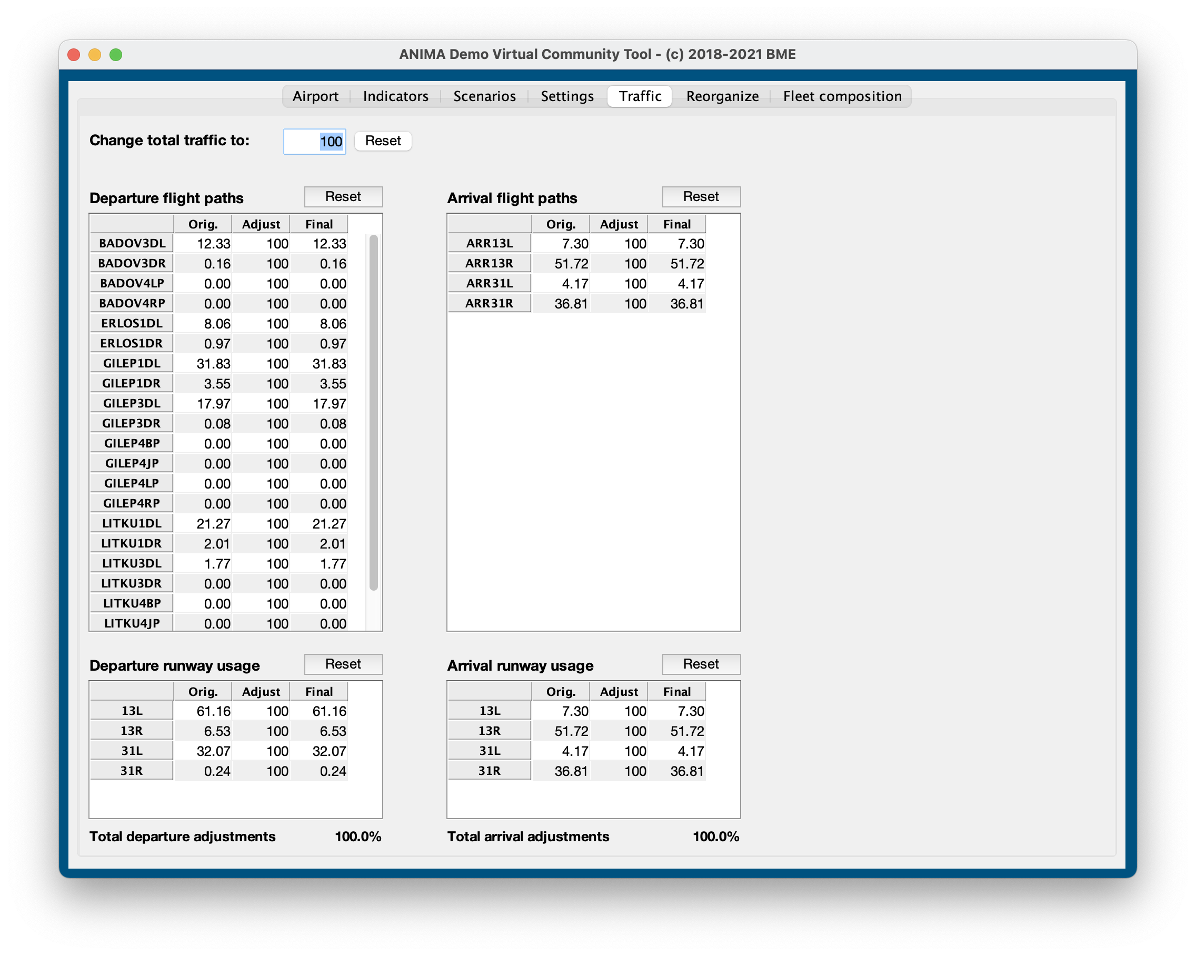
virtual community tool
Notes:
7

Slide 8
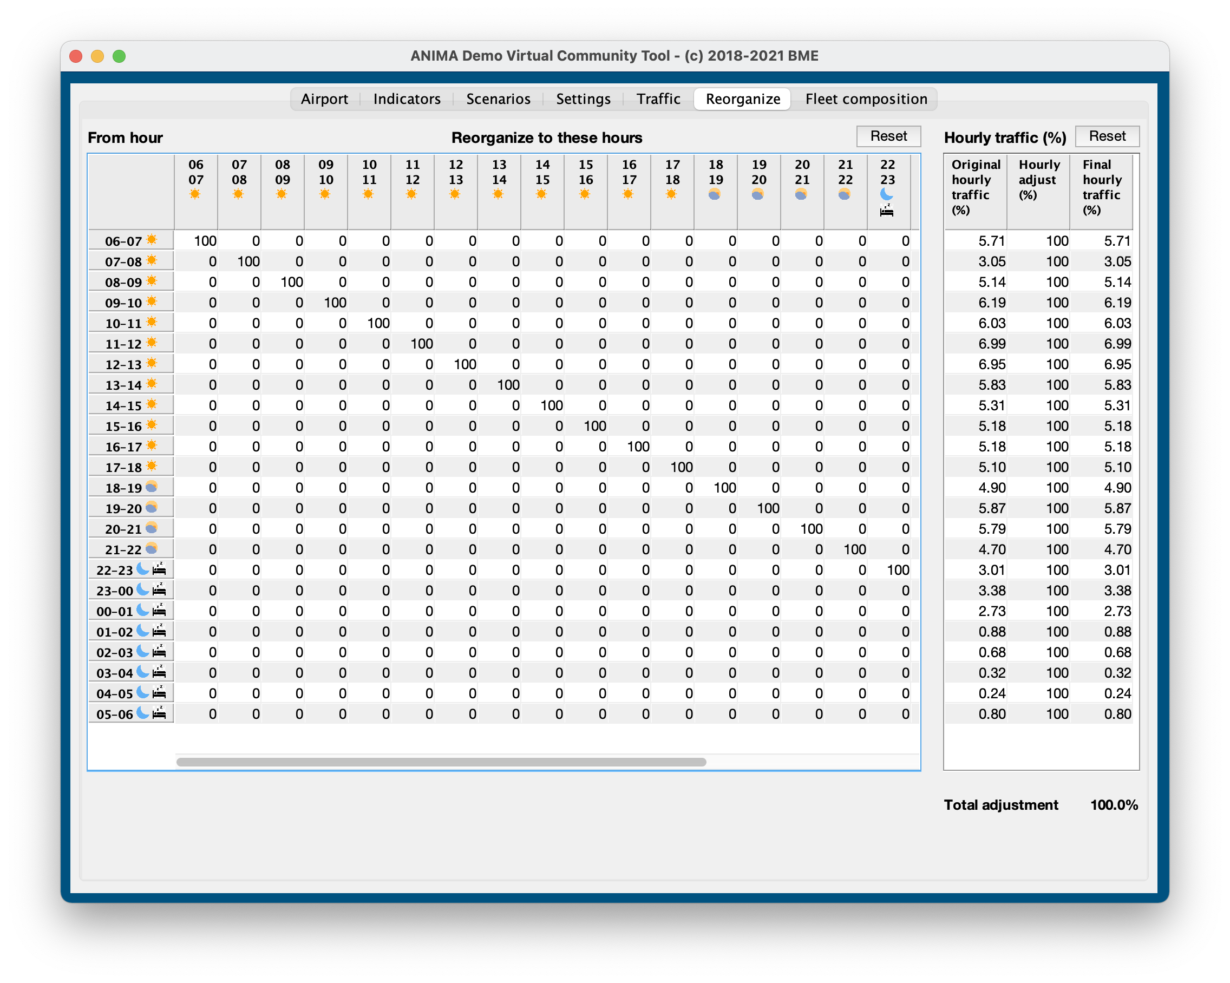
virtual community tool
Notes:
8

Slide 9
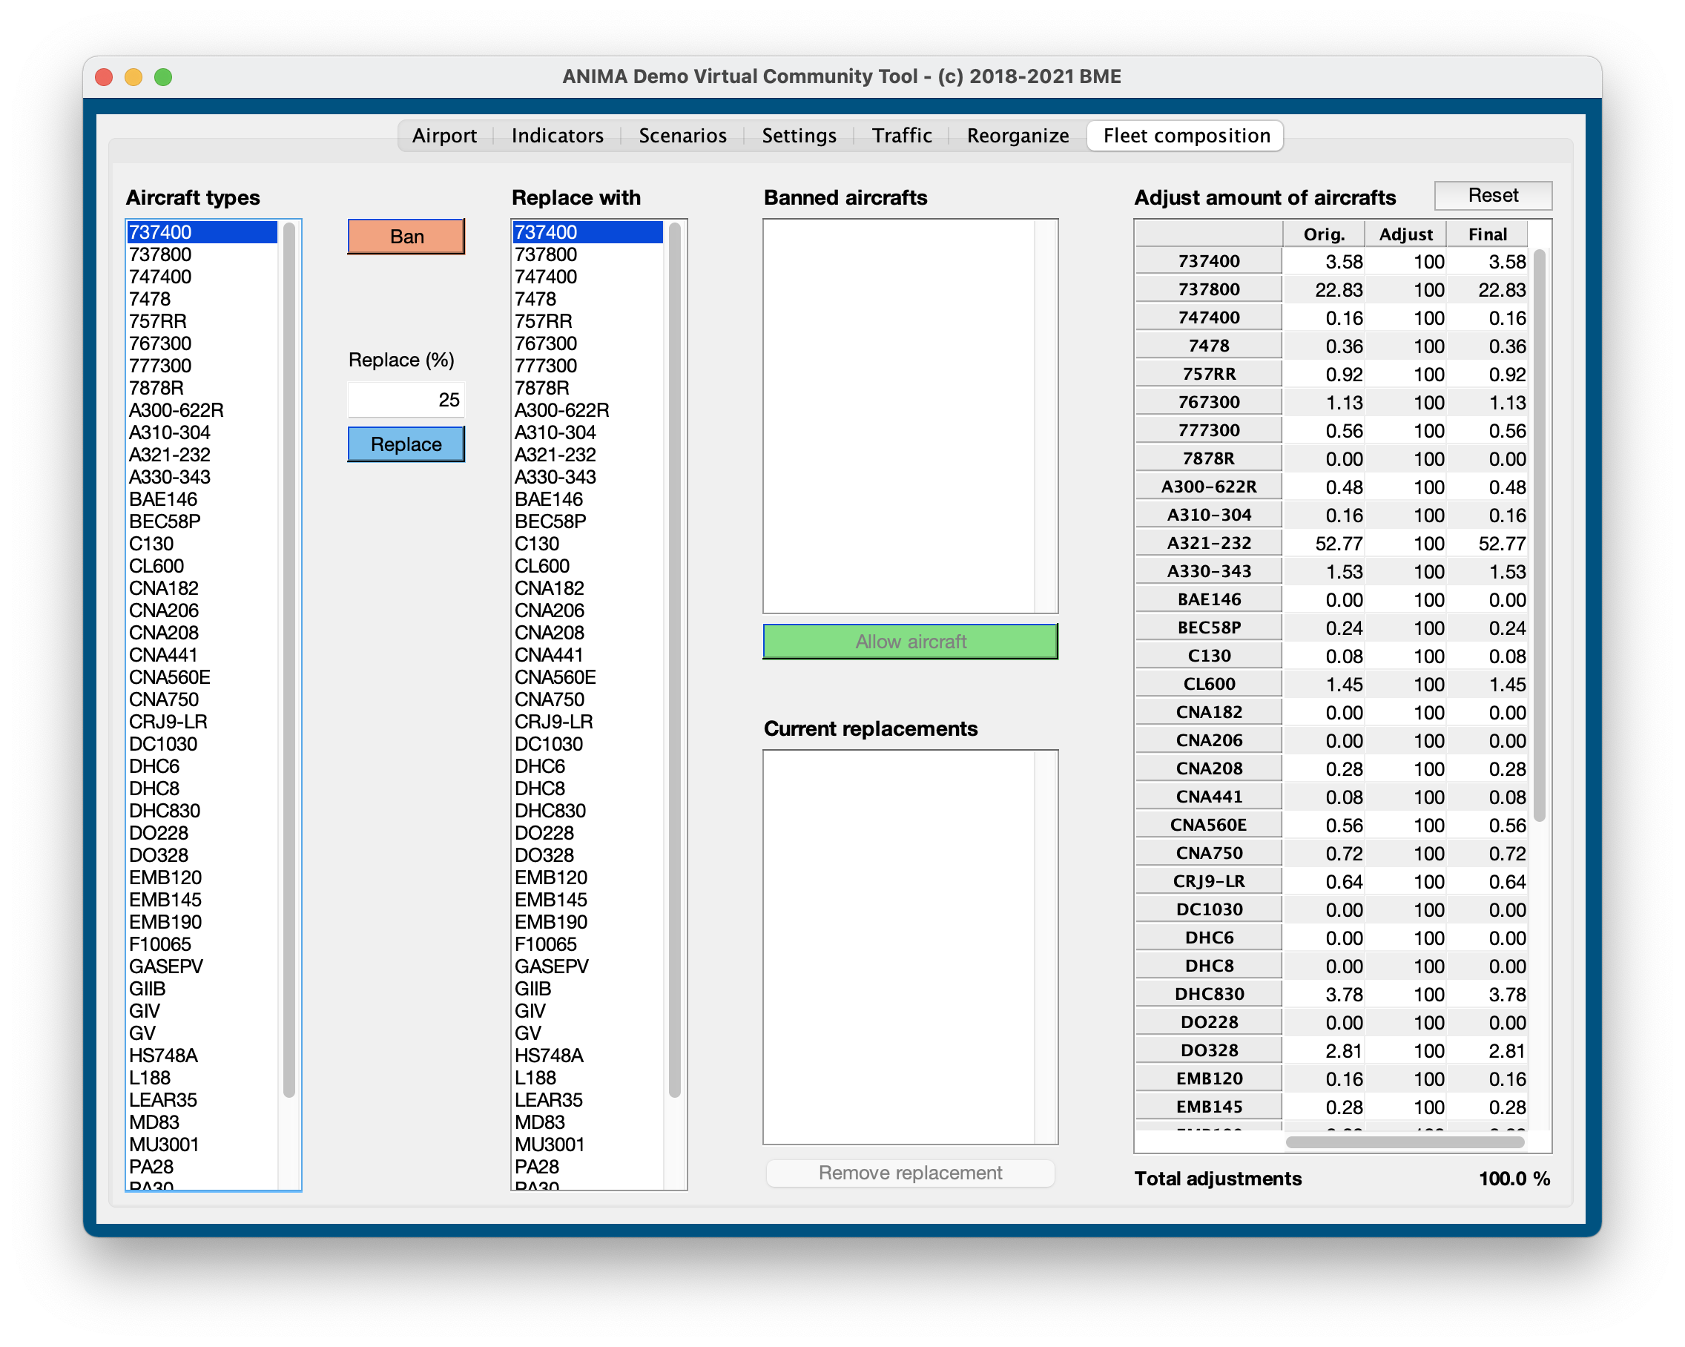
virtual community tool
Notes:
9

Slide 10
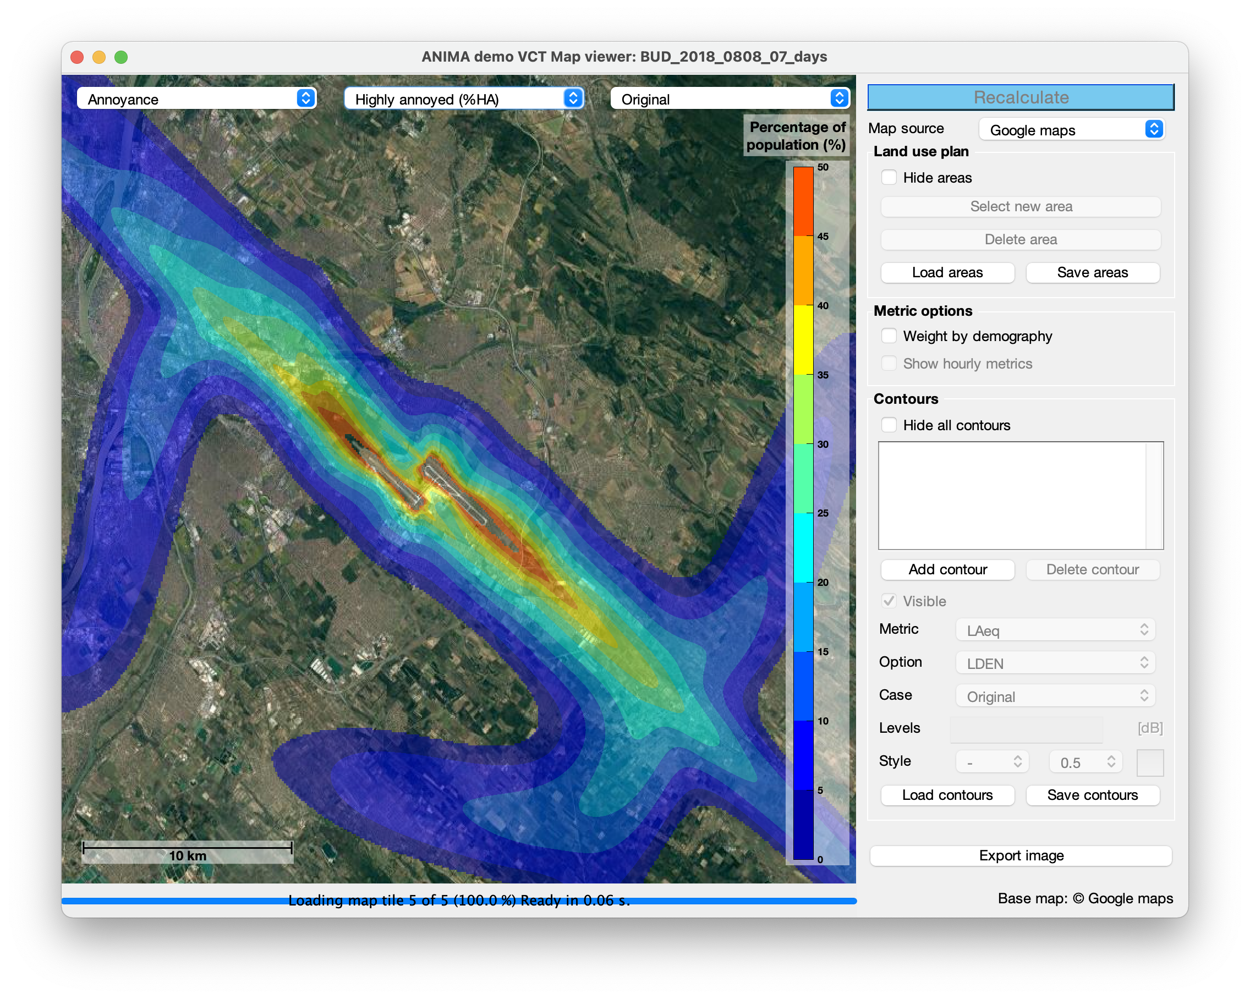
virtual community tool
Notes:
10

Slide 11
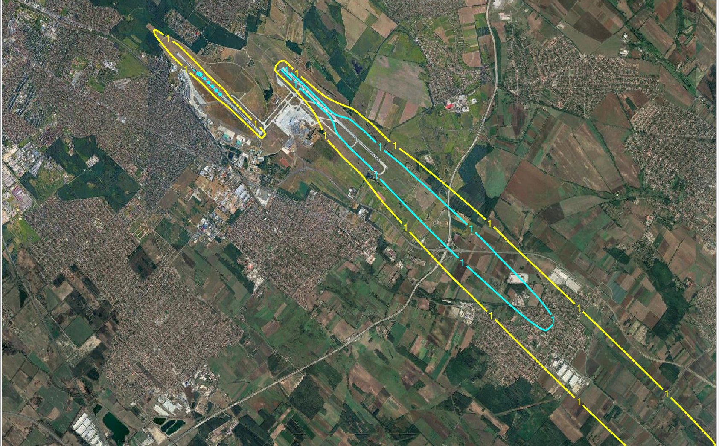
virtual community tool
Effect on awakening based on sleep preference
Sleep from 23-07
Sleep from 22-06
Notes:
11

Slide 12
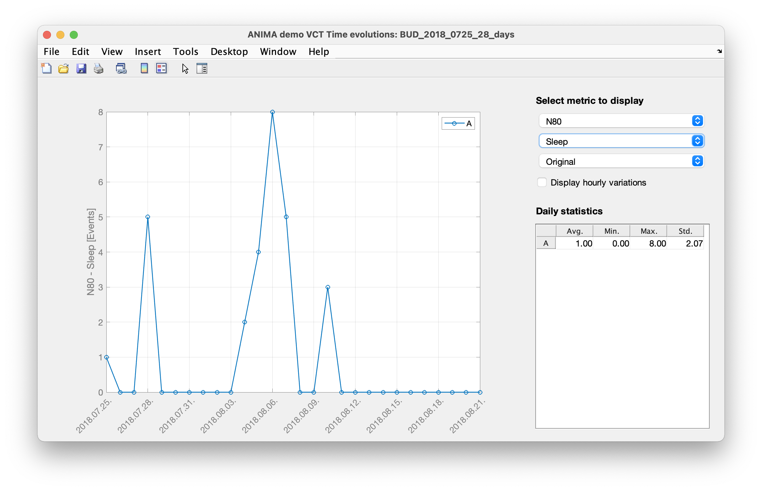
virtual community tool
Notes:
12

Slide 13


Thank you for your attention !
Laboratory of
Acoustics and
Studio
Technologies
© Department of Networked Systems and Services

