Slide 1
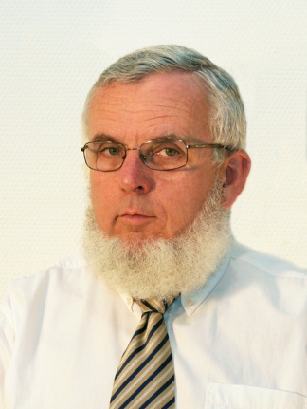
The characteristics of sounds Analysis and synthesis of sounds
Study aid for learning of Communication Acoustics
VIHIA 000
Fülöp Augusztinovicz professor
BME Dept. of Networked Systems and Services
fulop@hit.bme.hu

Slide 2
Classification of sounds
According to origin
speech
music
noise
On the basis of temporal variation
sinusoidal
periodic
transient (but still deterministic)
irregular, random
complex

Slide 3
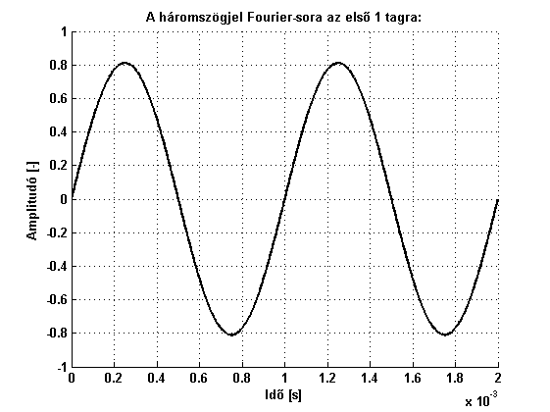
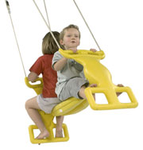
Szin usoidal process
A mechanical example: the swing
Just one single frequency!

Slide 4
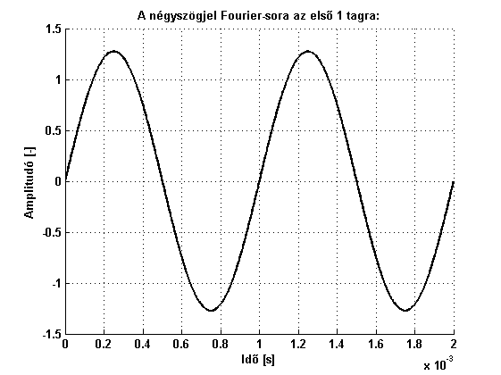
How are non-sinusoidal sounds generated?
Fundamental tone of a square wave

Slide 5
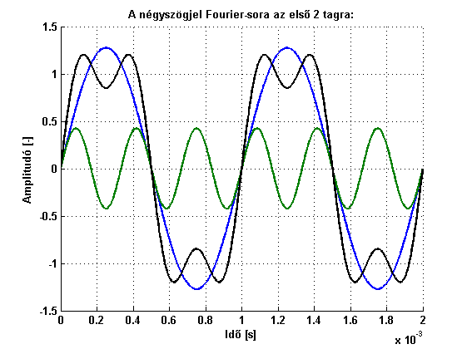
Hogyan adódik ki a nem szinuszos rezgés?
The first three components

Slide 6
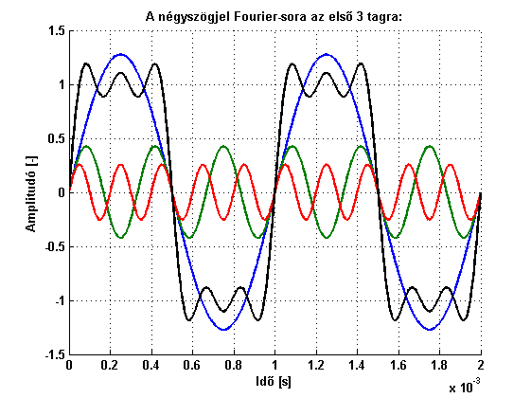
Hogyan adódik ki a nem szinuszos rezgés?
The first four components

Slide 7
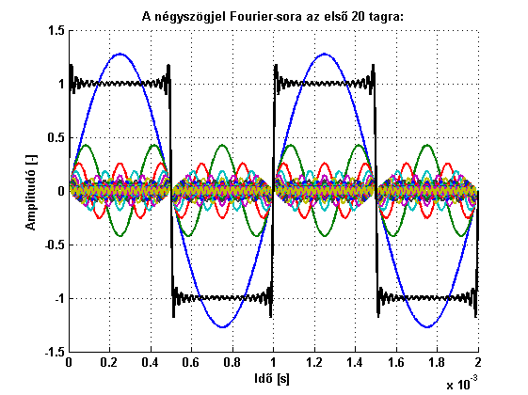
Hogyan adódik ki a nem szinuszos rezgés?
The first ten components

Slide 8
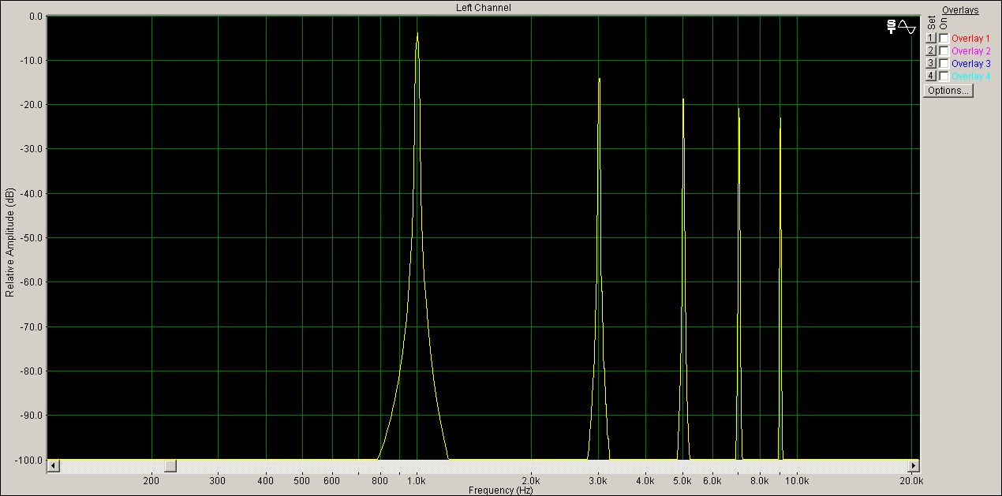
Components in the frequency domain
The first five components: a spectrum

Slide 9
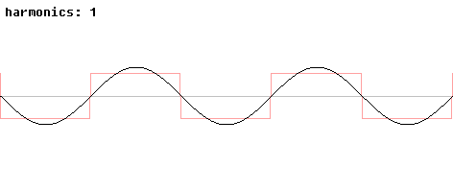
Synthesis of a square wave

Slide 10
Another example: the sawtooth wave
The fundamental

Slide 11
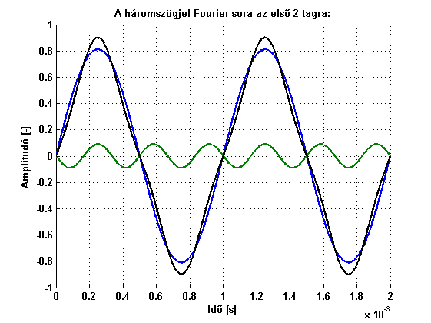
Another example: the sawtooth wave
The first two components

Slide 12
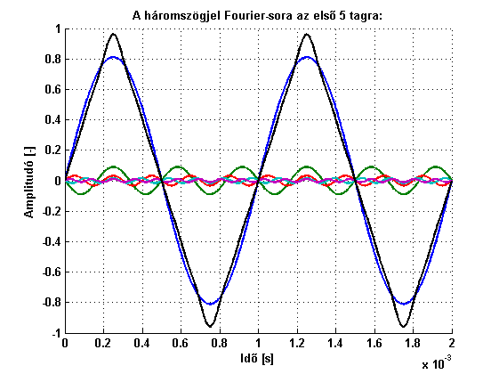
Another example: the sawtooth wave
The first five components

Slide 13
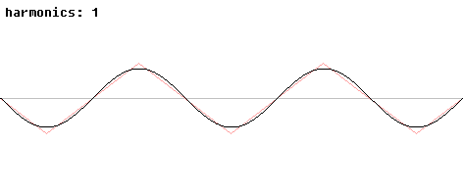
Another example: the sawtooth wave

Slide 14
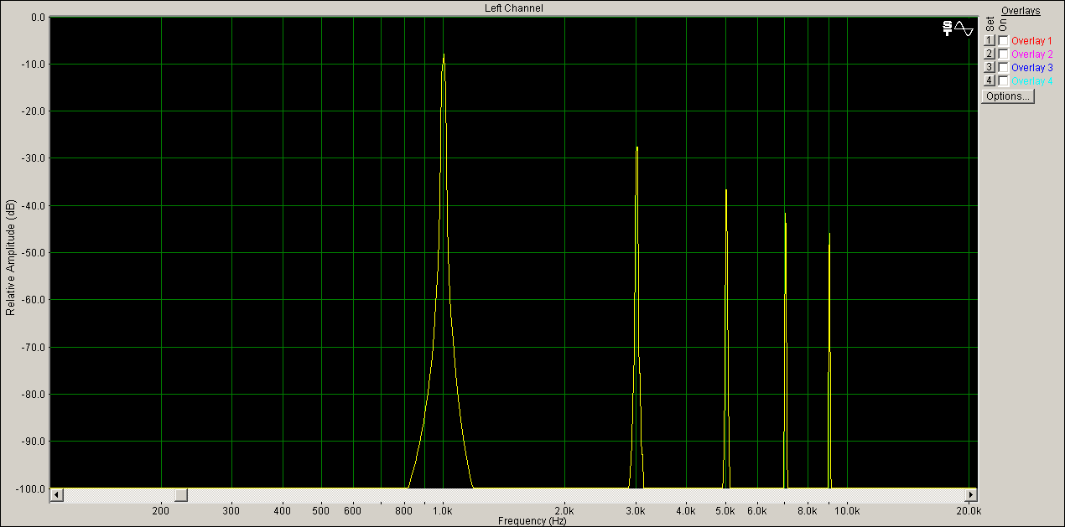
Frequency spectrum of the sawtooth wave
Note: same frequencies, but faster decrease of amplitudes

Slide 15
Harmonics
Harmonics: multiples of the fundamental frequency
Musical notions: octave, third-octave

Slide 16
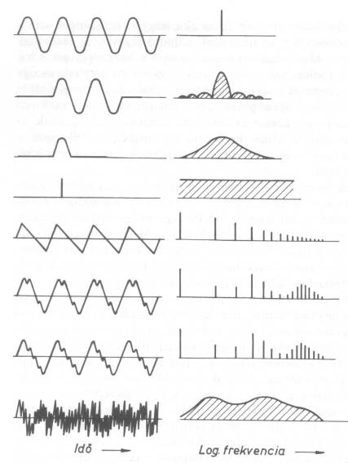
Relationship of frequency and time domain
Temporal variation Frequency content
This is the Heisenberg uncertainty principle of signal theory!

Slide 17
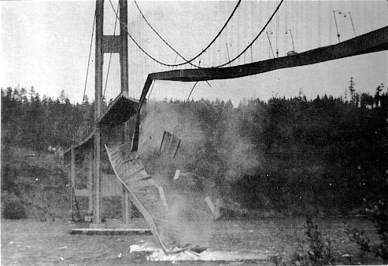
Formation of sounds in real-life systems
The wave, propagating along a waveguide is reflected from both ends
If the excitation appears in identical phase, amplification
If he newly supplied energy is just enough to maintain the process: self-sustaining wave
If it is too much: resonance

Slide 18
Generation of self-sustaining waves
One-dimensional propagation and reflection (along a rigid tube)
x
0
L
Particle
displacement

Slide 19
Generation of self-sustaining waves
One-dimensional propagation and reflection
x
L
Particle
displacement

Slide 20
Generation of self-sustaining waves
One-dimensional propagation and reflection
x
L
Particle
displacement

Slide 21
Generation of self-sustaining waves
One-dimensional propagation and reflection
x
L
Particle
displacement

Slide 22
Generation of self-sustaining waves
One-dimensional propagation and reflection
x
L
Particle
displacement

Slide 23
Generation of self-sustaining waves
One-dimensional propagation and reflection
x
L
Particle
displacement

Slide 24
Generation of self-sustaining waves
One-dimensional propagation and reflection
x
L
Particle
displacement
Reversal of phase, because displ. must be zero

Slide 25
Generation of self-sustaining waves
One-dimensional propagation and reflection
x
L
Particle
displacement
Reversal of phase, because displ. must be zero

Slide 26
Generation of self-sustaining waves
One-dimensional propagation and reflection
x
L
Particle
displacement

Slide 27
Generation of self-sustaining waves
One-dimensional propagation and reflection
x
L
Particle
displacement

Slide 28
Generation of self-sustaining waves
One-dimensional propagation and reflection
x
L
Particle
displacement

Slide 29
Generation of self-sustaining waves
One-dimensional propagation and reflection
x
L
Particle
displacement

Slide 30
Generation of self-sustaining waves
One-dimensional propagation and reflection
x
L
Particle
displacement

Slide 31
Generation of self-sustaining waves
One-dimensional propagation and reflection
x
L
Particle
displacement

Slide 32
Relationship between L and f
If the tube is closed on both ends:
If one end is closed and the other is open:
The same thing happens, if more periods of wave correspond to the length of tube:

Slide 33
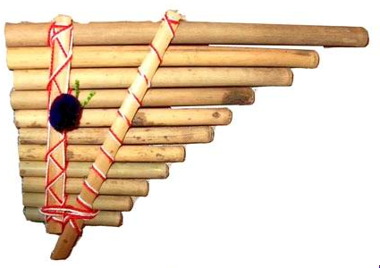
A practical, very simple example: the pan’s pipes
p
v
Z = 0
(p = 0)
Z = ∞ (v = 0)

Slide 34
Intonation of organ pipes

Slide 35
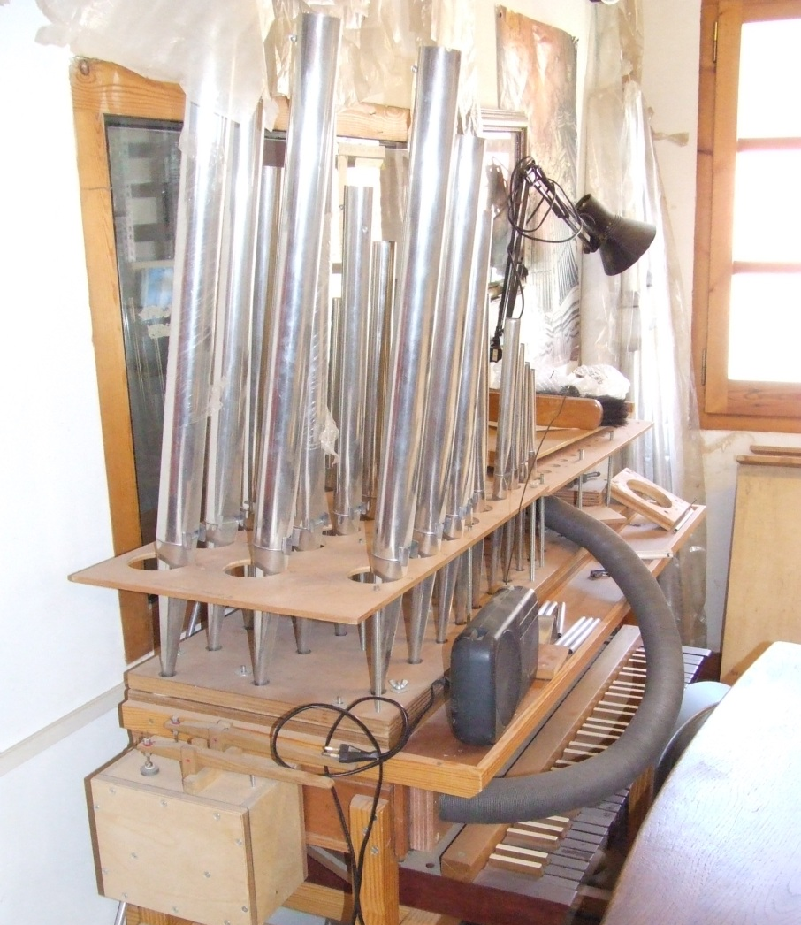
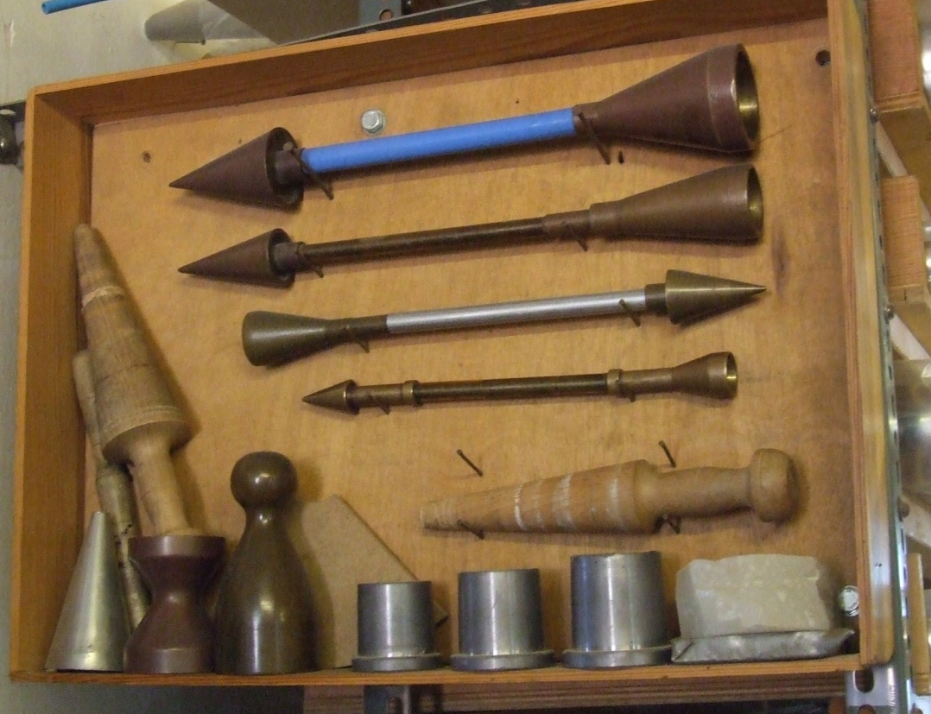
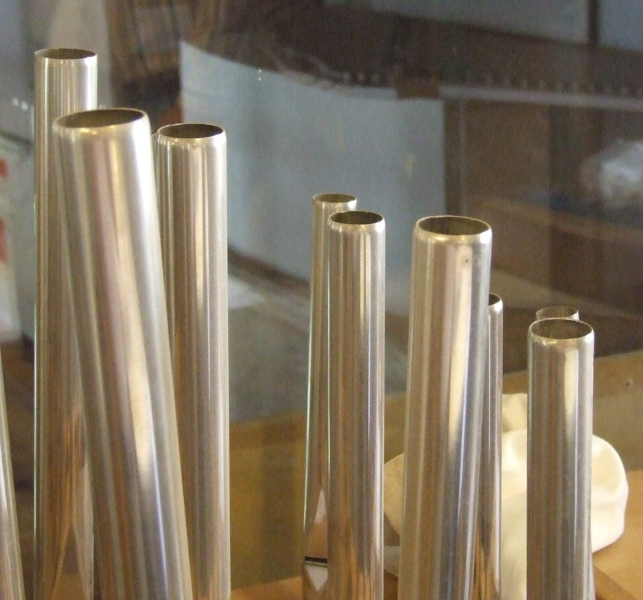
Intonation (aka voicing) of organ pipes

Slide 36
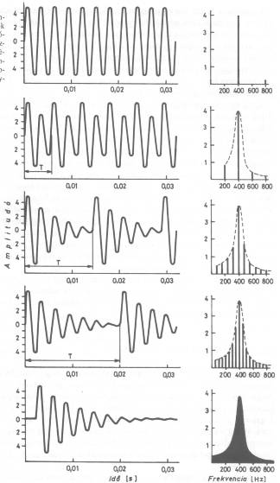
From sinusoids to transients

Slide 37
And backwards (t  f): Fourier-analysis
A periodic function x(t) with period T can be transformed into an infinite series of sinusoids of amplitude X:
A periodic function x(t) with period T can be transformed into an infinite series of sinusoids of amplitude X
Joseph Fourier (1768 – 1830)
Ide ábrát a Brüel könyvből

Slide 38
And what do we hear from all these?

Slide 39
Frequency analysis - experimental
Aim is to separate various frequency components by
decomposing into bands of constant absolute bandwidth
decomposing into bands of consant relative bandwidth
Narrow-band frequency analysis is
aimed at exact identification of tonal frequencies
Standard octave or third-octave band analysis is
aimed at modelling/imitating the human hearing system

Slide 40
Comparison of male and female voice by third-octave band analysis

Slide 41
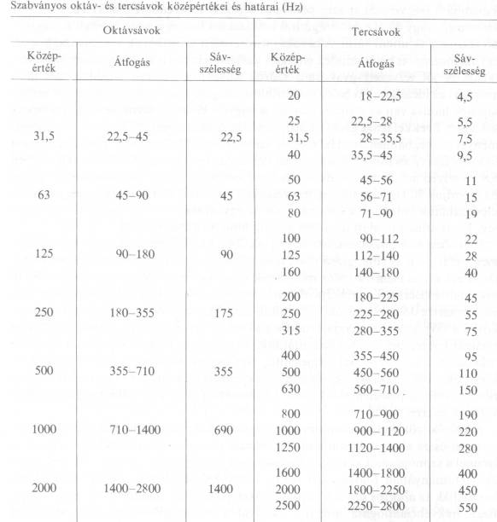
Standard octave and third-octave bands

Slide 42
Critical bands
Critical Band | Frequency (Hz) |  |  | Critical Band | Frequency (Hz)
 | Low | High | Width |  | Low | High | Width
0 | 0 | 100 | 100 | 13 | 2000 | 2320 | 320
1 | 100 | 200 | 100 | 14 | 2320 | 2700 | 380
2 | 200 | 300 | 100 | 15 | 2700 | 3150 | 450
3 | 300 | 400 | 100 | 16 | 3150 | 3700 | 550
4 | 400 | 510 | 110 | 17 | 3700 | 4400 | 700
5 | 510 | 630 | 120 | 18 | 4400 | 5300 | 900
6 | 630 | 770 | 140 | 19 | 5300 | 6400 | 1100
7 | 770 | 920 | 150 | 20 | 6400 | 7700 | 1300
8 | 920 | 1080 | 160 | 21 | 7700 | 9500 | 1800
9 | 1080 | 1270 | 190 | 22 | 9500 | 12000 | 2500
10 | 1270 | 1480 | 210 | 23 | 12000 | 15500 | 3500
11 | 1480 | 1720 | 240 | 24 | 15500 | 22050 | 6550
12 | 1720 | 2000 | 280

