Slide 1
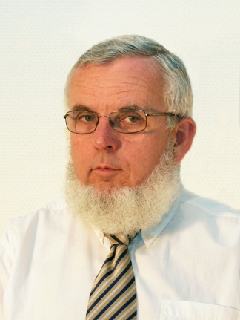
Basic nositons of hearing and psychoacousics
Educational guide for the subject Communication Acoustics
VIHIAV 035
Fülöp Augusztinovicz
Dept. of Networked Systems and Services
fulop@hit.bme.hu

Slide 2
Psychoacoustic phenomena
Sensing thresholds
Masking
in time
in frequency
Pitch [bark]
Cricital bands
Loudness [phon]
Sharpness [acum]
Fluctuation [vacil]
Roughness [asper]
Annoyance
Binaural hearing
lateralization (1D)
localisation (3D)

Slide 3
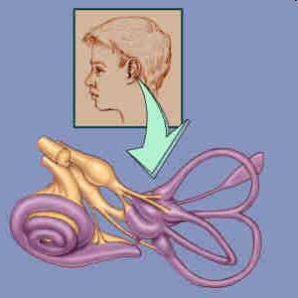
The inner ear
A csiga
Construction of the inner ear
A Corti-féle szerv

Slide 4
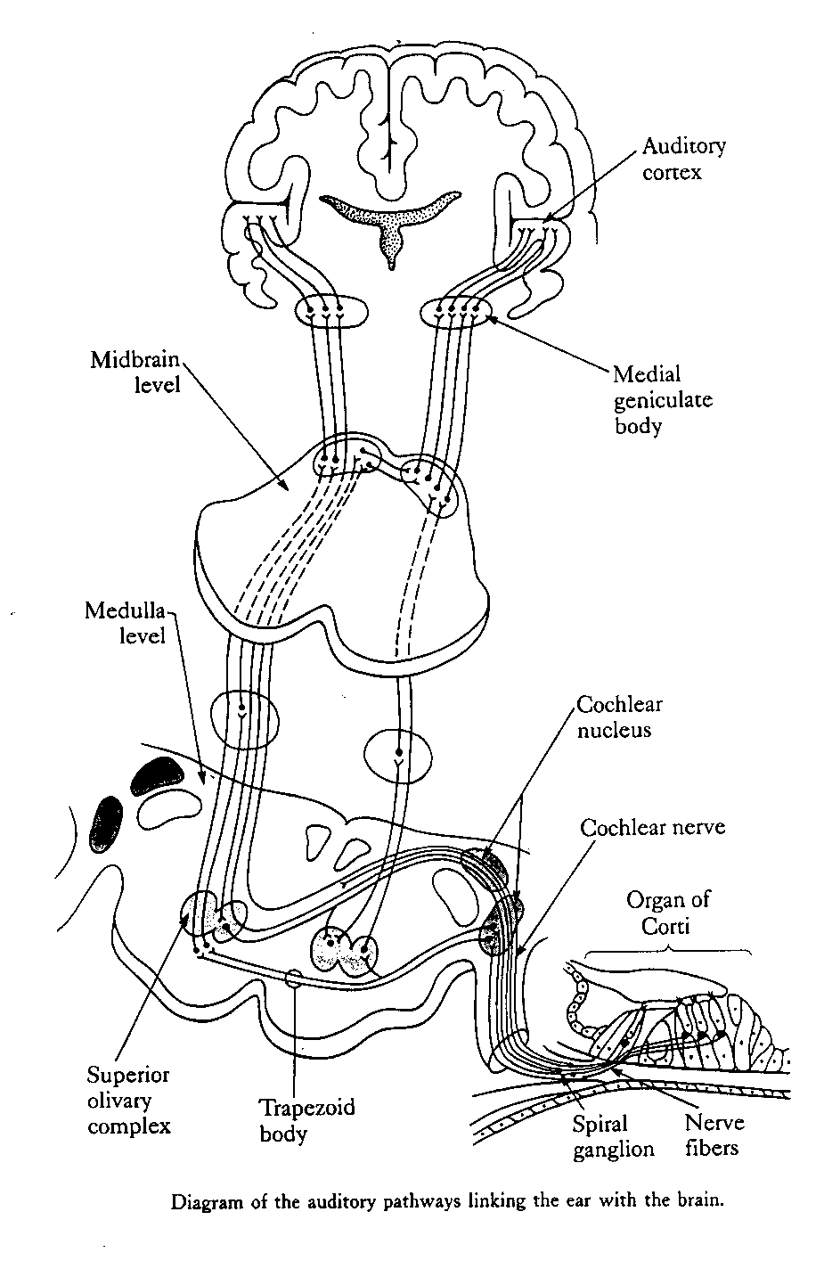
Relationship of the inner ear and the brain/ 1
Time domain decoding, speech processing
Spatial domain decoding, spectral processing (music)

Slide 5
Relationship of the inner ear and the brain/2
Physical parameters
Perception parameters
intensity
frequency
spectrum
duration
direction
etc.
loudness
pitch
tone
sensed duration
sensed direction
etc.
Φ
sensing organ
neural conduction
brain operation
Ψ

Slide 6
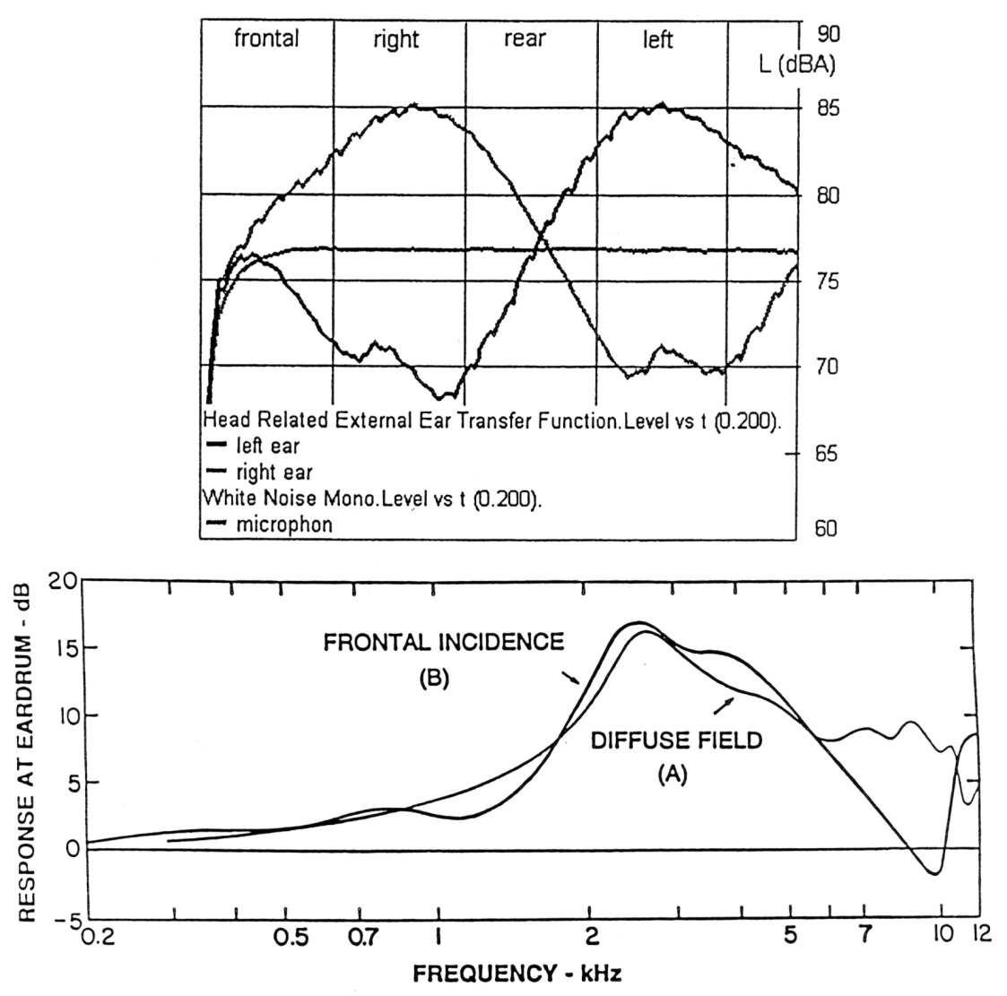
Sensing of direction by two ears
Basis of direction sensing: the two ears hear different sounds, both in amplitude and in phase
Description of the different hearing by the two ears is expressed by the HRTFs (Head Related Transfer Function)

Slide 7
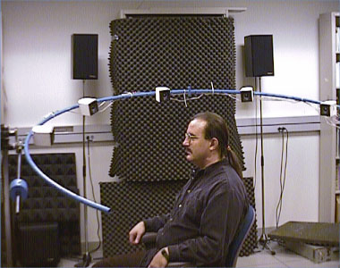
The measurement of HRTF

Slide 8
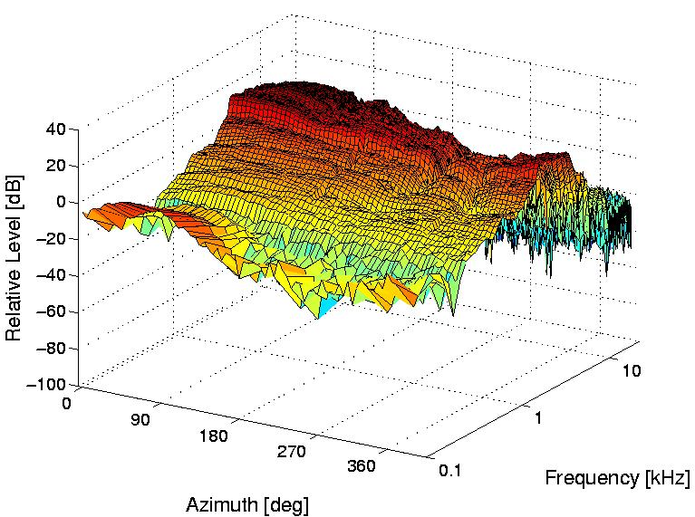
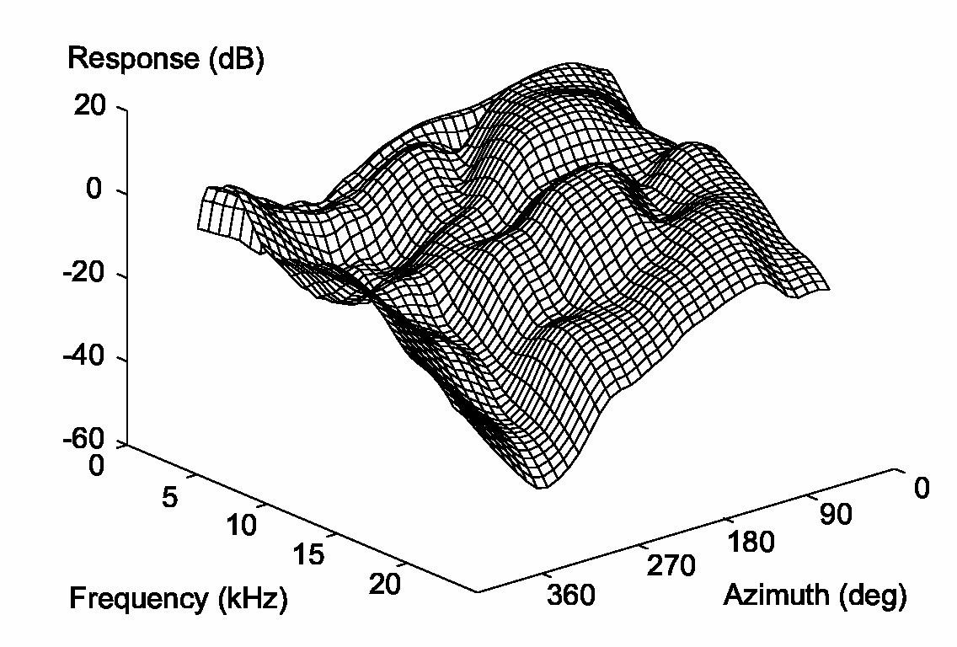
The binaural hearing
Time-delay panning
Amplitude-panning
HRTF-filtering

Slide 9
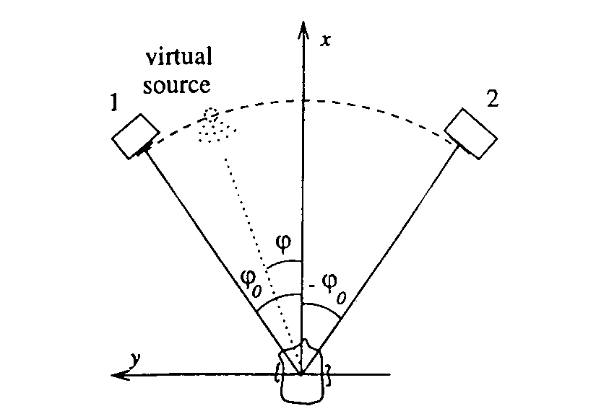
Use of binaural hearing for virtual (acoustic) reality
Time delay
Amplitude rendering
Head Related Transfer Function (HRTF) technique

Slide 10
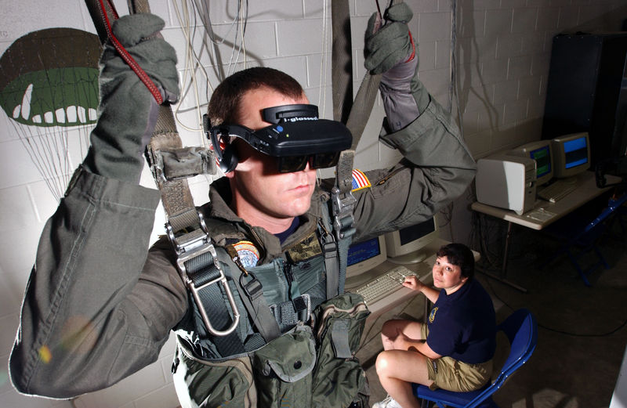
Virtual acoustics

Slide 11
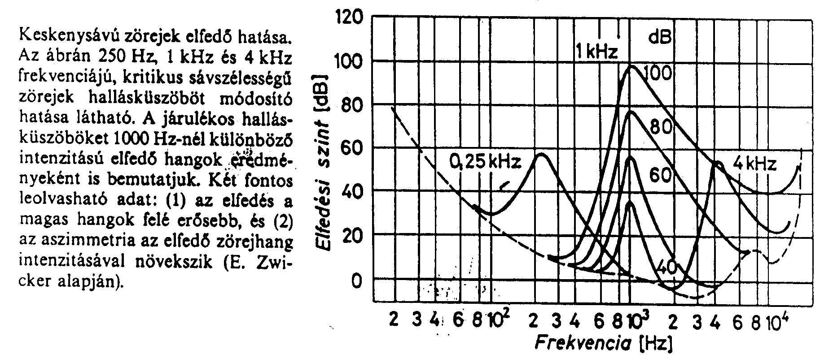
Masking of narrow-band noise
Hearing threshold shift for narrow band sounds of critical bandwidth, as a function of frequency and level.
Conclusions:
masking is stronger for higher frequencies
asimmetry is increased for higher intensities

Slide 12
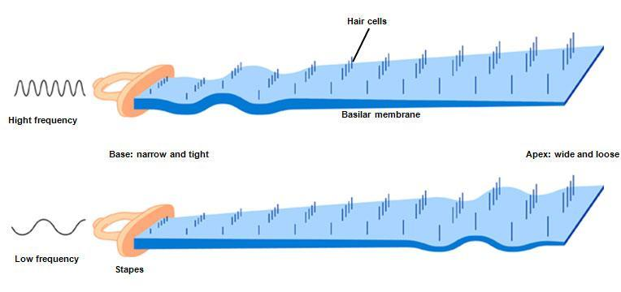
Masking for sinusoidal sounds: critical bands
Masking in the frequency domain
the cochlea creates an "auditory filter„
Characterized by critical bands:
the band of audio frequencies within which a second tone will interfere with the perception of a first tone
the band within which increasing the bandwidth of narrow band excitation will not increase the percepted loudness
Reason: geometry and characterictics of the basilar membrane

Slide 13
Critical bandwidth vs. center frequency
Demo: increasing the bandwidth with constant energy
http://www.feilding.net/sfuad/musi3012-01/demos/audio/103_critical_bands_loudness.htm

Slide 14
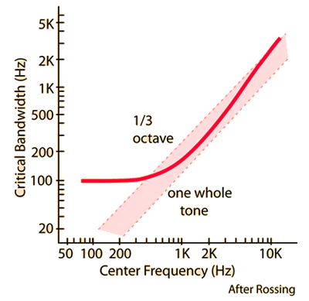
Critical bands
Each critical bandwidth corresponds to constant, 1,3 mm along the basilar membrane
but
Each critical bandwidth corresponds to varying frequency bandwidth

Slide 15
Critical bands
Critical Band | Frequency (Hz) |  |  | Critical Band | Frequency (Hz)
 | Low | High | Width |  | Low | High | Width
0 | 0 | 100 | 100 | 13 | 2000 | 2320 | 320
1 | 100 | 200 | 100 | 14 | 2320 | 2700 | 380
2 | 200 | 300 | 100 | 15 | 2700 | 3150 | 450
3 | 300 | 400 | 100 | 16 | 3150 | 3700 | 550
4 | 400 | 510 | 110 | 17 | 3700 | 4400 | 700
5 | 510 | 630 | 120 | 18 | 4400 | 5300 | 900
6 | 630 | 770 | 140 | 19 | 5300 | 6400 | 1100
7 | 770 | 920 | 150 | 20 | 6400 | 7700 | 1300
8 | 920 | 1080 | 160 | 21 | 7700 | 9500 | 1800
9 | 1080 | 1270 | 190 | 22 | 9500 | 12000 | 2500
10 | 1270 | 1480 | 210 | 23 | 12000 | 15500 | 3500
11 | 1480 | 1720 | 240 | 24 | 15500 | 22050 | 6550
12 | 1720 | 2000 | 280

Slide 16
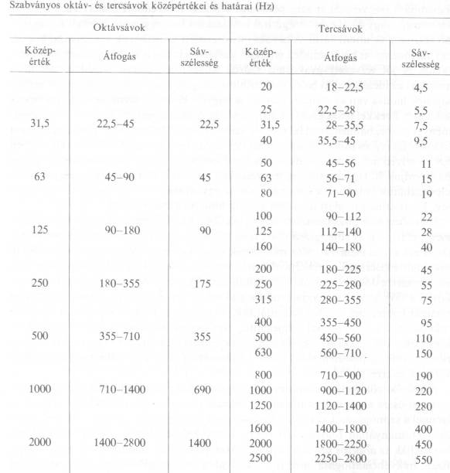
Standard octave and third-octave bands

Slide 17
Loudness
Subjective loudness of a 1000 Hz sinusoidal sound equals the physical quantity: sound pressure level.

Slide 18
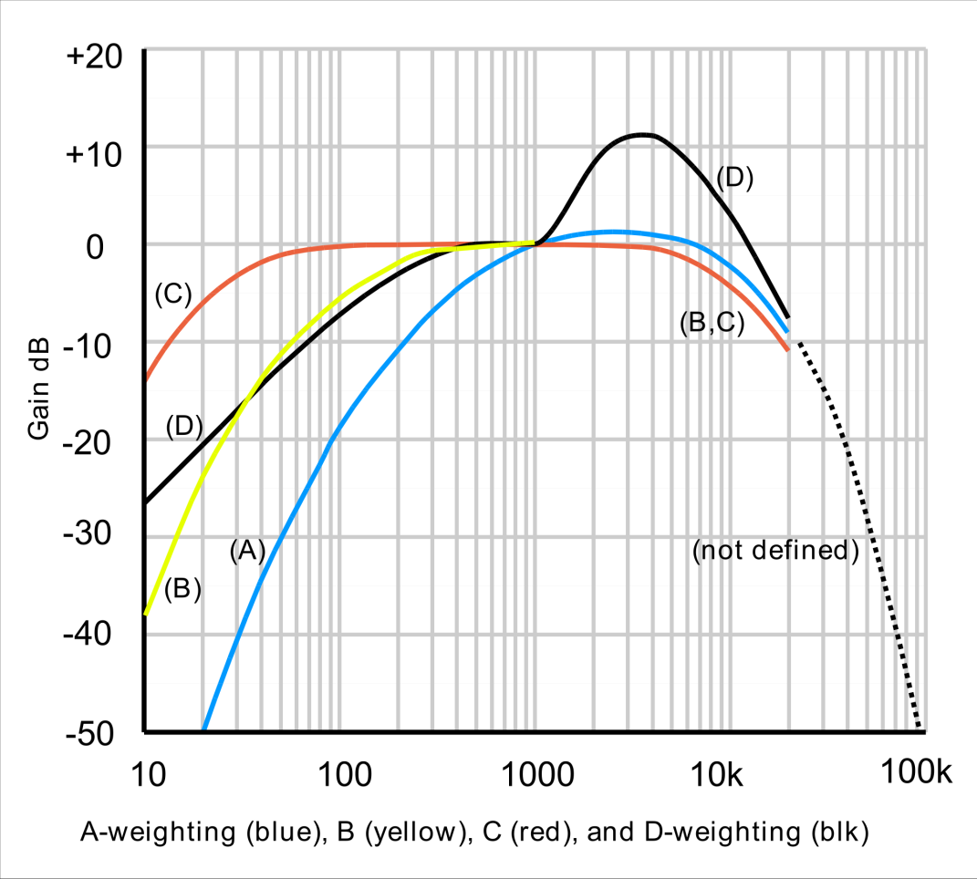
Simulation of loudness by weighting functions
Historical development: inverse curves of the 40, 70 and 100 phon loudness curves (1928)
Very easy to implement by simple RC circuits
Obviously very rough approximation, still not yet obsolete
A is generally used nowadays
B, C has nearly died out
D is used for jet aircrafts

Slide 19
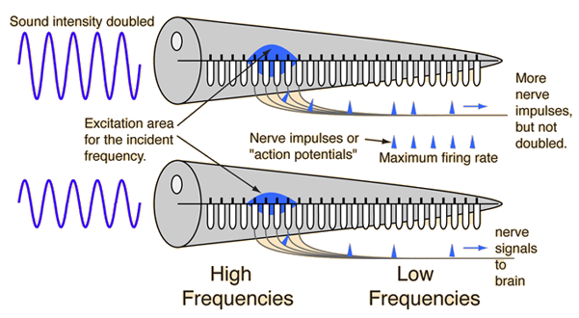
Summation of loudness /1
What happens, if sounds of various frequencies are summed?
1 pc 1000 Hz 60 dBSPL sinusoidal sound ⇒ 60 phon
10 pc of 60 dBSPL sounds of various frequencies ⇒
Physically summed: 70 dB
Loudnesses summed: 90 phon!
Why?

Slide 20
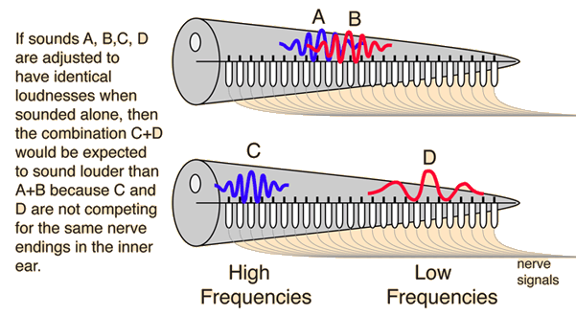
Summation of loudness /2
Summation is different for slosely spaced and for faraway frequencies

Slide 21
Summation of loudness
Tool for the summation: the Zwicker method

Slide 22
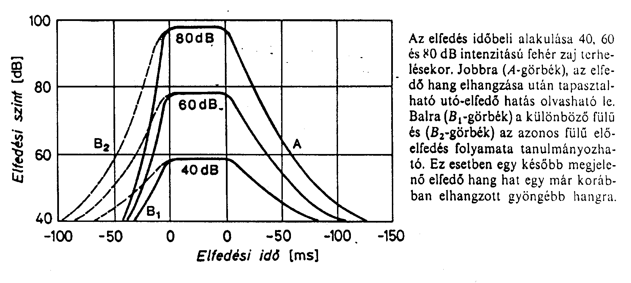
Masking in time
Consequence: a new sound arriving with short time delay is not sensed as a separate sound but appears as the original sound would be stronger (Haas-effect)

Slide 23
Implications and applications
Room acoustics
Optimization of digital sound processing (bit rate reduction, data reduction)
Mp3 player
Mobile phone technologies

