Slide 1
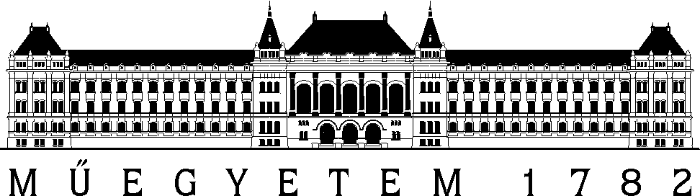
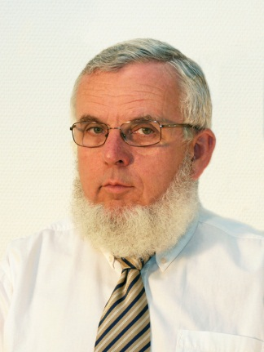
Directional hearing
Study aid for learning of Communications Acoustics
VIHIM 000
Prof. Fülöp Augusztinovicz
BME Dept. of Networked Systems and Services
fulop@hit.bme.hu

Slide 2
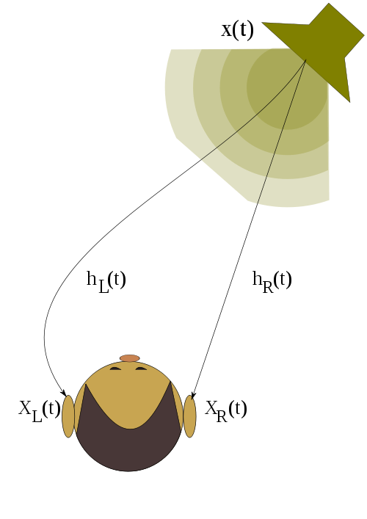
Basics of the directional hearing
Two differences:
  inter-aural time difference, ITD
  inter-aural intensity difference, ILD
Implication:
  Distinct transmissions from
  source to left & right ears
  Ratio of the two FRFs: HRTF
  (Head Related Transfer Function)

Slide 3
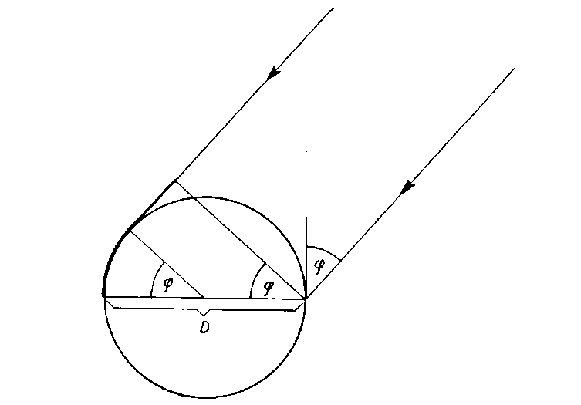
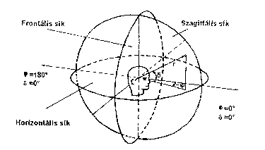
Basics of directional hearing
Geometry of directive hearing
frontal plane
sagittal plane
horizontal plane

Slide 4
Directional hearing
Operating mechanisms for various frequencies:
  For low frequencies the relative intensity differences are not relevant (due to the diffraction effect)
  For high frequencies the phase differences are not relevant/useful, if the travel time delays are in the order or magnitude of the wavelength, or higher
  Therefore
  For low frequencies it is ITD while for high frequencies it is ILD which is more appropriate
  Unfortunately, according to newer experiments the problem is not so simple

Slide 5
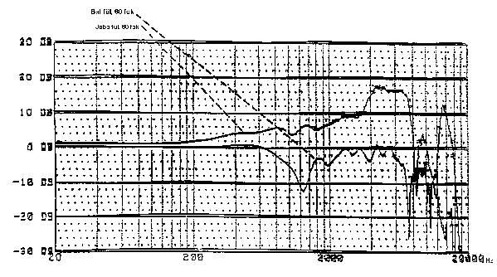
HRTF
Source at -60°, transfer function to the two ears
right ear
left ear

Slide 6
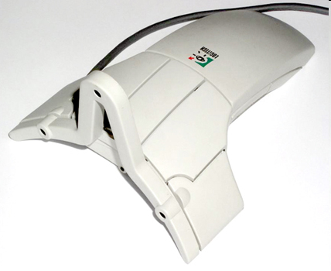
Problems with application of HRTFs
The „world” rotates together with the headset/user
Solution: head tracker

Slide 7
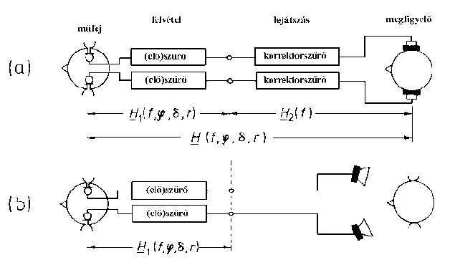
Ensuring directional hearing: binaural recording/playback

Slide 8
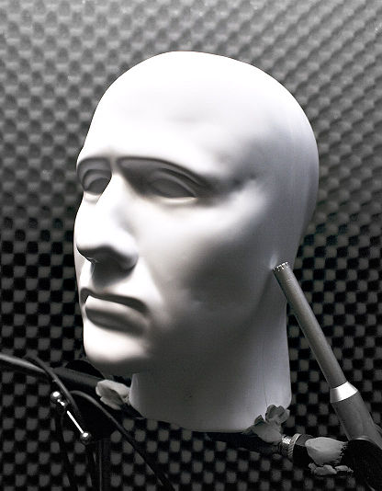
Artificial head
For sound recordings and high-fidelity measurements (primarily in NVH)

Slide 9
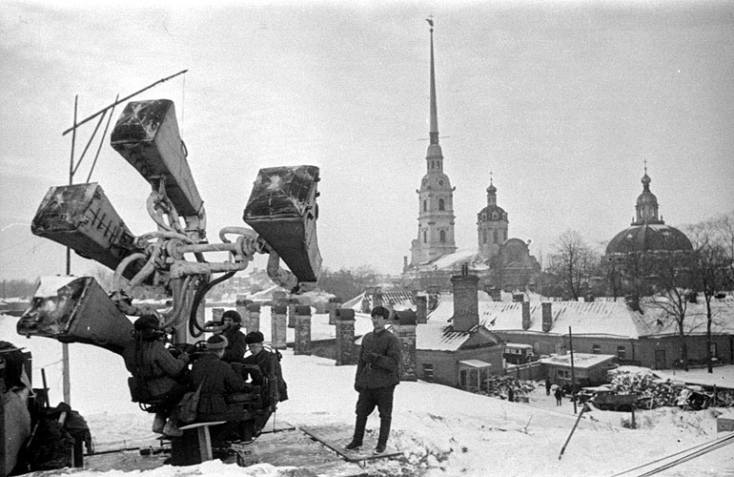
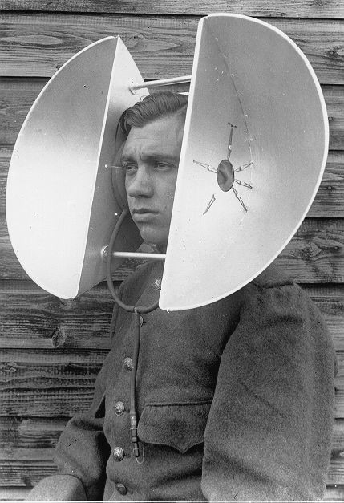
Directional hearing aids

Slide 10
A short history of stereo sound recording
1877 First recording by Thomas A. Edison, Mary Had A Little Lamb.
1888 The Gramophone, invention of Emile Berliner, American inventor: the flat record
1898 Invention of the magnetic sound recording
(Valdemar Poulsen, Denmark)
1931 Stereo record (inventor Alan D. Blumlein, US)
1933 Bell Labs realizes the first stereo concert broadcast on a telephone line from Philadelphia to Washington
1940 Walt Disney first uses stereo sound for his movie Fantasia c.
1954 The stereo tape recorder is commercialized for home users
1958 Stereo LP record by using V-cut
1961 Outset or stereo radio broadcast
1969 Outset of the quadrophone (4-ch) radio broadcast
1970 Record industry changes entirely to stereo technology

Slide 11
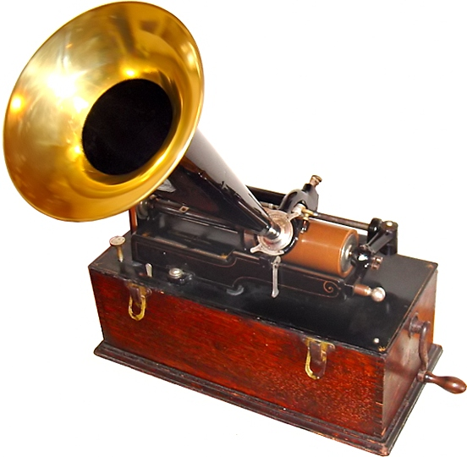
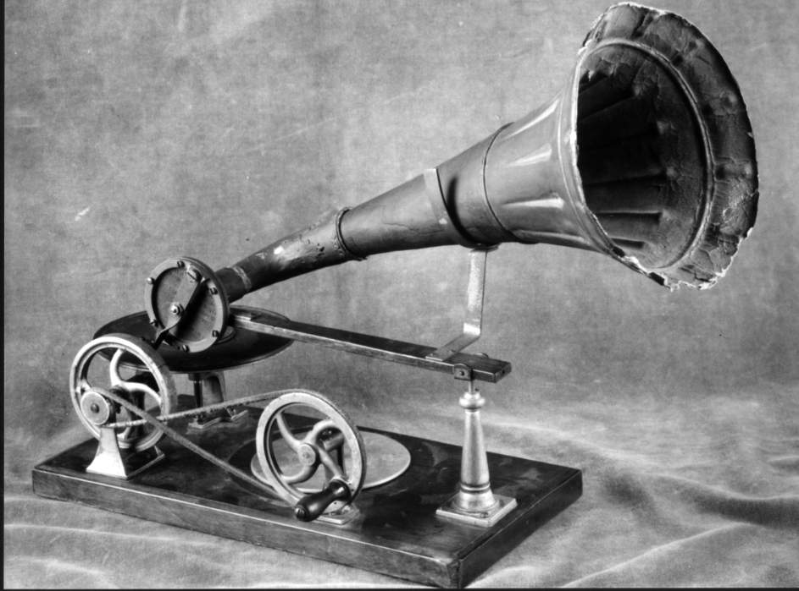
Some early recorders
http://en.wikipedia.org/wiki/Phonograph_cylinder

Slide 12
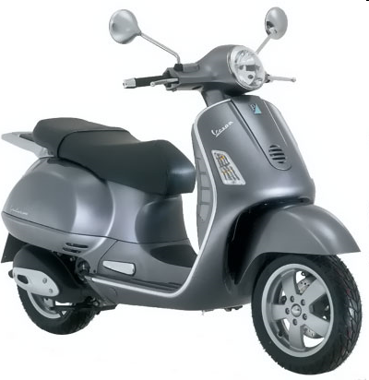

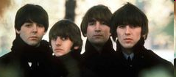
Mono
Sztereo

Slide 13
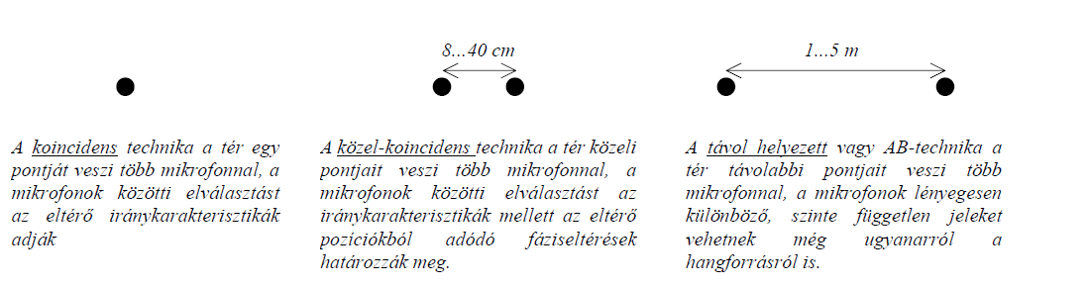
Stereo microphone techniques
Coincident method
Distinction is given by differing directional characteristics of mics
Nearly coincident method
Distinction is given both by differing directional characteristics of mics and phase deviations
Faraway configuration
Mics record nearly independent signals

Slide 14
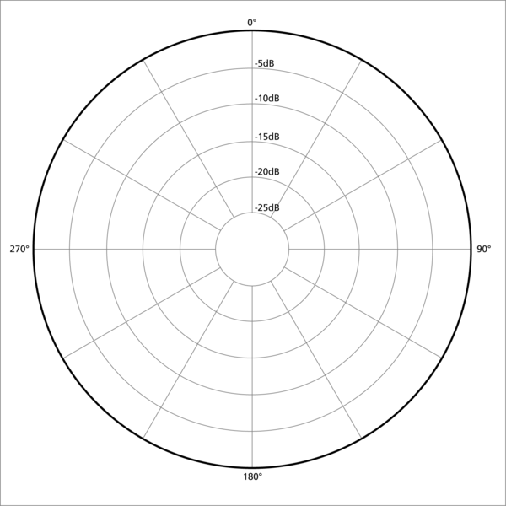
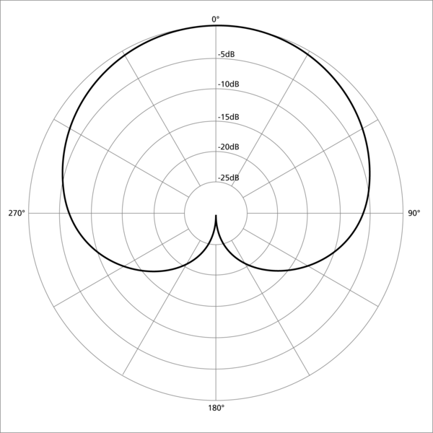
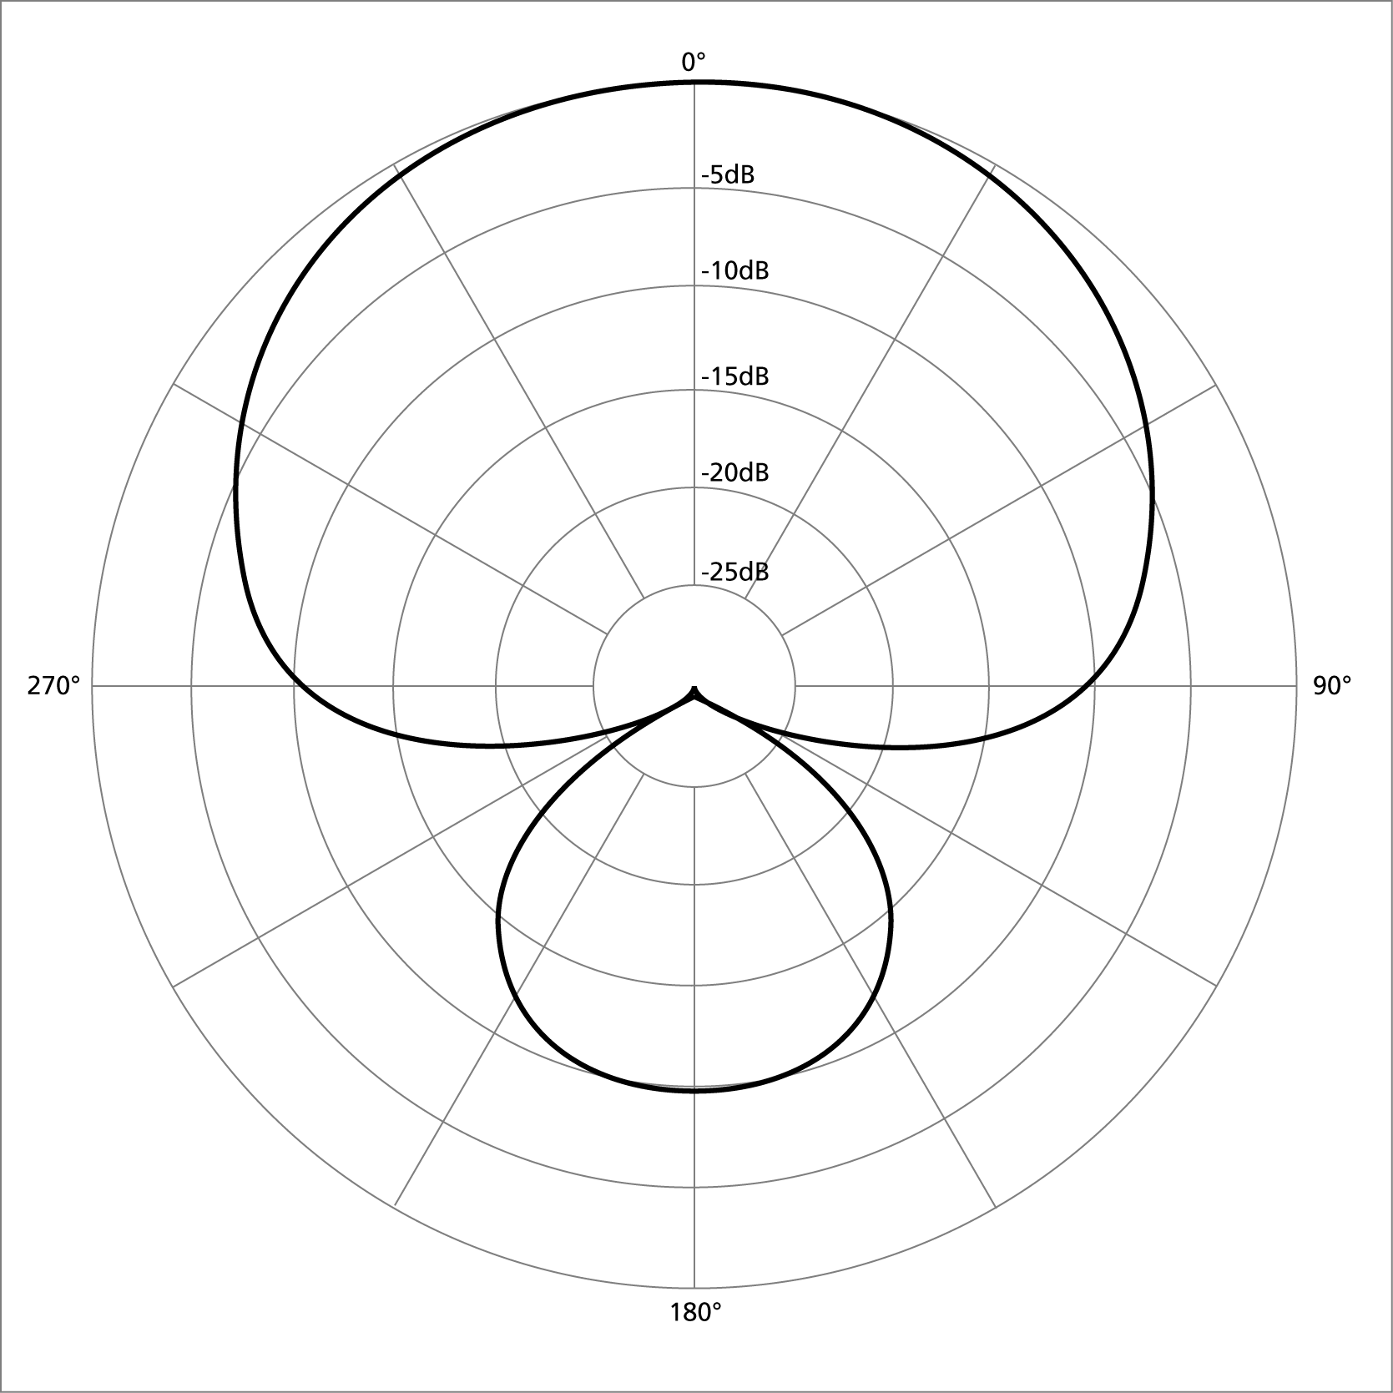
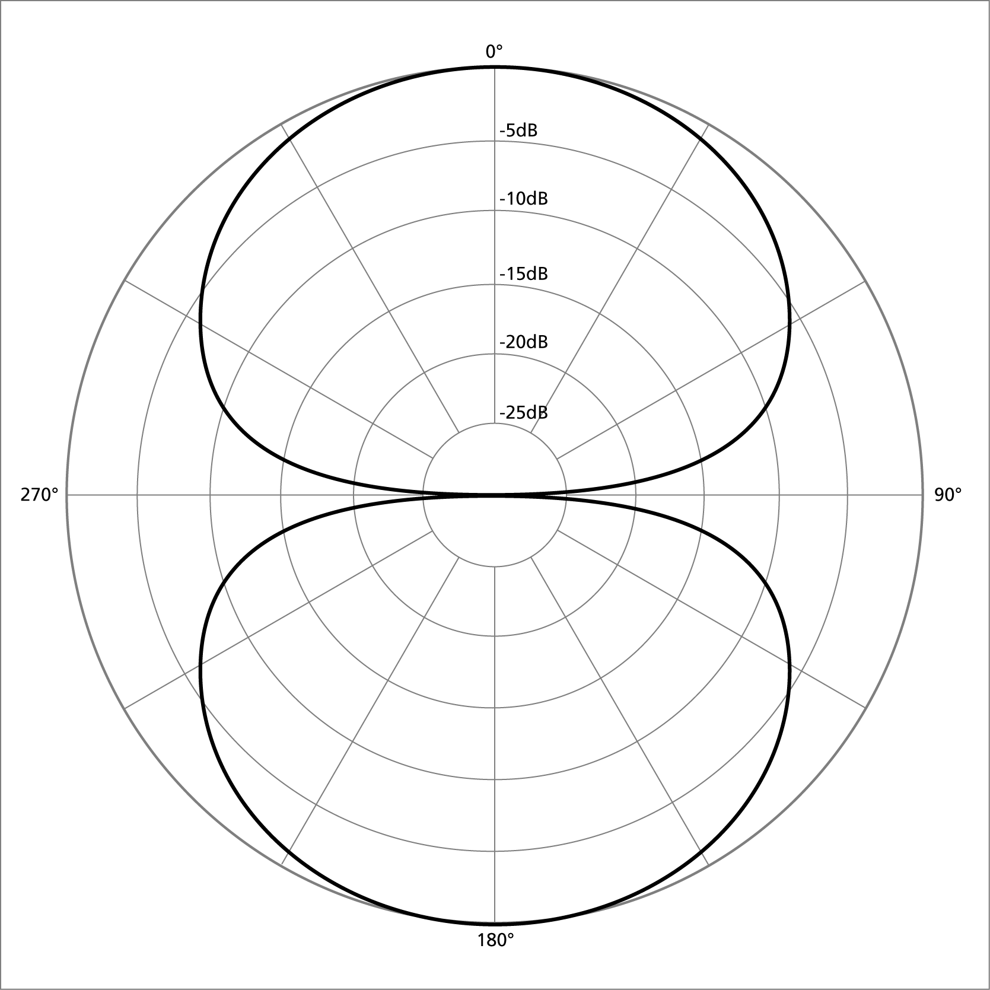
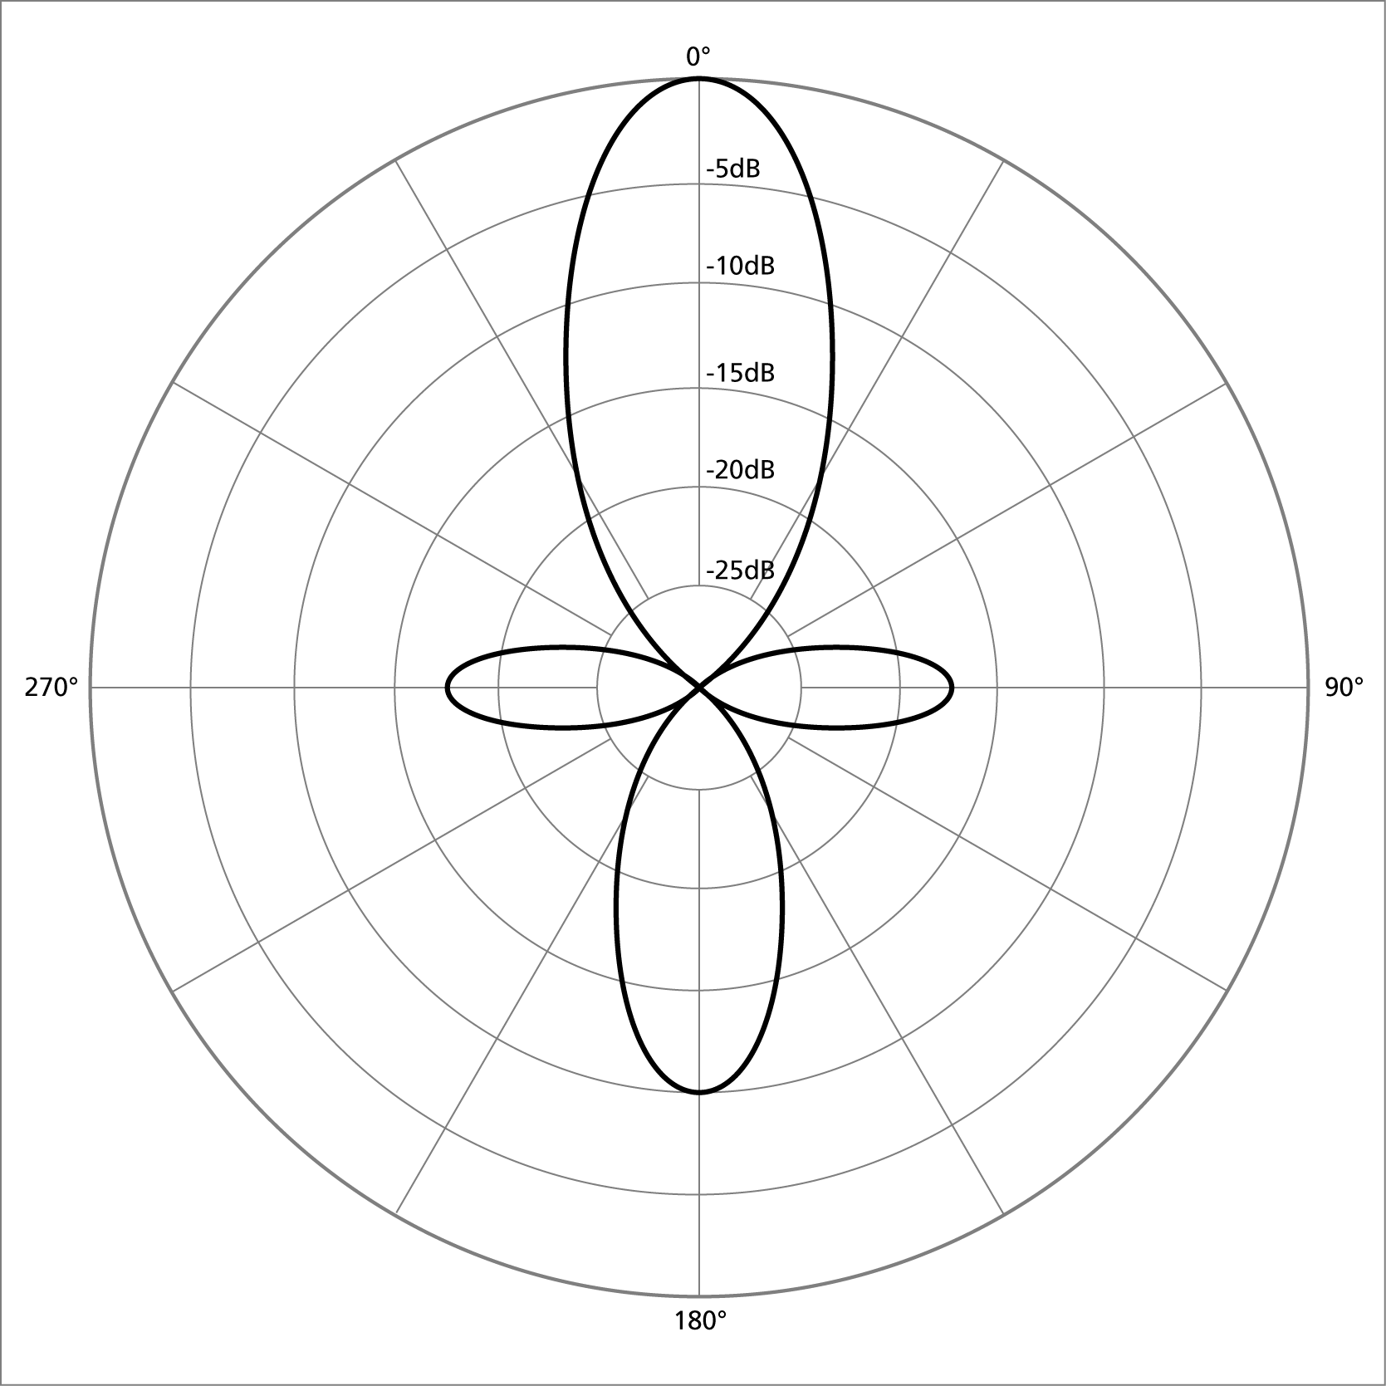
Directivity patterns of microphones
supercardioid
omnidirectional
cardioid
bidirectional (eighter)
highly directional
(mic gun)

Slide 15
Stereo microphone techniques
XY microphones (intensity stereophony)

Slide 16
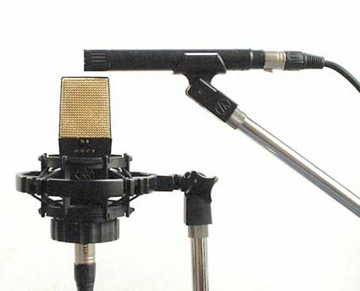
Stereo microphone techniques
M-S (mid – side) microphone

Slide 17
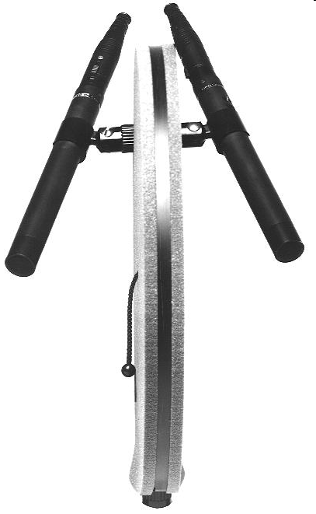
Stereo microphone techniques
Nearly coincident: the Jecklin.disc

Slide 18
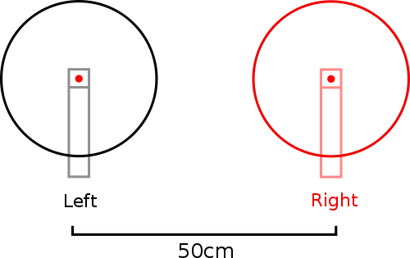
Stereo microphone techniques
A-B microphone configuration

Slide 19
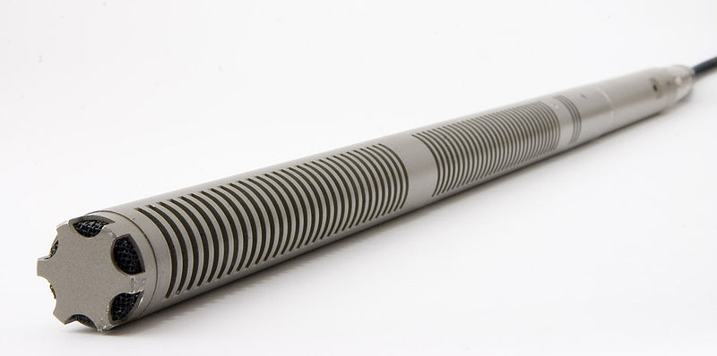
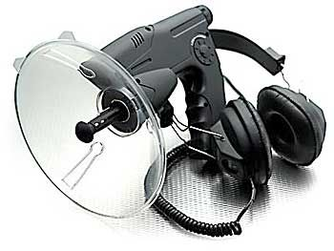
Highly directive microphones

