Slide 1

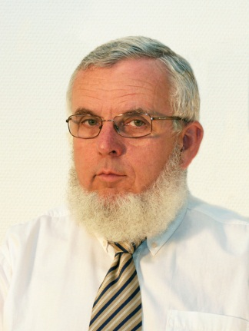
The speech
Study aid for learning of Communications Acoustics
VIHIM 000
Prof. Fülöp Augusztinovicz
BME Dept. of Networked Systems and Sefvices
fulop@hit.bme.hu

Slide 2
Introduction
The language:
  Communication between the individuals of the human society
  Main tool of the human thinking
The speech:
  Primary manifestitation of the language
  Most widespread form of human communication (but by far not the only one)
  The very first, from the chronological point of view: well before writing

Slide 3
Suggested literature
E. Keller (Ed.), Fundamentals of speech synthesis and speech recognition. Basic concepts, state-of-the-art and furure challenges.
John Wiley, 1994.
P. Ladefoged & I. Maddieson: The sounds of the world’s languages
Blackwell Publishers, 1985

Slide 4
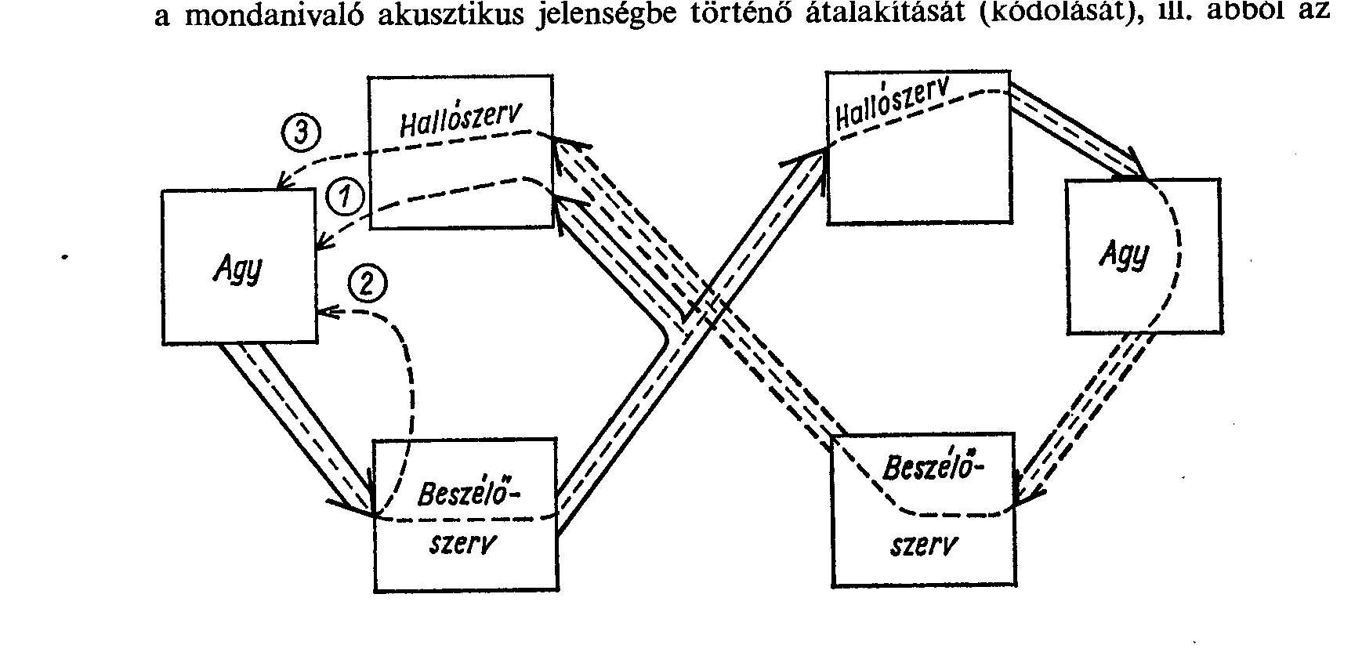
The natural chain of speech
hearing organ
hearing organ
brain
brain
speaking organ
speaking organ
Brain level
Organic level
Acoustical level
Organic level
Brain level

Slide 5
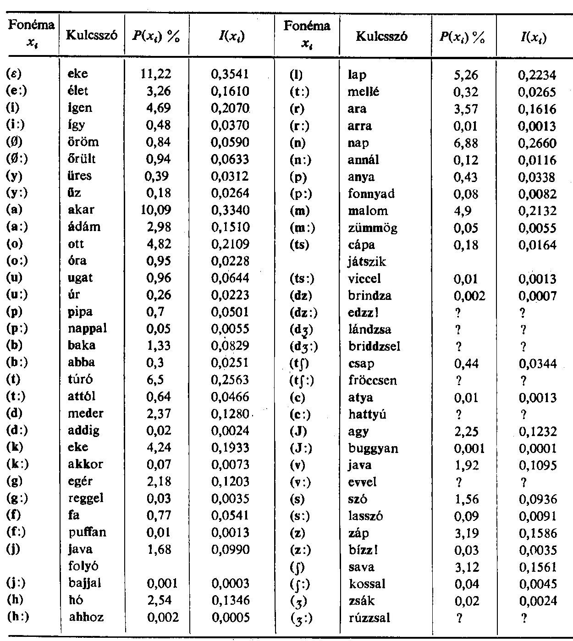
The structure of speech
Sentence > word > syllable > phonema > speech sound
  Notion of phonemae:
  The smallest contrastive linguistic unit which may bring about a change of meaning

Slide 6
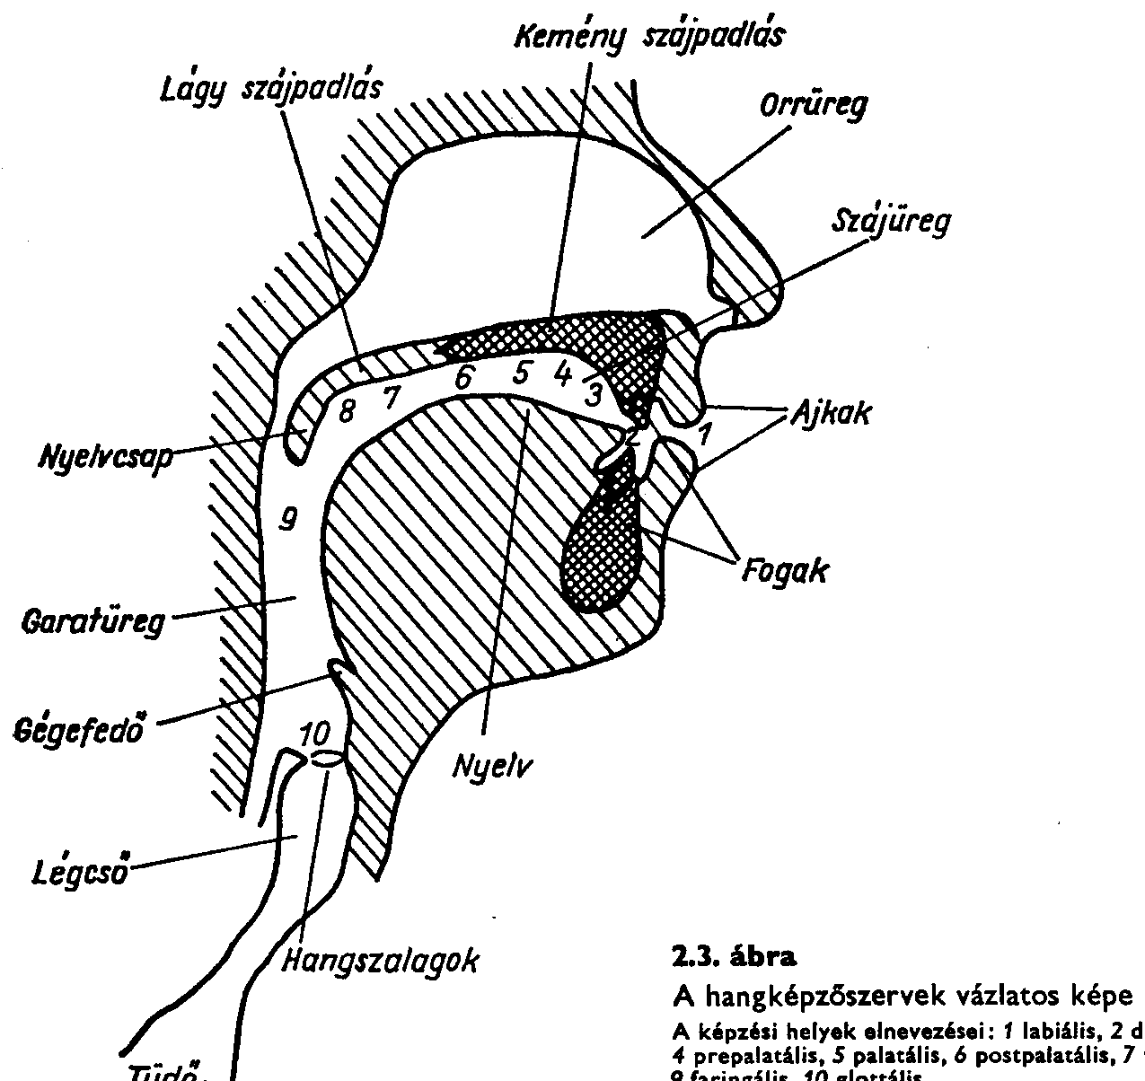
The speaking organ / 1
Hard palate
Soft palate
Nasal cavity
Oral cavity
linguo-alveolarport
lips
velarport
labialport
linguo-palatalport
teeth
pharynx
epiglottis
the vocal tract
esophagus
tongue
trachea
larynx
Vocal cords

Slide 7


The speaking organ / 2
Larynx and the vocal cords

Slide 8
The speech production process / 1
release of air from the lung
the air at the larynx either
  passes through: unvoiced sound (consonants like s, t or f)
  Is set into vibration by the vocal cords: voiced
  (vowels or voiced consonants like m or z)
operation of ports (or valves)->production of various sounds:
  if velar port is open: nasal consonants or vowels
  (m, n, of franc)
  if linguo-palatal port is closed: k, g or ng
  in the linguo-alveolar port: mostly consonants
  e.g. explosives (t, d) and fricatives (s, z, ∫, ʒ)
  in labial port: p, b, t, v

Slide 9
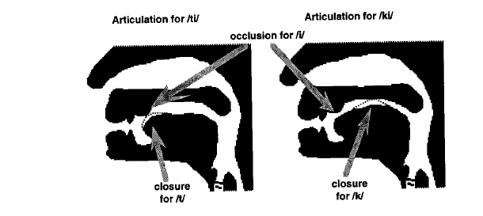
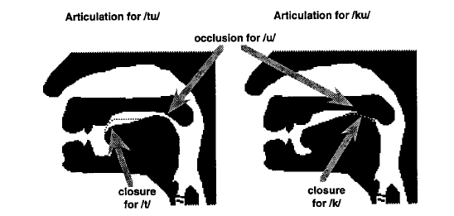
Example: articulation of voiceless plosives

Slide 10
The speech production process / 2
The transmission system
  system of resonators (aka vocal tract, articulation channel)
Excitations
  voicing
  turbulence
  shock wave

Slide 11
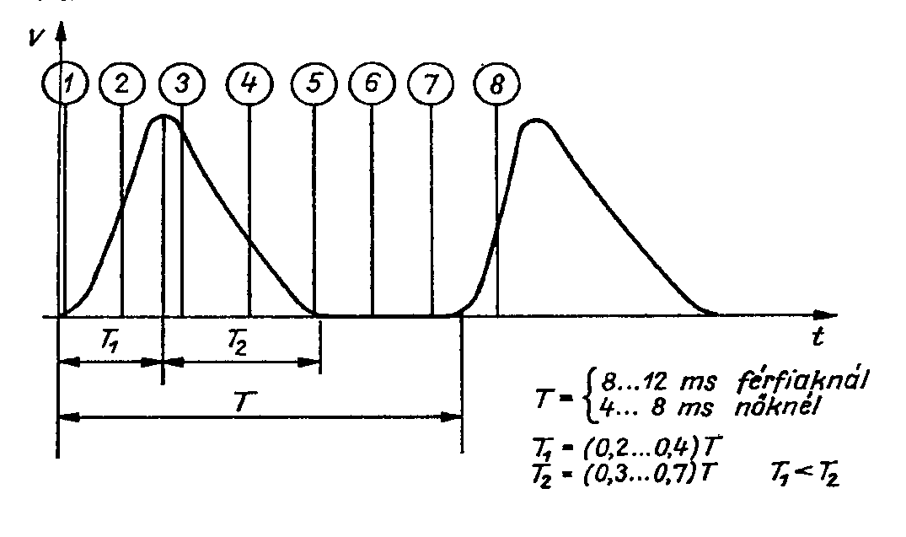
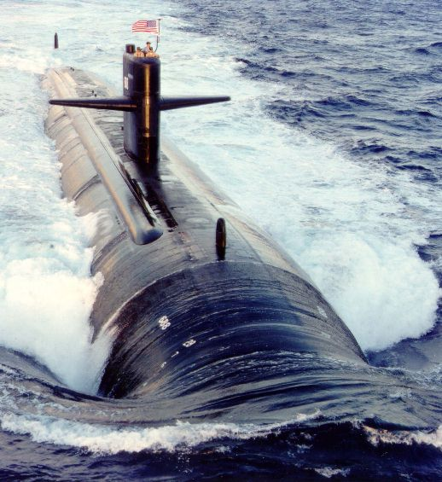

Excitation mechanisms
voice
turbulence
shock wave

Slide 12
Classification of speech sounds
Vowels (V) i, é, ü, ö, e á, a, o, u
Consonants (C)
  stops
    nasals m, n, ny, ng
    plosives
    voiced b, d, g, gy
    voiceless p, t, k, ty
    rhotic / trill r
  lateral fricatives l, j
  fricatives
    voiced v, z, zs
    voiceless f, s, sz, h
  stop-fricatives (affricate)
    voiced dz, dzs
    voiceless c, cs

Slide 13
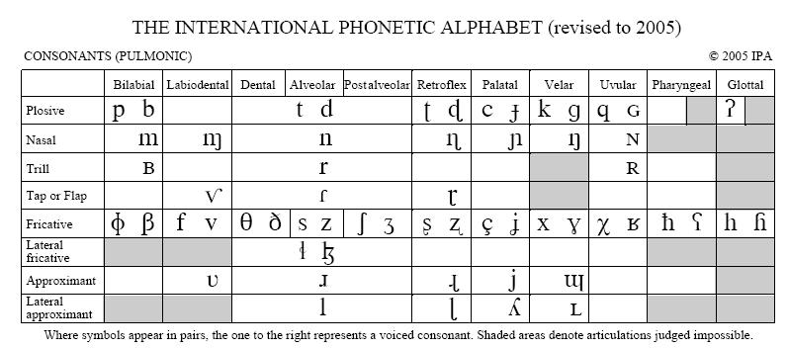
The international phonetic alphabet

Slide 14
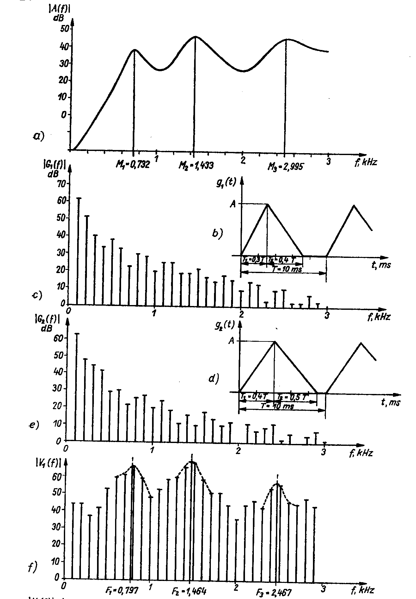
Characteristics of vowels
FRF of the vocal tract
line spectrum of the voice, female
line spectrum of the voice, male
final spectrum, modified by the transmission of the vocal tract

Slide 15
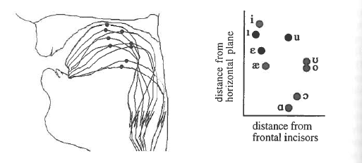
The oral cavity as a tuned resonator

Slide 16
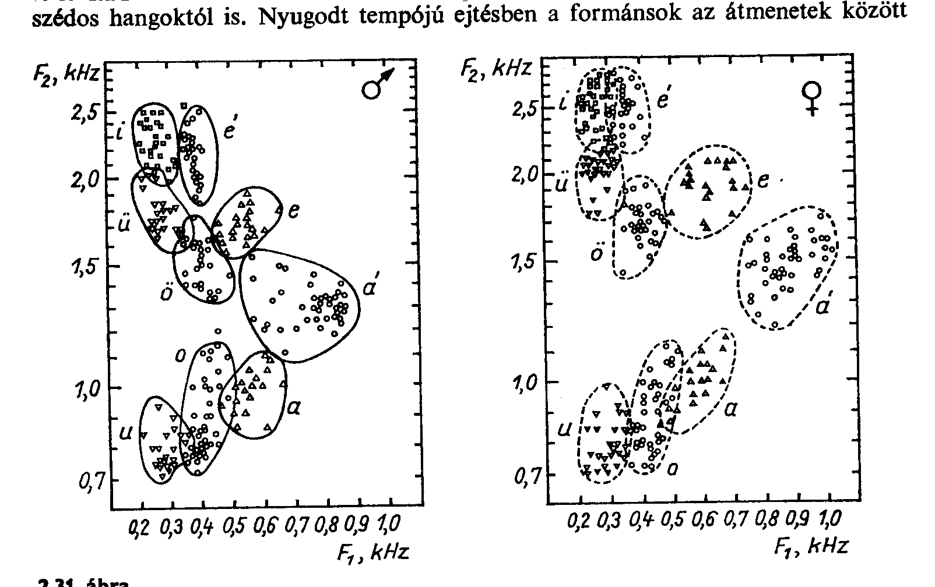
Formants of vowels

Slide 17
Characteristics of consonants
Fricatives
  turbulent excitation > resonance of the vocal tract
Plosives
  cannot be held for long time
  no structure of formants
  shock wave > time out of vocal cords > stabilised vowel

Slide 18
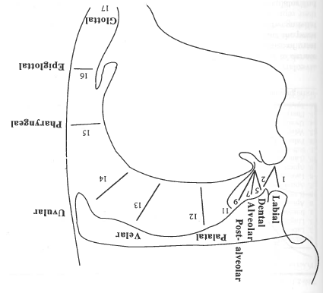
Articulation places of consonants

Slide 19
Daabase of Hungarian speech sounds
http://magyarbeszed.tmit.bme.hu/index.php?p=interaktiv

Slide 20
The speech intelligibility

Slide 21
Influencing factors of intelligibility
  articulation capability of the speaker
  listening capability of the listener
  characteristics of the sound field (room acoustical parameters)
  level of background noise
Parameter 3 and 4 ae expressed in form of two ratios:
3. direct to reverberant ratio
and
4. signal to noise ratio

Slide 22
Measurement of intelligibility
Subjective tests
  test with meaningless syllables
    invoking many test persons
    result is the ratio of correctly understood syllables to the total number of syllables, in %
  test with full sentences
Objecitve tests
  articulation index (AI): only background noise is considered
  Speech Intelligibility Index (SSI): reverberation is also taken into account
  Speech Transmission Index (STI): subjective quantity is approached by objective measurements (international standard)
    the speech consists of components of various frequencies, which are amplitude modulated by a low frequency envelope
    in order to remain intelligible, this modulation should be retained
    the transmission of this modulation without distortion is deteriorated both by multiple-path transmission (reverberation) and by background noise

Slide 23
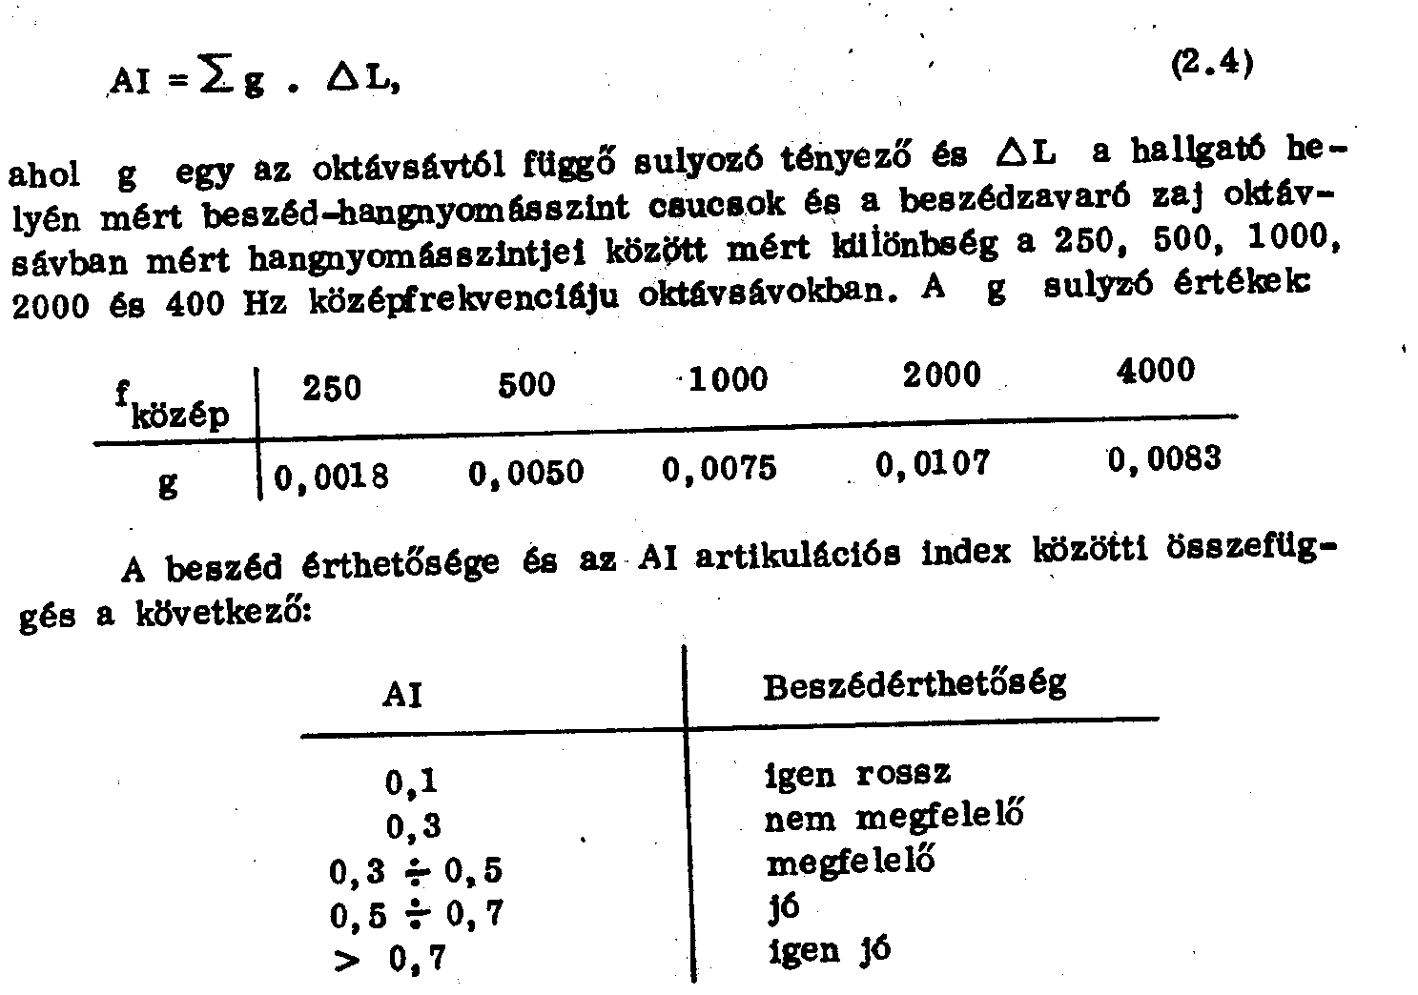
Effect of noise: Articulation index (AI)
Replacement rule of thumb: the signal to ratio should be as high as possible, but min. 5-10 dBA

Slide 24

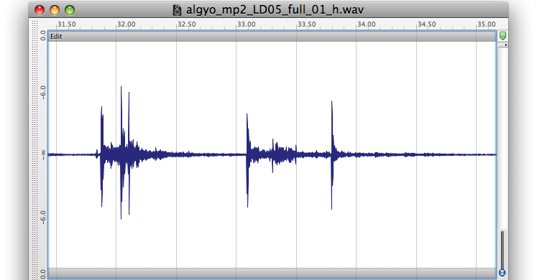
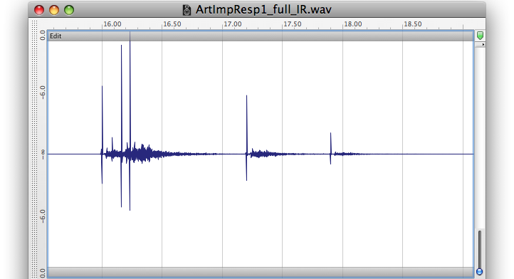
Effect of reverberation on the intelligibility
Original sound sample
In-situ recording
Measured impulse response
Artificially reverberated sound

Slide 25
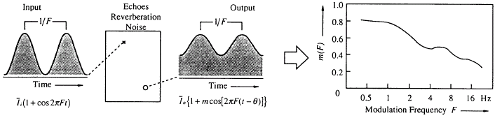


Calculation of STI
modulációs transzfer függvényen keresztül:
  mérése régebben kisfrekvenciásan modulált sávkorlátozott zajjal, újabban impulzusválasszal
ebből látszólagos jel-zaj értéket képezünk:
majd több lépés után:
w_{k} 0.13 0.14 0.11 0.12 0.19 0.17 0.14

Slide 26
Evaluation of STI values
Many figures of merit of intelligibility can be compared by using the CIS (Combined Intelligibility Scale) value:
CIS = 1 + lg (STI).

Slide 27
Characteristics of the STI
It depends on
  signal to noise ratio
  reverberation
  bandwidth
  nonlinear distortions
  etc.

Slide 28
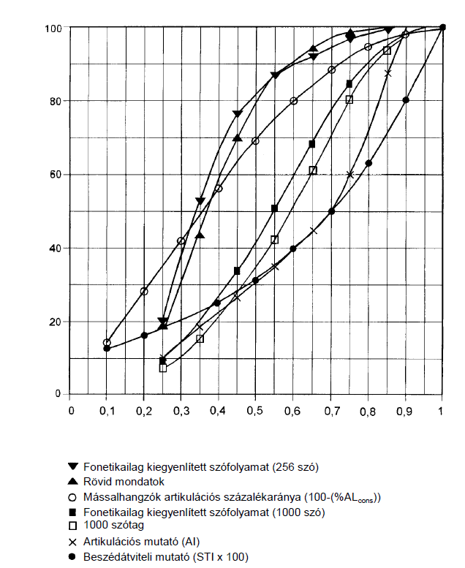
Relationship of measurable SI descriptors
%
CIS

