Slide 1
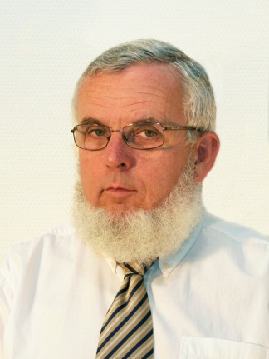
Basic elements of musical acoustics Scales, instruments and ensembles
Study aid to learn Communication acoustics,
VIHIAM 000
Fülöp Augusztinovicz, professor
Department of Networked Systems and Services
fulop@hit.bme.hu

Slide 2
The musical sounds
Sinusoidal signal
sterile, dificult to produce in natural way
the most similar sound is that of flute
The sound of real instruments is harmonic
superposition of sinusoids
The tone is determined by their amplitude ratio
The sequential harmonic sounds form a musical scale
Very many scales did exist, changing by era and culture
The construction of a scale is based
on one basic sound and a fixed set of acceptable sounds
within this set, the intervals are perceived as pleasant and perfect

Slide 3
Relationship of music and physics: the series of harmonics
The proportion of frequencies (eigenfrequencies) is equal to ratios of whole numbers
octave: 1:2
fifth: 2:3
fourth: 3:4
major third: 4:5
minor third: 5:6
Major second
Minor second
Only in european music!

Slide 4
Hangolás (skálák)
Pitagoraszi hangolás: egész számok hányadosai szólnak a legtisztábban
oktáv: 1:2 (mert 7 hang után a 8. ismétlődik), kvint: 2:3
ezzel viszont nem lehet minden hangnemben tisztán játszani!
XVI. – XVII. sz: középhangú hangolás
a terc már konszonánsnak minősül
az alaphangnemek (F, C, G, D) majdnem pontosan tiszták
Barokk: jóltemperált hangolás
minden hangnem elfogadhatóan tiszta
J. S. Bach: Wohltemperiertes Klavier sorozat
Ma: kiegyenlített hangolás: az oktáv 12 félhangja pontosan egyenlő távolságban van
eszerint egyik hangköz sem felel meg pontosan egészszámú aránynak

Slide 5
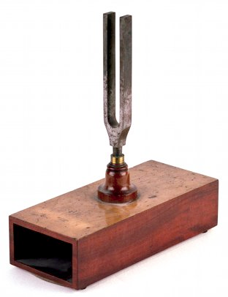
The basic pitch of scales
http://www.music.vt.edu/musicdictionary/appendix/pitch/pitch.html
Today’s normal pitch (a₁): 440 Hz
Historical changes
At the beginning pitch was measured by feet (organ pipe!)
Possible frequencies (by A. Ellis,1885): between 370 és 567 Hz
Larg chaos before the sound fork was invented (in 1711)
G.F. Händel’s sound fork today: 422,5 Hz
Large classical composers based on frequencies between 415 – 423 Hz
Slowly increasing in romantics
Paris Opera: 448 Hz, Vienna opera: 456 Hz!
The French Academy fixes in 1859-ben rögzíti: 435 Hz (Lissajous and Berlioz, Meyerbeer & Rossini)
Final fixing in1939: 440Hz @ 20 °C

Slide 6
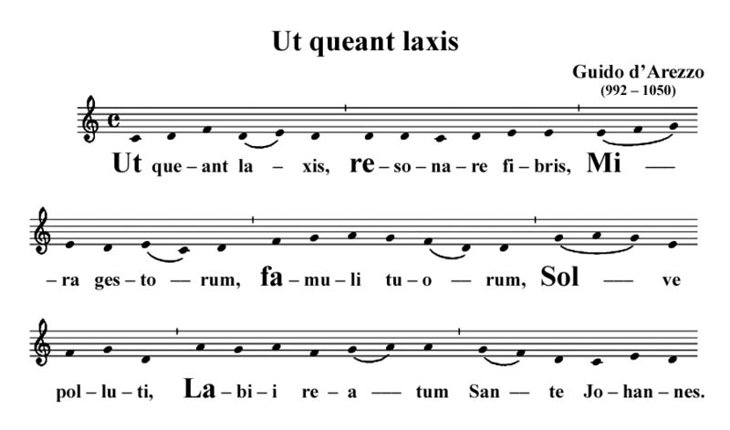
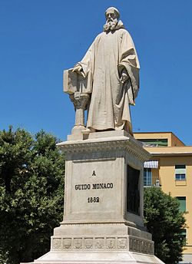
Solmisation
Origin: Saint John’s anthem (composed by Guido d’ Arezzo, a Benedictine lived in the 11th century)
„Hogy könnyült szívvel csoda tetteidnek zenghessék hírét szabadult szolgáid, oldd meg, Szent János, kötelét a bűntől szennyes ajaknak. ”

Slide 7
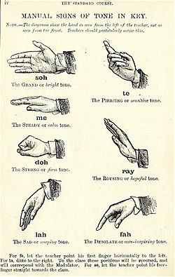
Development of solmisation
Sarah Ann Glover has anglicized (early 17th century)
John Curwen (1842) extended and formed into a system
In Hungary
Jenő Ádám revitalized (1944)
Zoltán Kodály introduced into music teaching in primary school
nowadays highly neglected

Slide 8
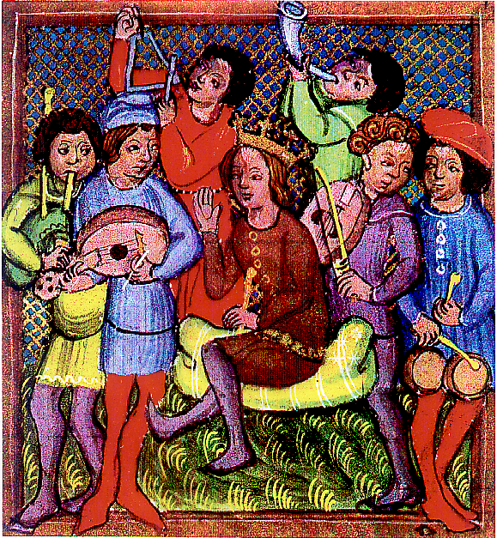
Grouping of musical instruments
According to the dominant element of sound production:
stringed
chordophone
wind
aerophone
membraneous
membranophlne
elastic solid
Idiophone

Slide 9
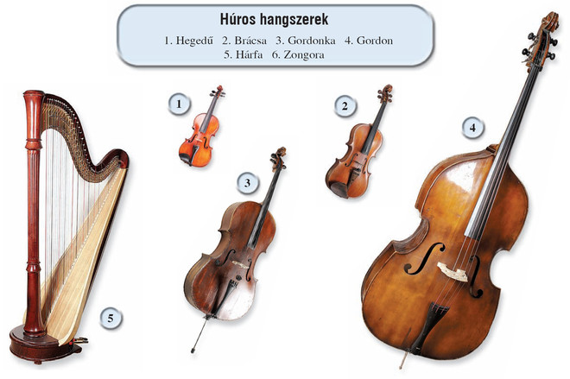
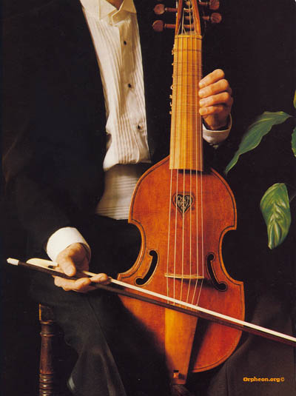
Stringed instruments / 1
Played by bow:
Violin, viola, cello, doublebass
Many versions in earlier times: viola da gamba, viola d’amour, etc.

Slide 10
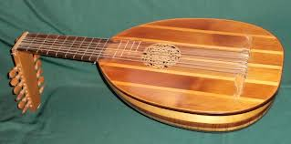
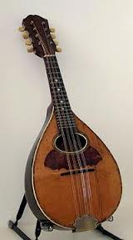
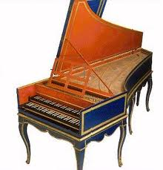
Stringed instruments / 2
Plucked instruments
cembalo, harp, guitar, lute, mandoline, banjo, tambour…
http://www.youtube.com/watch?v=f19KEzLRL4s

Slide 11
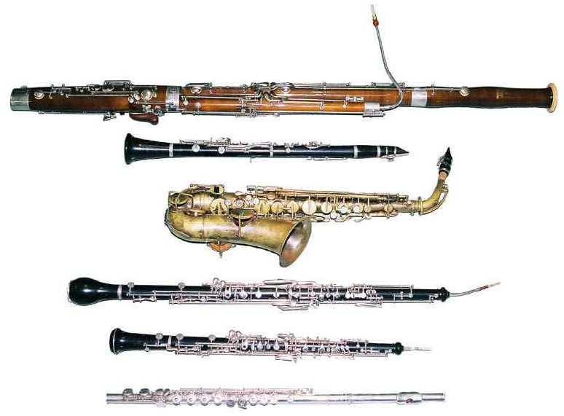
Wind instruments / 1: woodwind
Bassoon http://www.youtube.com/watch?v=CZ1Nz3UOOas
clarinet
Saxophone
English horn http://www.youtube.com/watch?v=0HhrxVx1Ztc
oboe
flute

Slide 12
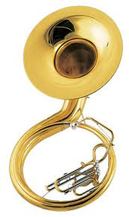
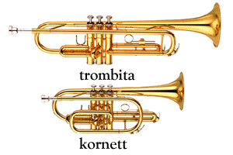
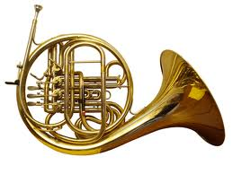
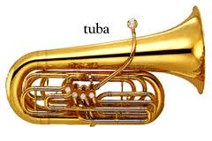
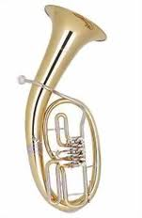
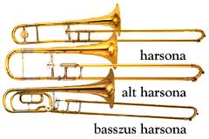
Wind instruments/ 2: brass
French horn
http://www.youtube.com/watch?v=jnFl1q0IYTA
suzaphone
trumpets
trombones
tenor/bariton horn

Slide 13
A musical joke on brass and on woodwind instruments
Mnozil Brass (Wien)
http://www.youtube.com/watch?v=uzpUaUIrabc
http://www.youtube.com/watch?v=PQPk-RX-3jA

Slide 14
Percussion instruments
Holló Aurél – Váczi Zoltán: Traditions Part One – The winning number… / BeFORe John7
Amadinda Percussion Ensemble, Liszt Academy of Music, Budapest, 2009
http://www.youtube.com/watch?v=R7rlrl6U2-A&list=UU59BjQMnyUXtv5Je4SxdC_Q&index=7

Slide 15
How does it work – stringed instruments
Slip-stick vibration (dry friction)
Results in periodic vibrations with many harmonics

Slide 16
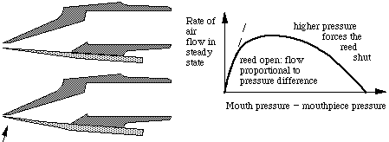
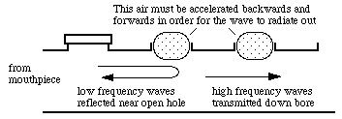
How does it work – woodwind instruments
Clarinet
construction
Production of sound
pitch

Slide 17
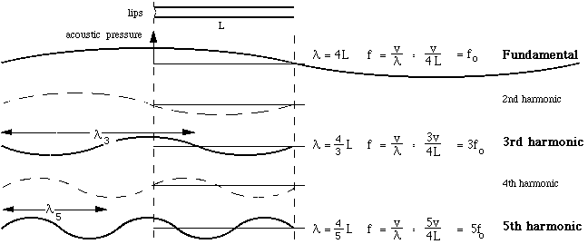
How does it work – brass
http://newt.phys.unsw.edu.au/jw/brassacoustics.html#lips

Slide 18
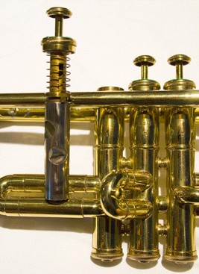
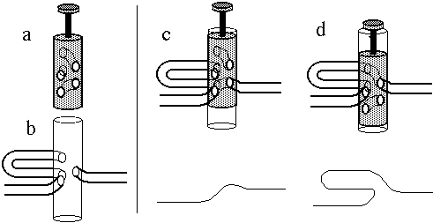
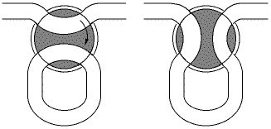
Control of pitch for brass instruments
Piston valve - trumpet
Rotating ventil – French horn

Slide 19
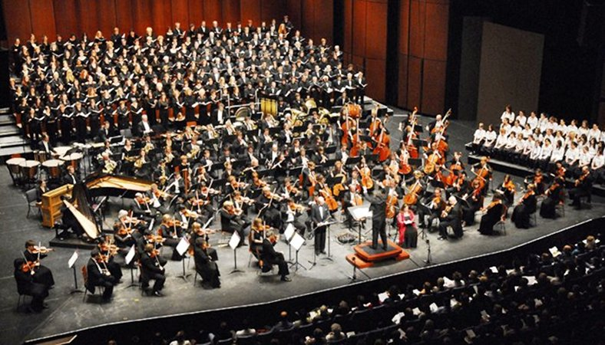
The symphonic orchestra

Slide 20
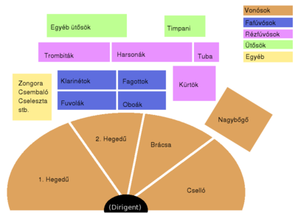
Symphonic orchestra

