Slide 1
My PhD research
Mihaly Ulveczki
Department of Networked Systems and Services
ulveczkim@hit.bme.hu

Slide 2
Previous studies
MSc thesis
Vibroacoustic simulation of a xylophone
Articles: 2 conference, 1 journal + OTDK 1st place
Notes:
2

Slide 3
My research topic
Modeling of Coupled Aeroacoustic Systems
Csatolt áramlásakusztikai rendszerek modellezése
Noises/sounds, caused by moving air
Cars, airplanes
HVAC
Flute
Notes:
3

Slide 4
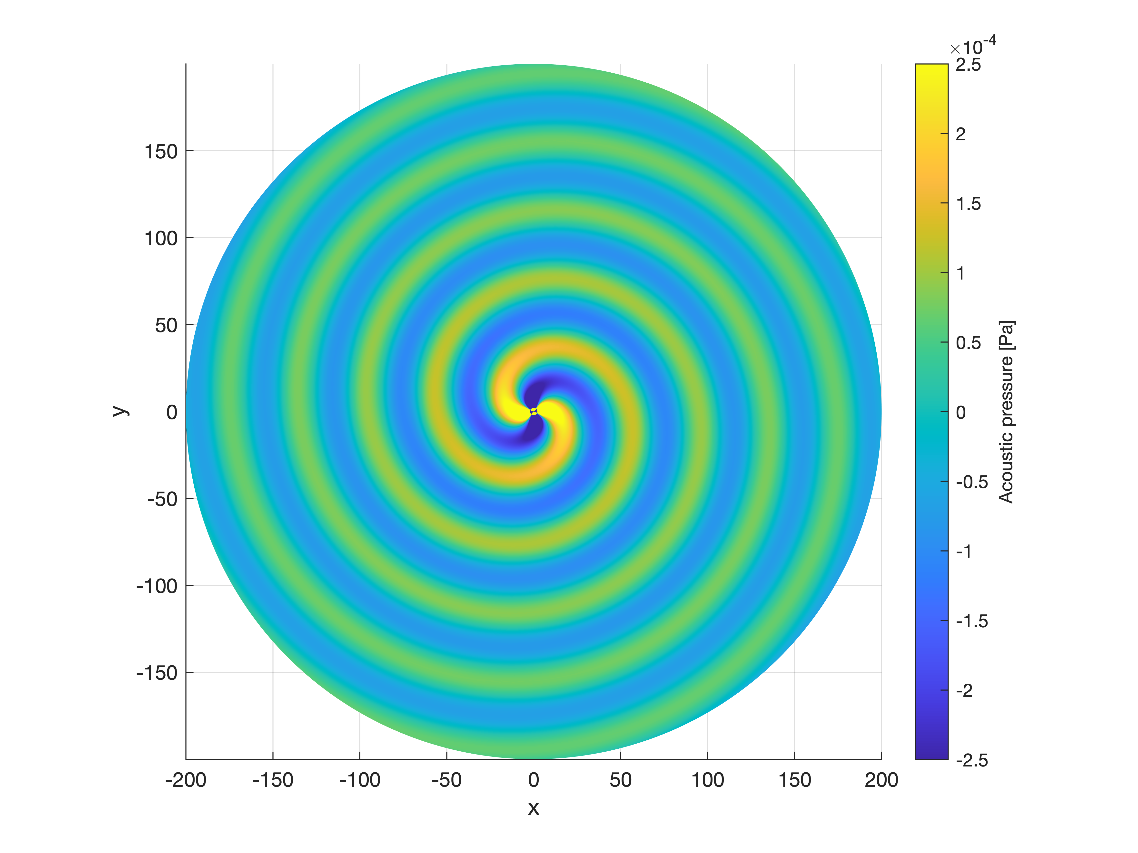
Aeroacoustic simulations
Acoustic simulation
Pressure change
No vortices
Flow simulation
Constant pressure
Vortices - acoustic sources can be calculated
Flow + acoustics
Different scale
Methods based on decomposition
Helmholtz-decomposition
Notes:
4

